Slide 1
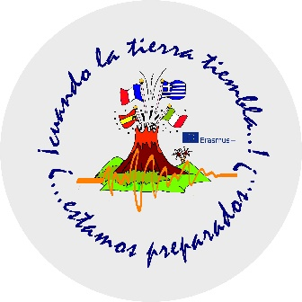
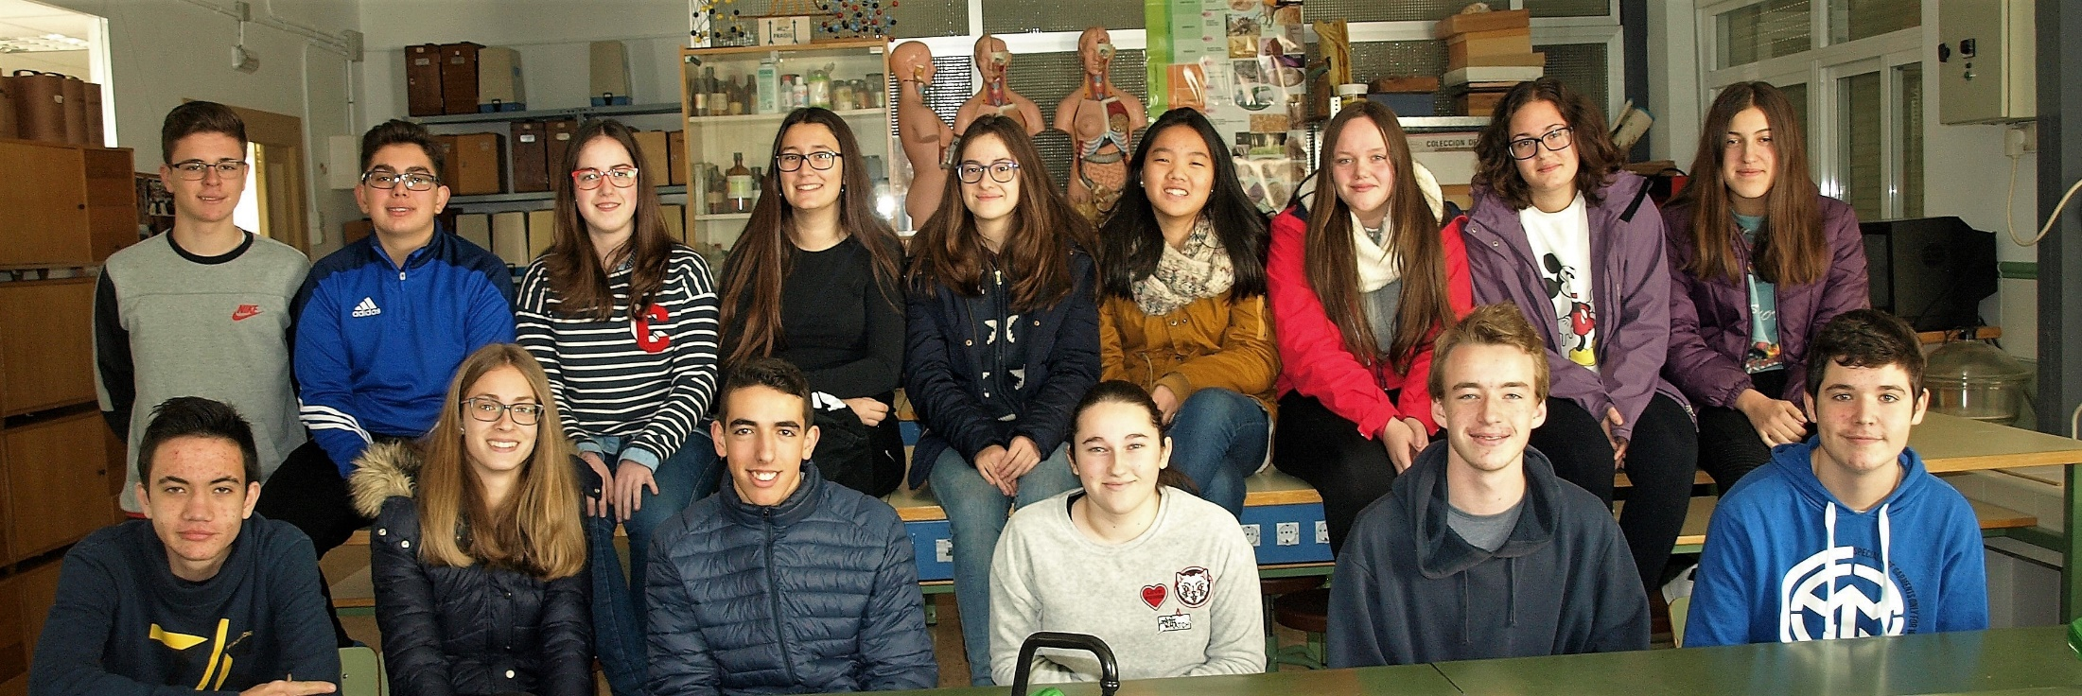
IF THE EARTH SHAKES! WILL YOU BE READY?
2016-2018

Slide 2
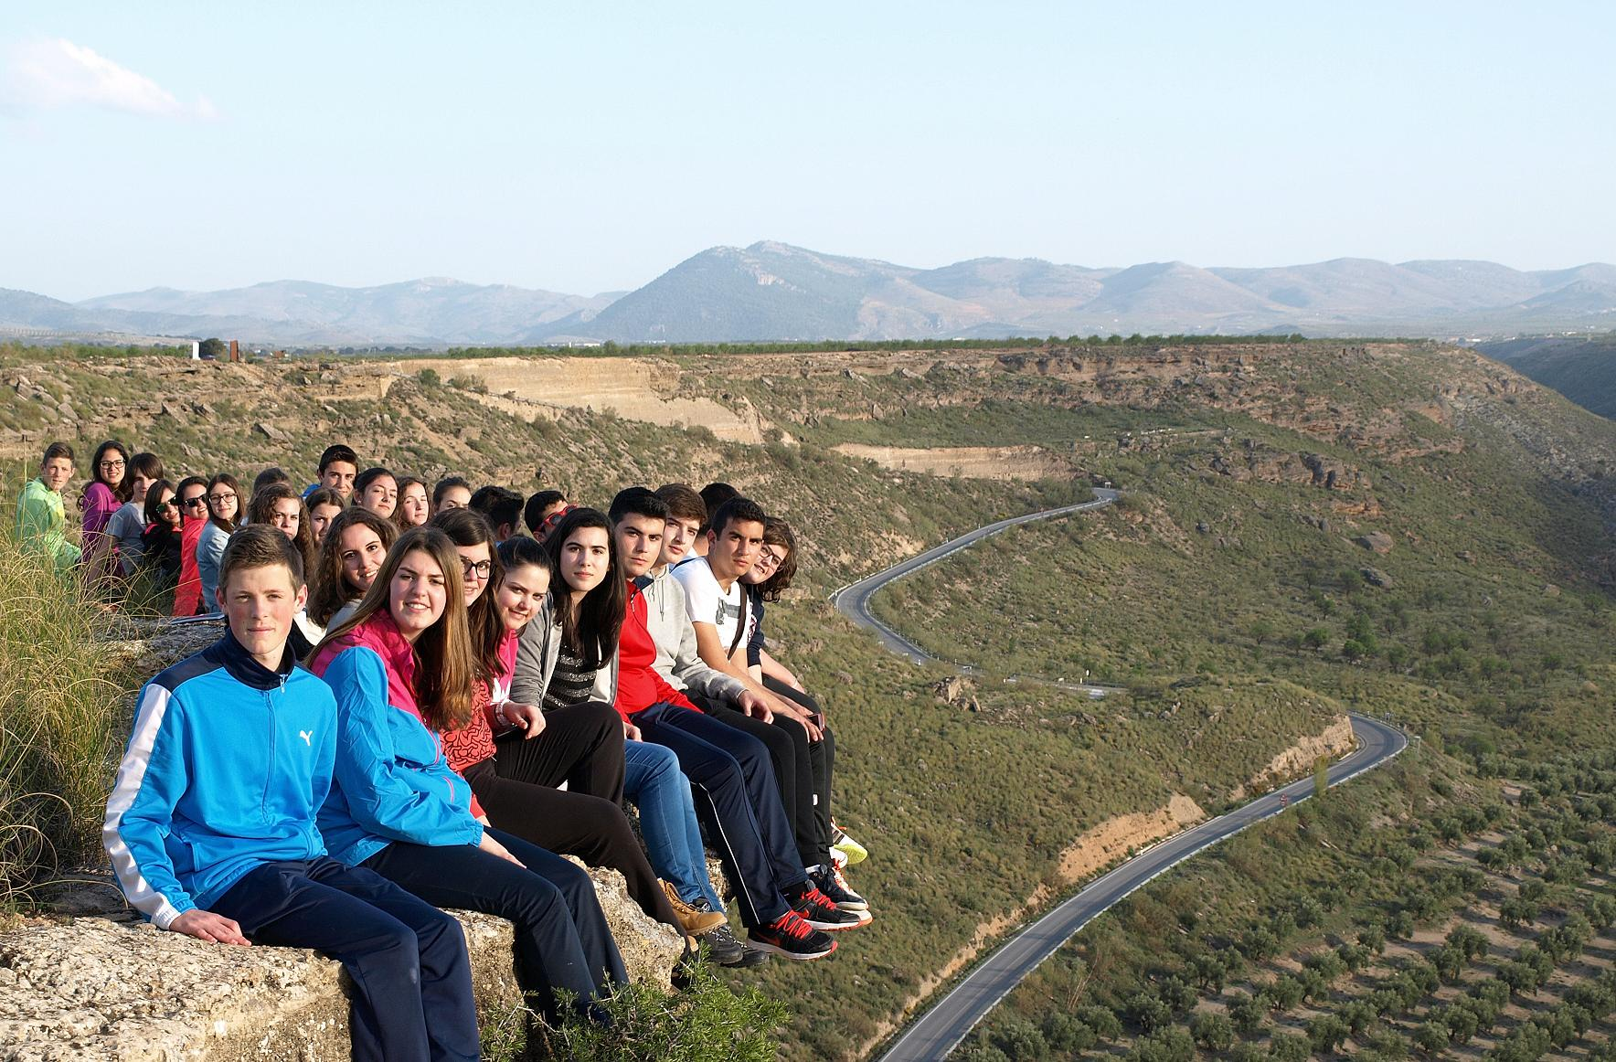
The school partnership project between the José Marín secondary school in Andalucía and the Gymnasium Willibald of Eichstätt in Bavaria began in the academic year 2011-2012. It’s been three times already!
Our main goal is to meet and exchange knowledge on the heritage in General and to live other culture too. In the image you can see the Gor River Canyon and the Megalithic Park of Gorafe (Granada). The photo is an optical illusion

Slide 3
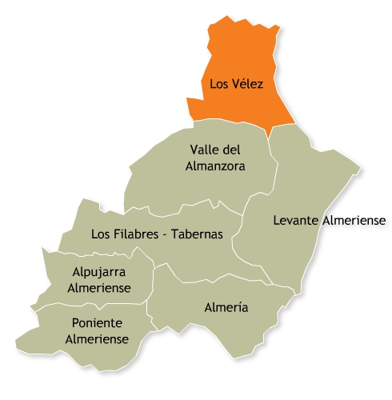
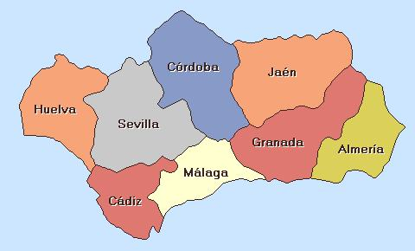
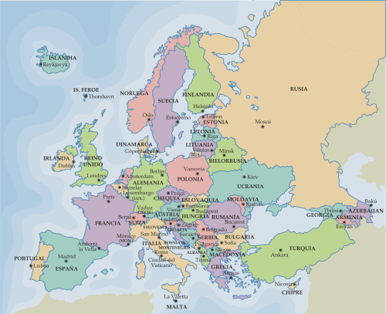
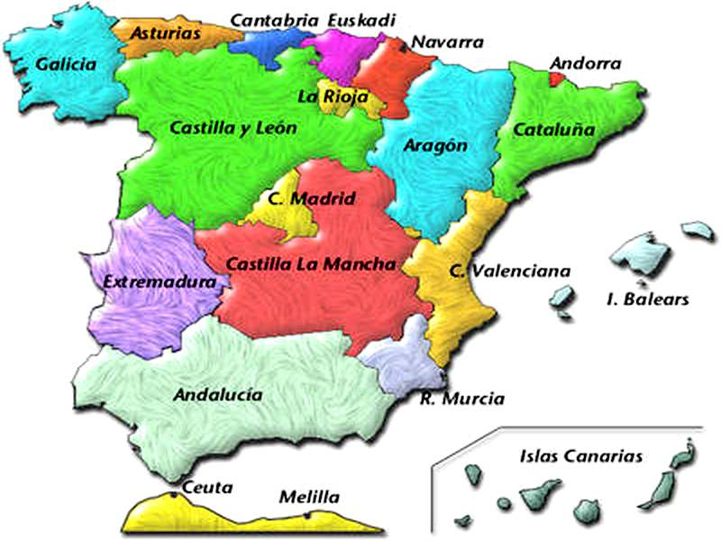
Our school "José Marín" is in the region of Los Vélez, in the province of Almería, Autonomous Community of Andalusia, Spain and Europe

Slide 4
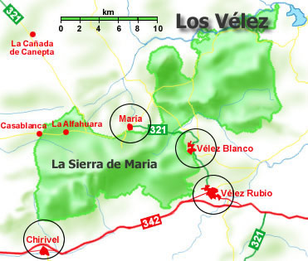
In the region, it lies the Natural Park of Sierra María - Los Vélez, located in the northern part of the province of Almería, close to the neighboring provinces of Granada and Murcia
In Los Vélez there are cave paintings that are a symbol of the province, as the Indalo or the sorcerer as it is the case of the caves of Cueva de los Letreros or Cueva de Ambrosio. The region consists of the following villages: Vélez Rubio, Vélez Blanco, María and Chirivel

Slide 5
The Natural Park of Sierra María-Los Velez provides a large fauna and flora wealth. The feral turtle is a strange reptile which lives in this setting

Slide 6
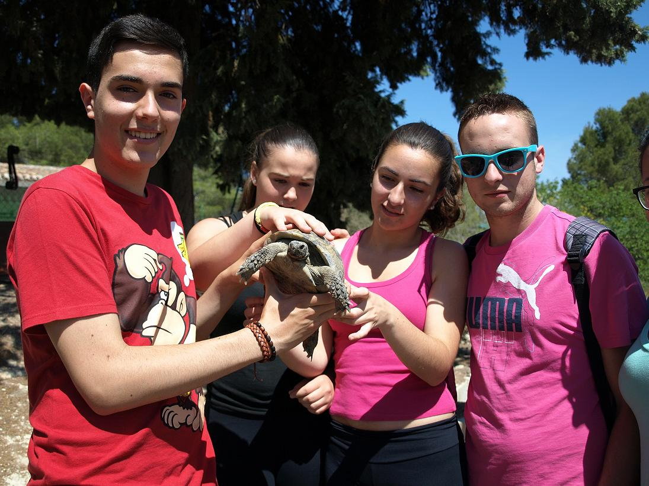
In this Natural Park there is a recovery centre for the preservation of the feral turtle which is an endangered species

Slide 7
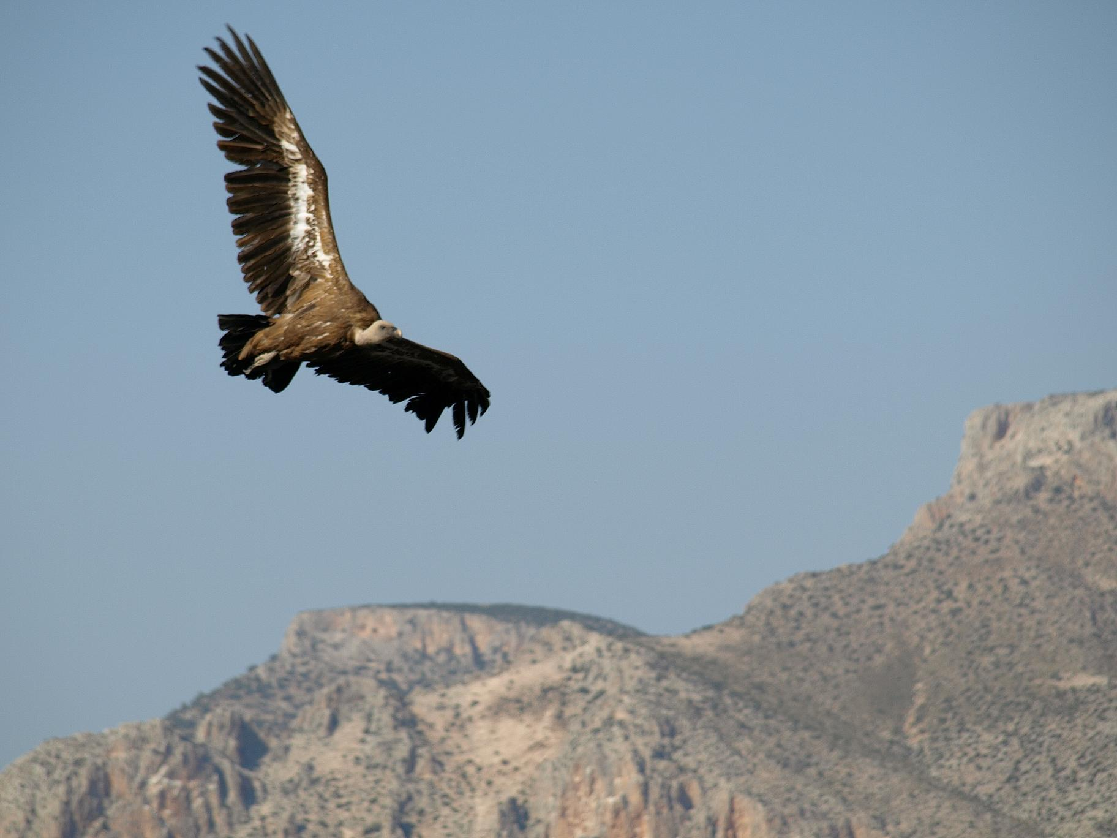
The griffon vulture has been reintroduced in the area of the Natural Park because of the recovery project of endangered species

Slide 8
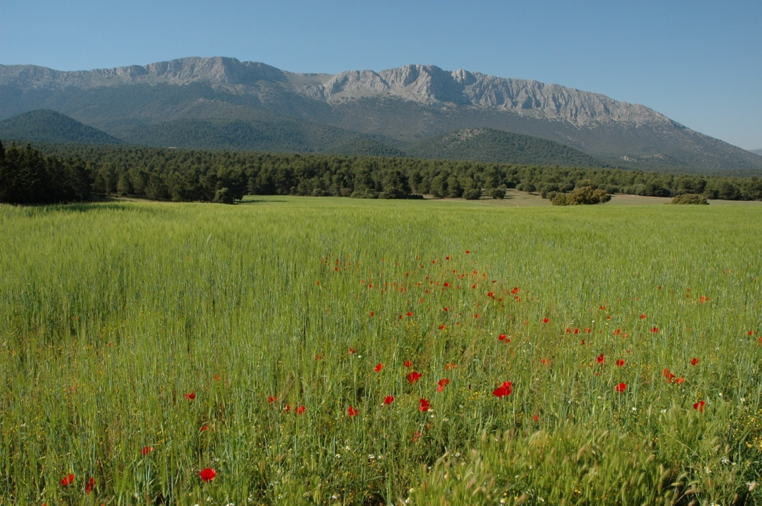
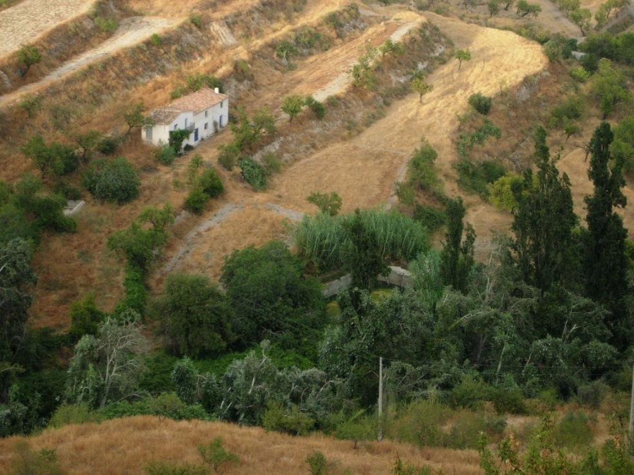
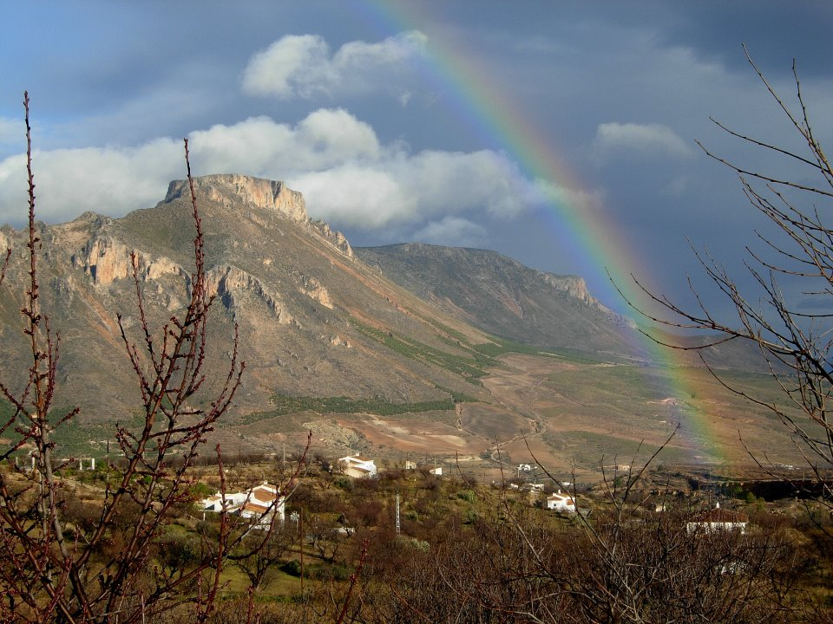
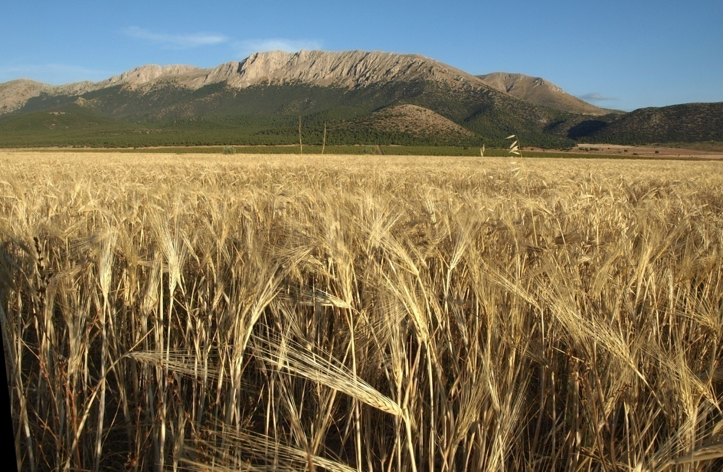
The Region of Los Vélez is of rural vocation

Slide 9
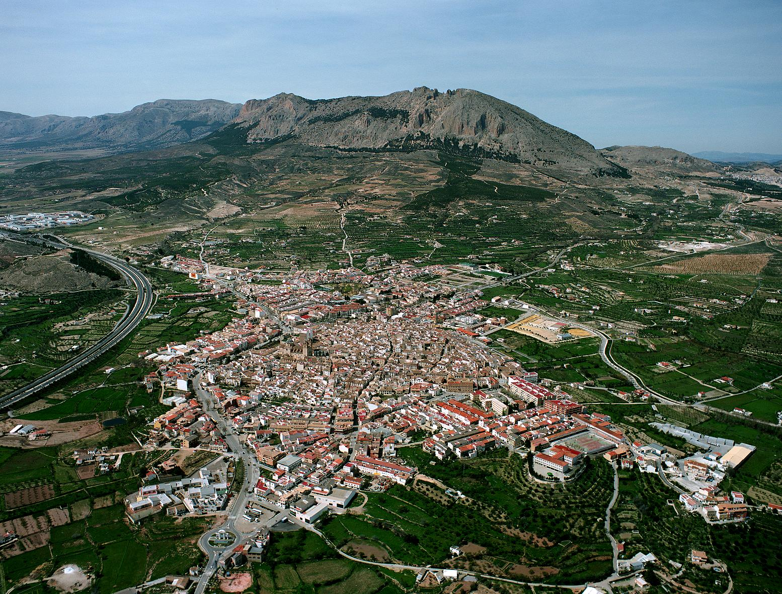
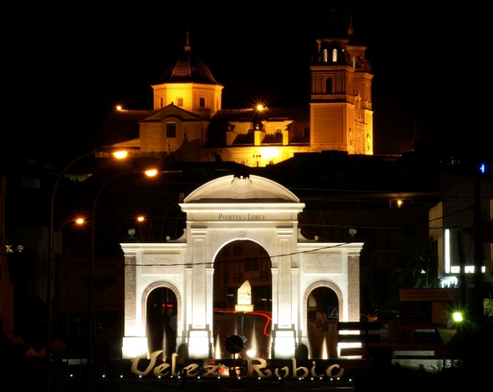
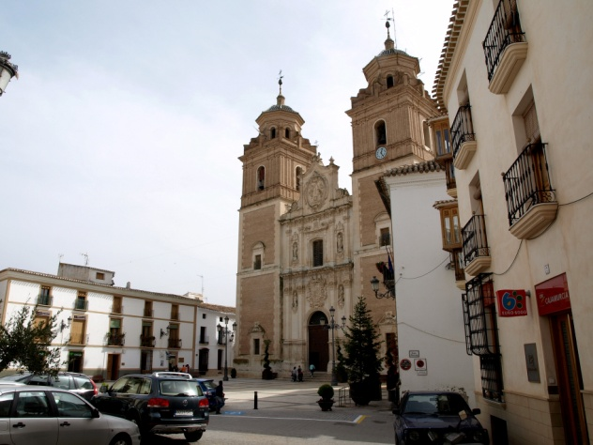
Vélez Rubio is the administrative center of the region. It has an area of 282 square kilometers and 7,071 inhabitants approximately. Its heritage is enriched by archaeological sites and remains of civilizations, as well as the Arab fortress of El Castellón Hill and the historic church La Iglesia de la Encarnación

Slide 10
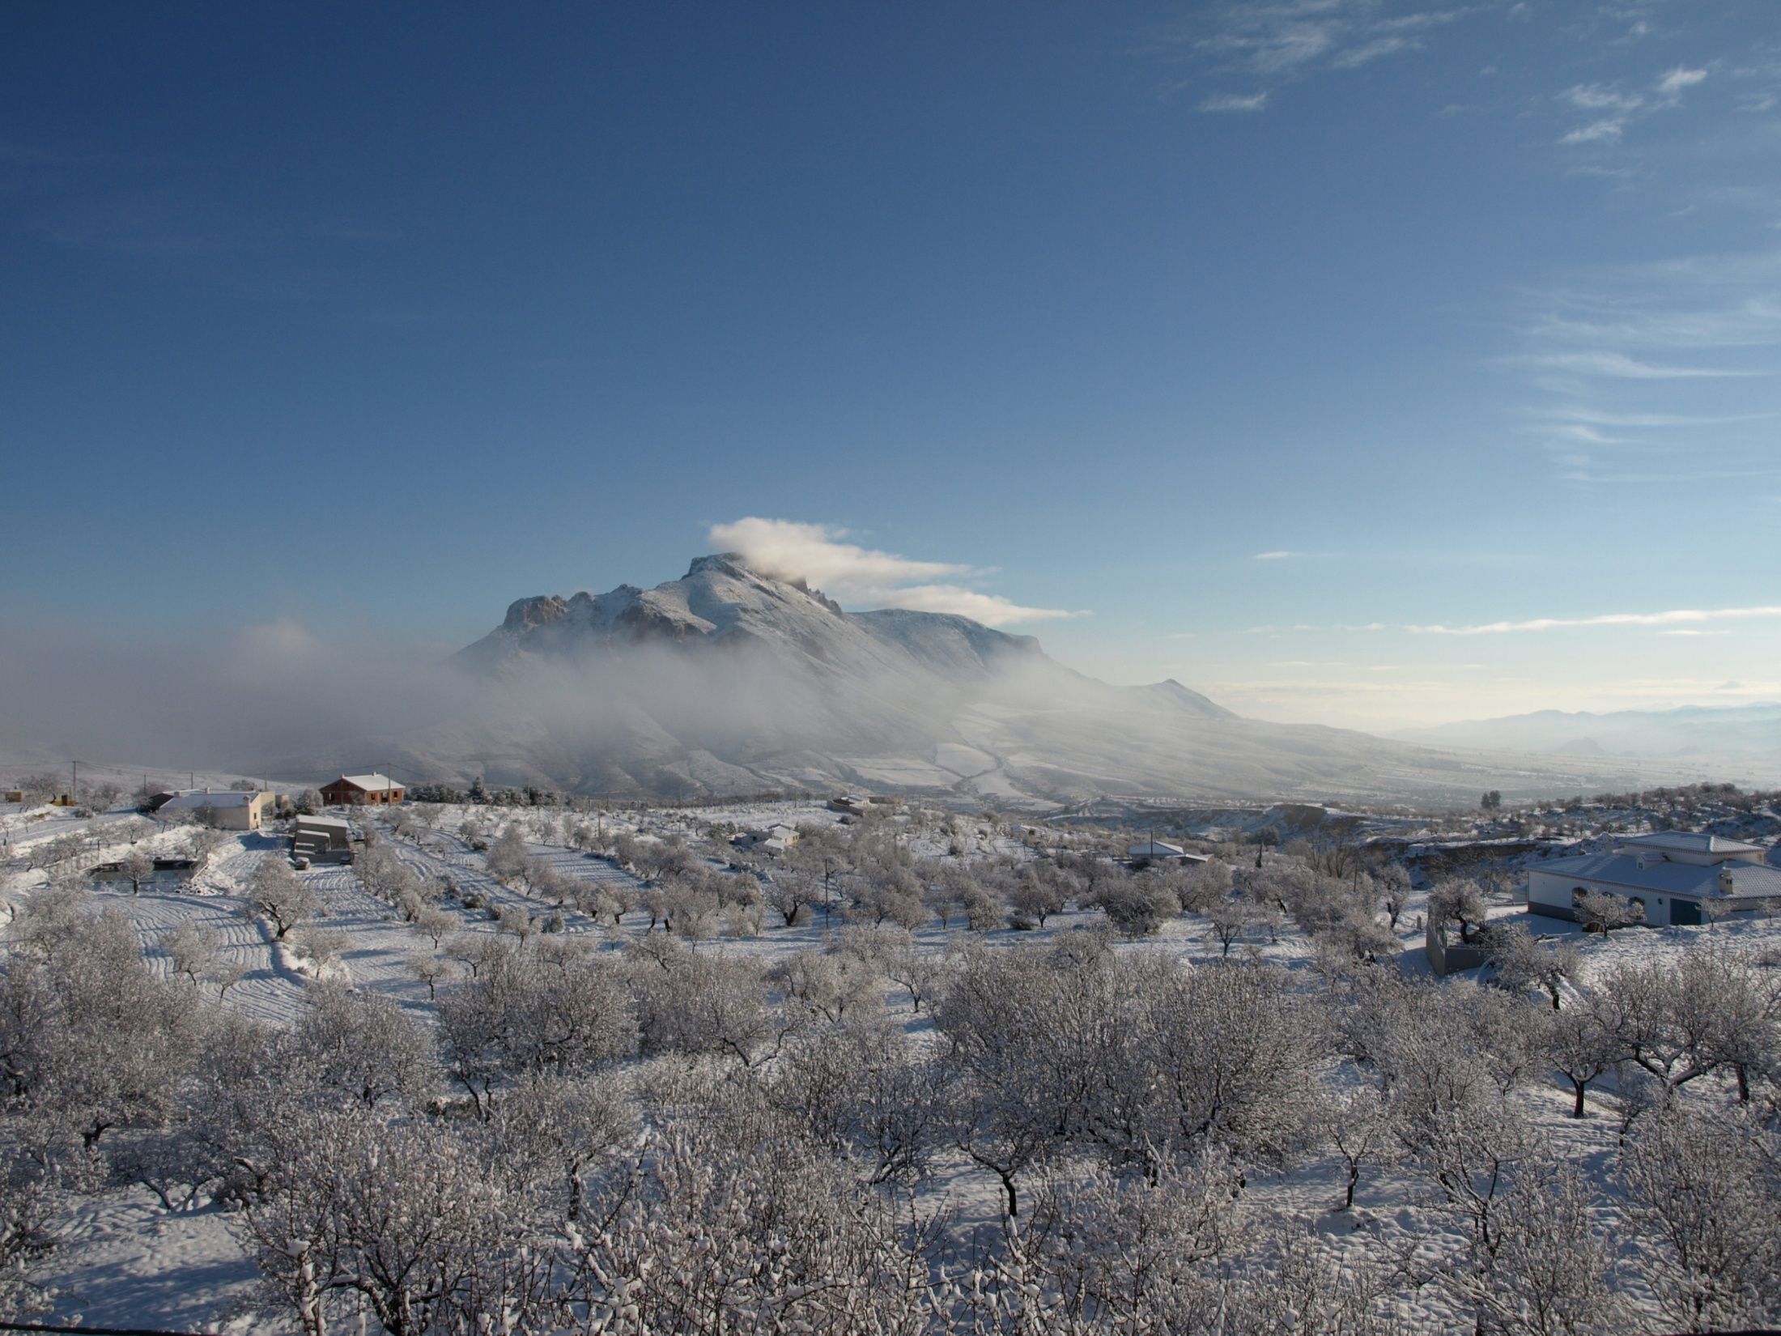
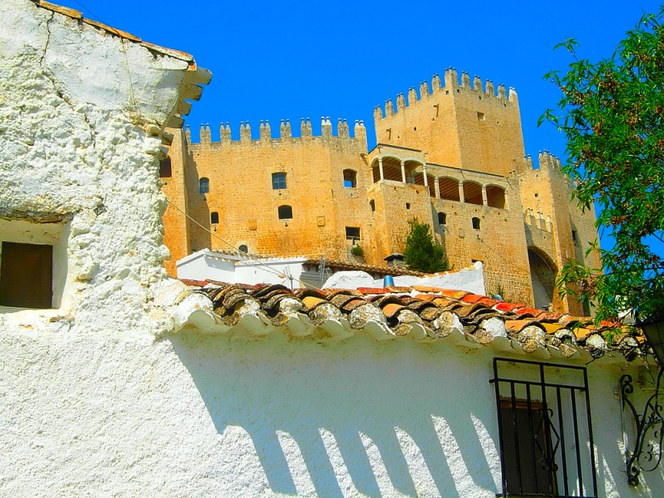
Vélez-Blanco is located at he foot of the Maimón Mount more than 1,000 meters high. The castle, which belonged to the Marquis of LosVélez, stands out.

Slide 11
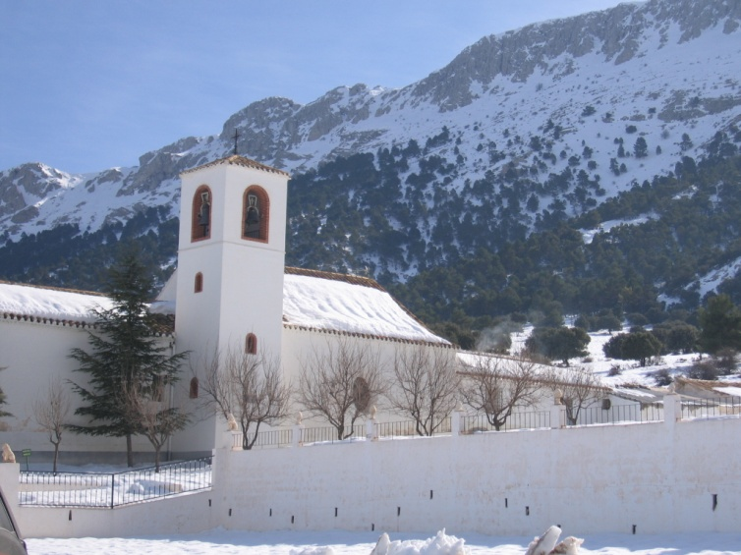
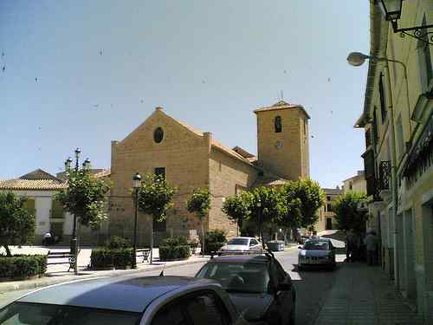
María, which is 1,200 meters above sea level, is a village of about 1,000 inhabitants. It is part of the Natural Park. The winters are cold and snowy; summers are warm and short

Slide 12
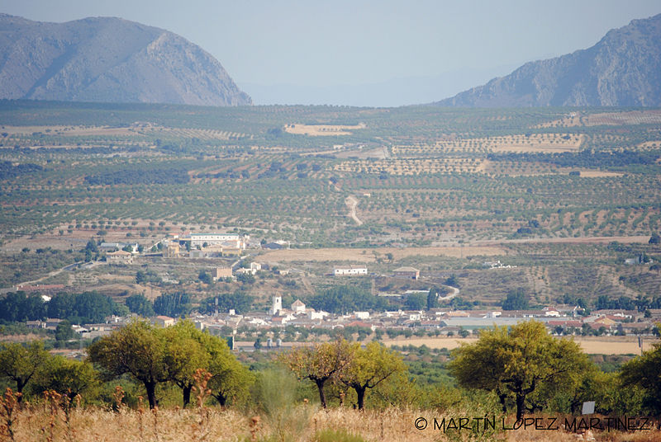
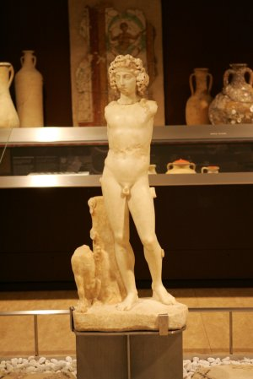
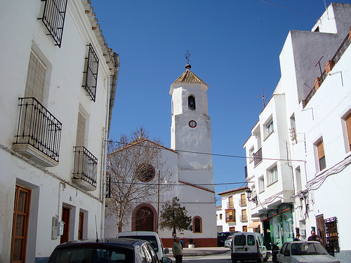
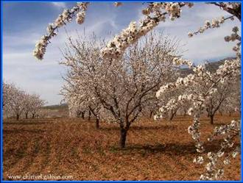
Chirivel has an area of 197 square kilometers and 1,811 inhabitants approximately. It is the archaeological site of El Villar, which owns pieces of Roman origin: columns and capitals.

Slide 13
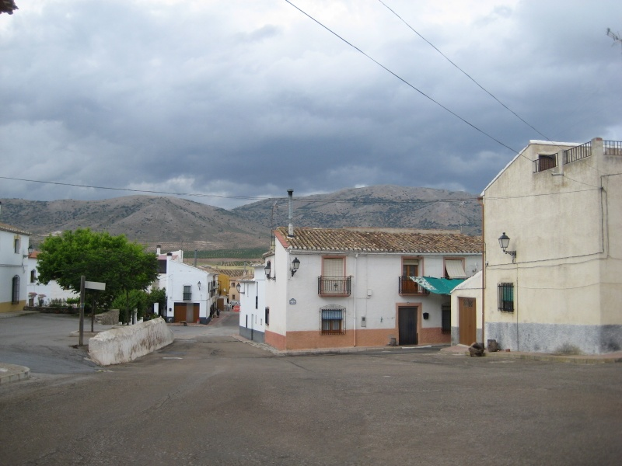
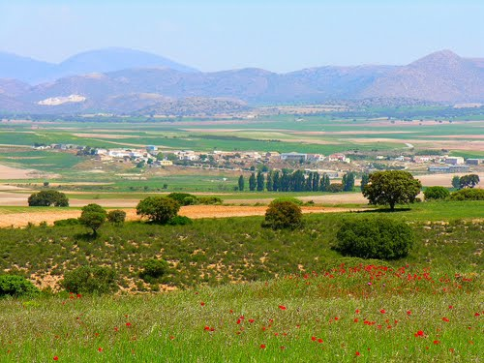
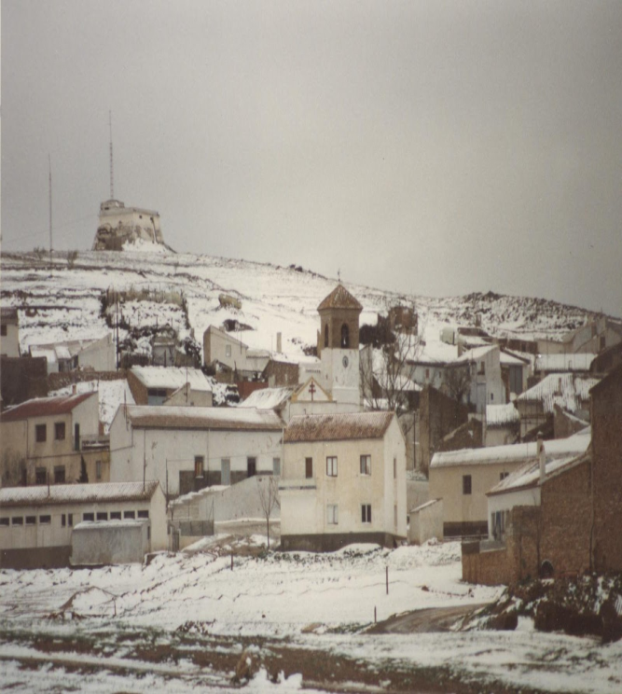
El Contador is a district of the municipality of Chirivel, where the Museum of Esparto can be stood out, unique in Europe and the Church of San Antonio of Padua
Cañadas de Cañepla is a village of María. A worth mentioning environment for its microclimate, temperature, nature, birds, endemic species and close to it, the remains of the first man of Western Europe, Orce Man, were found.
Topares is a district of the municipality of Vélez-Blanco

Slide 14
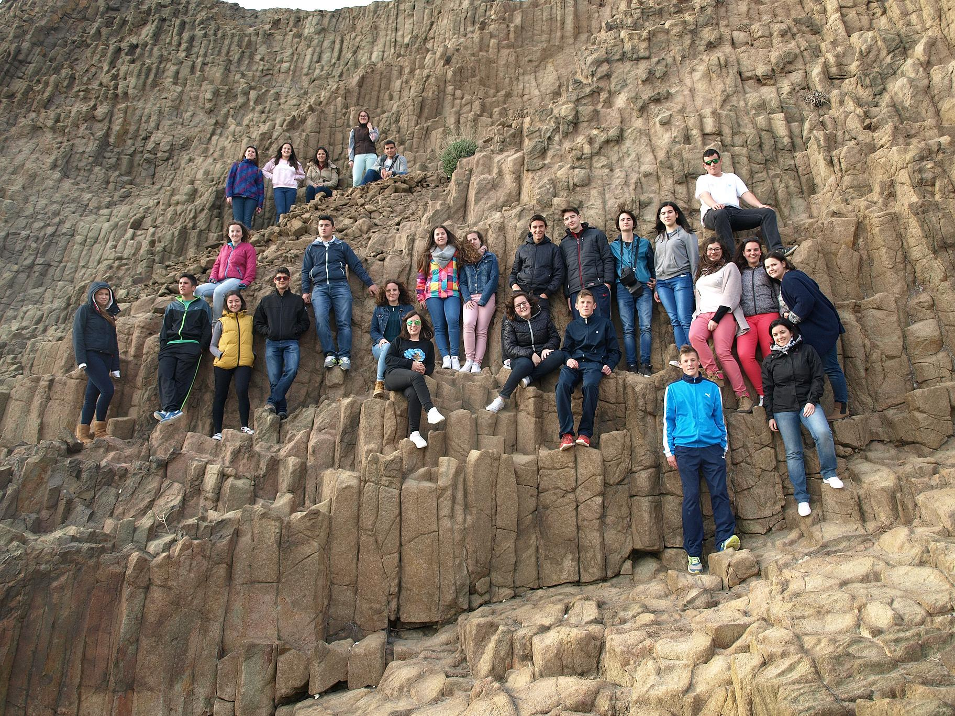
GEOLOGICAL HERITAGE OF ANDALUSIA (I)
Formation of the Baetic Mountains Ranges

Slide 15
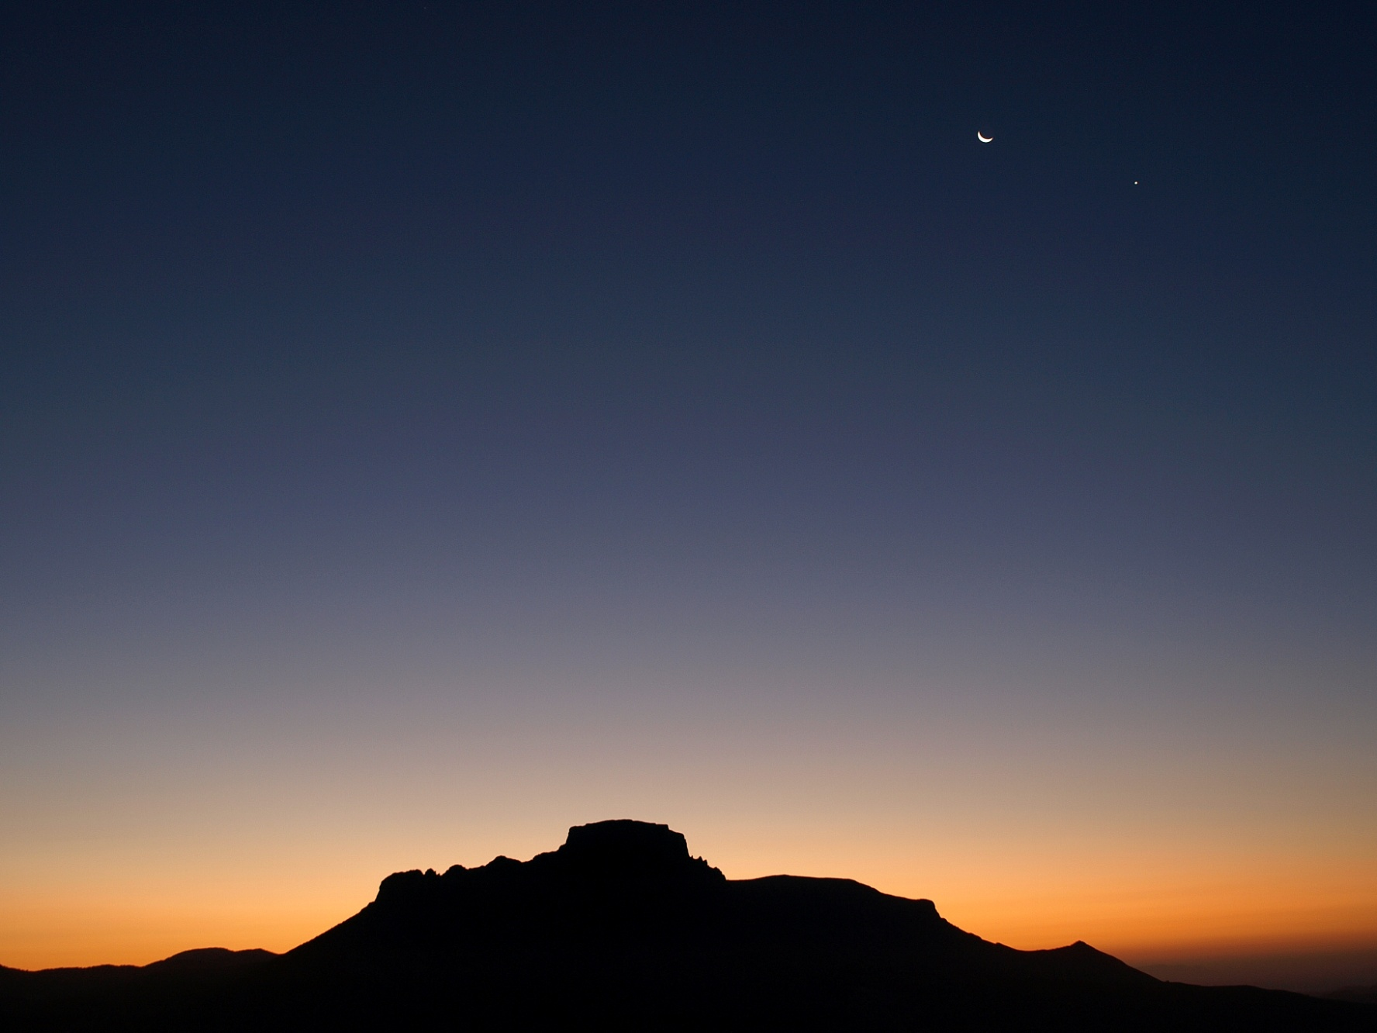
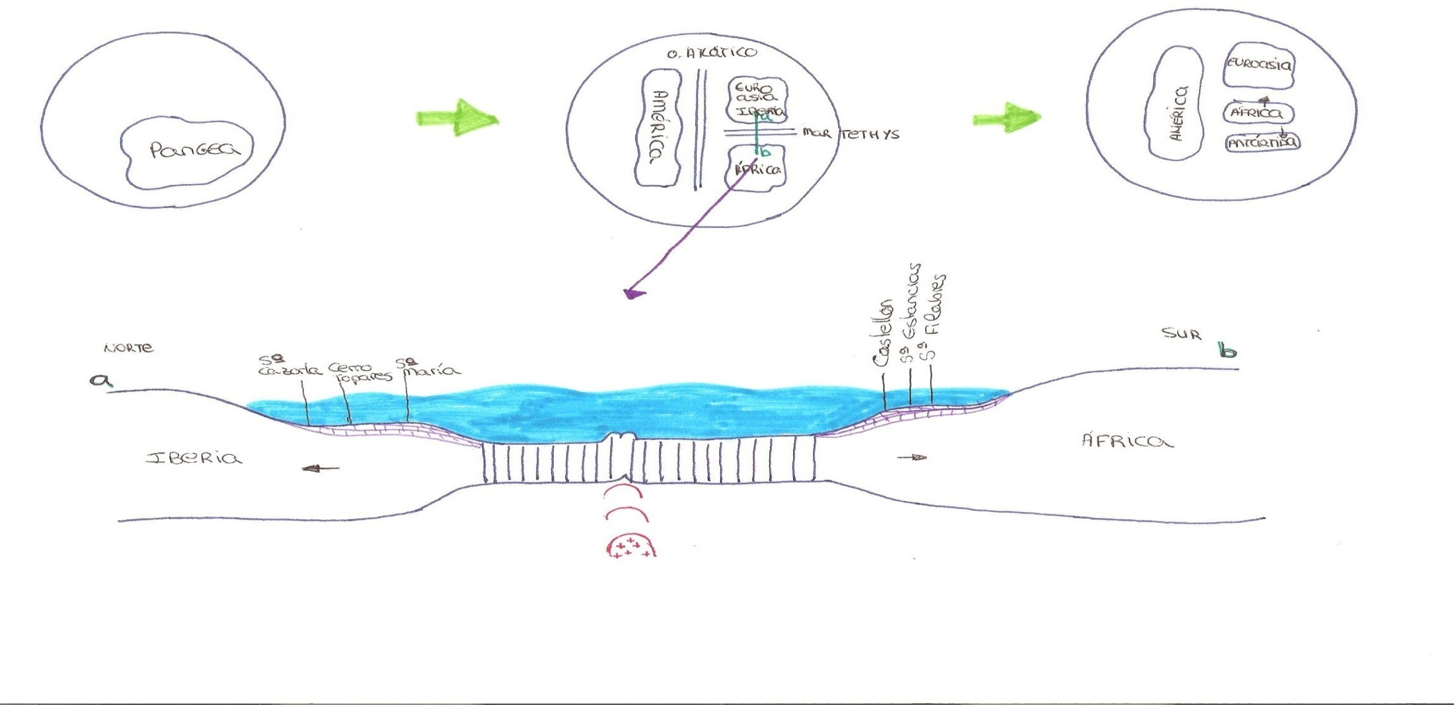
1st STAGE
(250 millions of years ago)
CONTINENTAL RIFT
The Pangea is divided into different continents by hot spots
2nd STAGE
It generates the ridge between Iberia and Africa and the Tethys Sea appears. Consequently, the ammonites appear
3rd STAGE
(65 millions of years ago) The Tethys Sea begins to close and subduction occurs. The corals appear

Slide 16
4th STAGE
COLLISION of CONTINENTS
The Tethys Sea disappears and there is a collision which gives rise to the mountains of the Baetic Mountains (Alpine Orogeny)
5th STAGE
The phase of Rift begins in the Cabo de Gata area by a hot spot again. The Mediterranean Sea expands itself

Slide 17
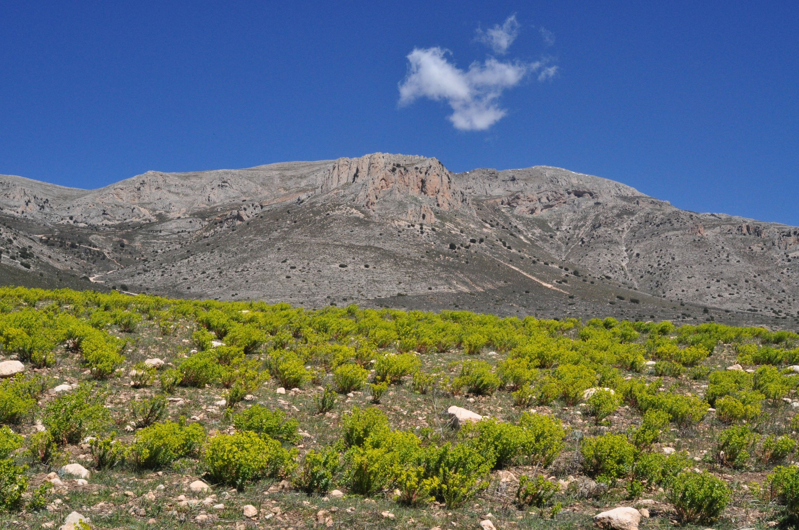
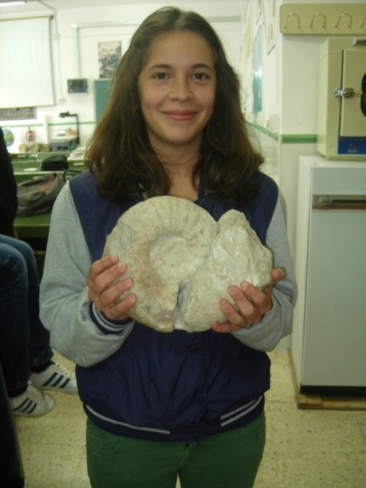
María Mountain
Ammonites found in María Mountain, Natural Park of Sierra María-Los Vélez mountain. Age about 250 to 65 million years old
Ammonites found in the Naturpark Altmühltal. Age about 250 to 65 million years old

Slide 18
Hill of El Castellón
Nummulites fossil approximate age: 30 million years old

Slide 19
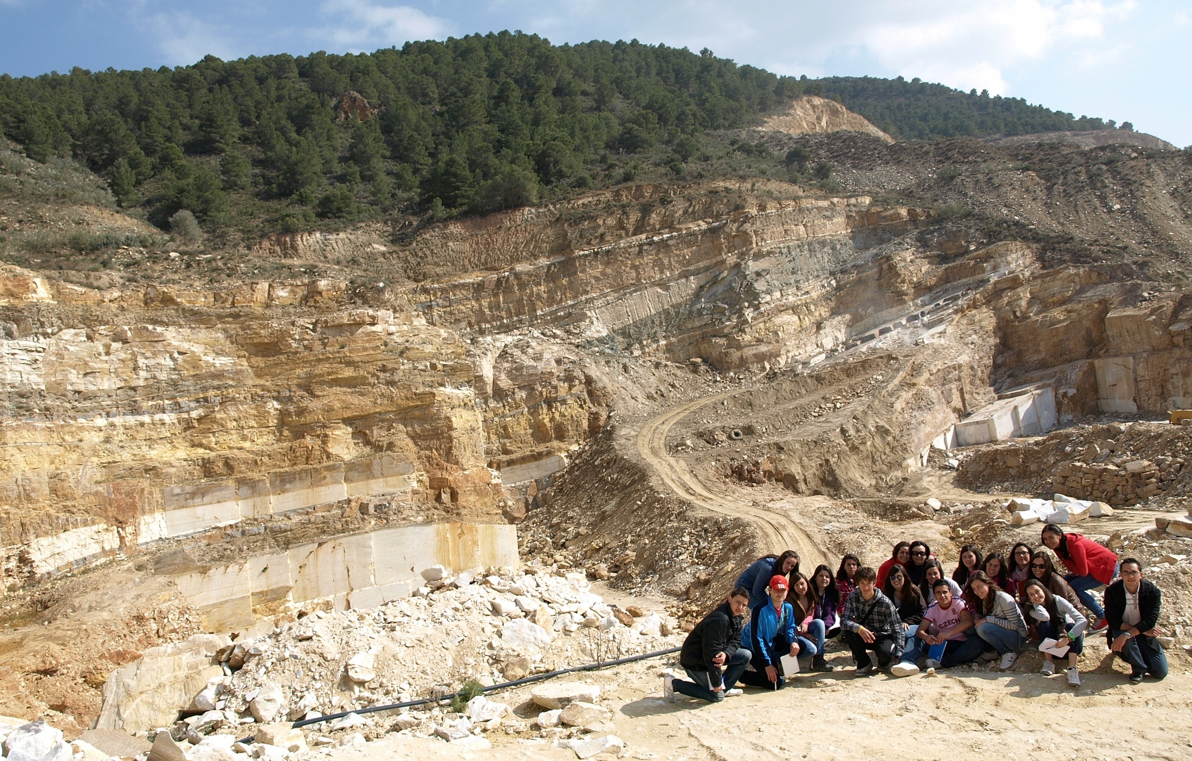
The Filabres mountain
Macael white marble quarries

Slide 20
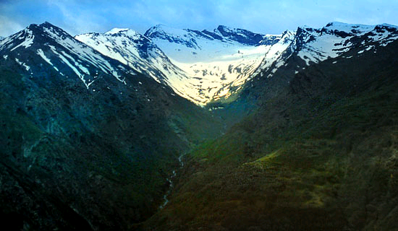
Sierra Nevada
Glacial Landforms

Slide 21
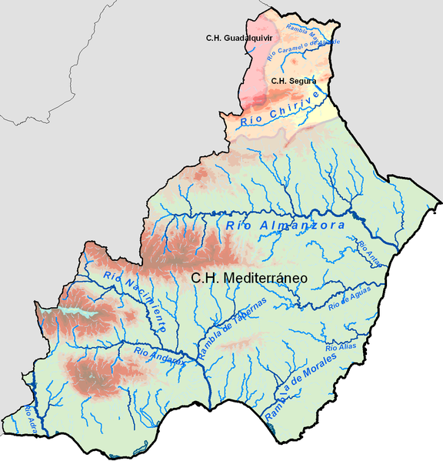
GEOLOGICAL HERITAGE OF ANDALUSIA (II)
Inside Mountains Basins

Slide 22
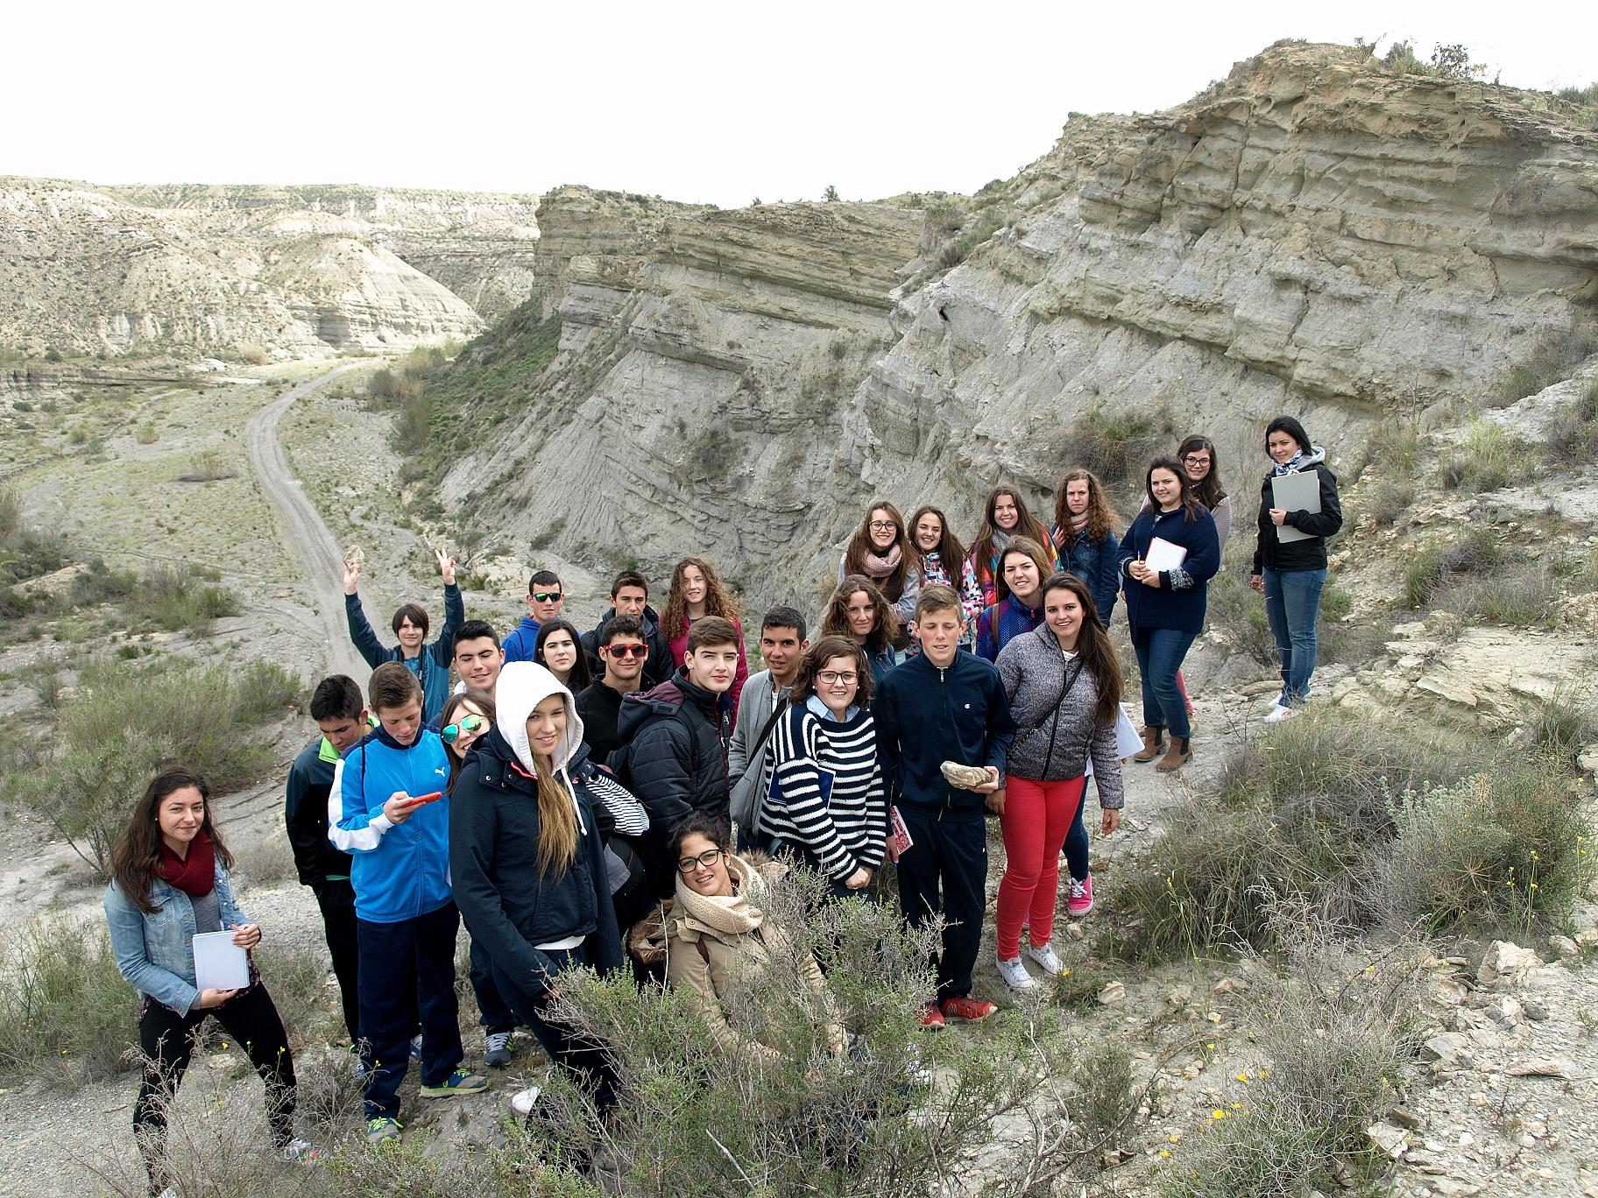
Basin of Almanzora
Located in the middle of the province of Almería, where the river Almanzora flows.

Slide 23
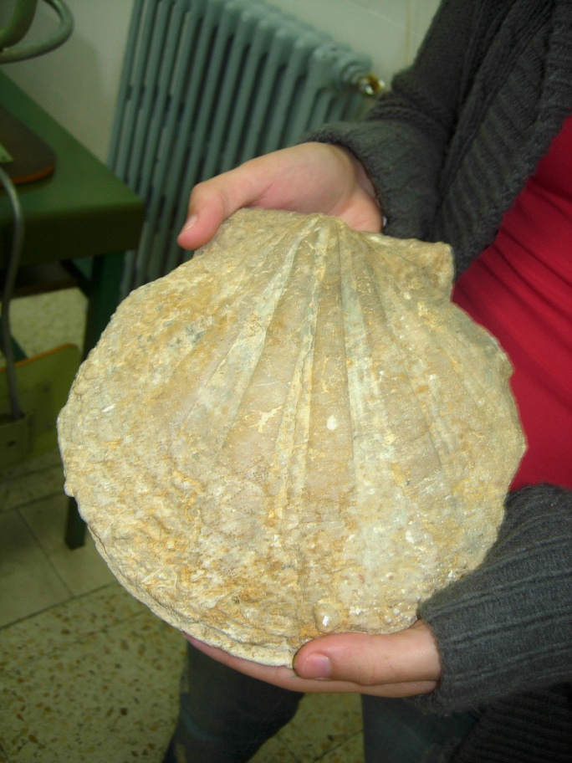
On the walls of the basin of the river you can see strata where you see lots of fossils, such as shells, ostraeas, corals, sea urchins, teeth sharks, etc. This indicates that this area was previously under the sea and that it was a likely place for the formation of corals

Slide 24
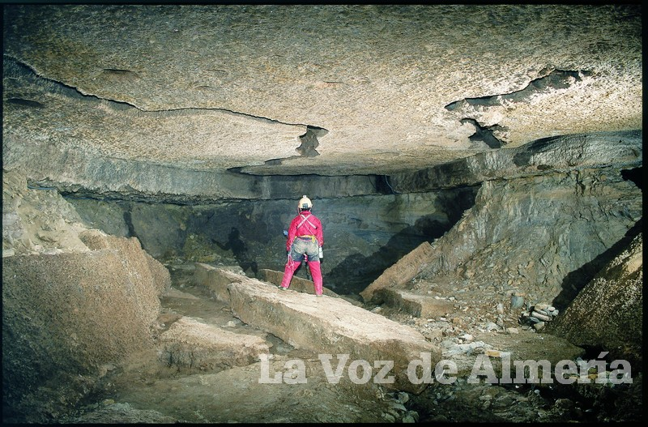
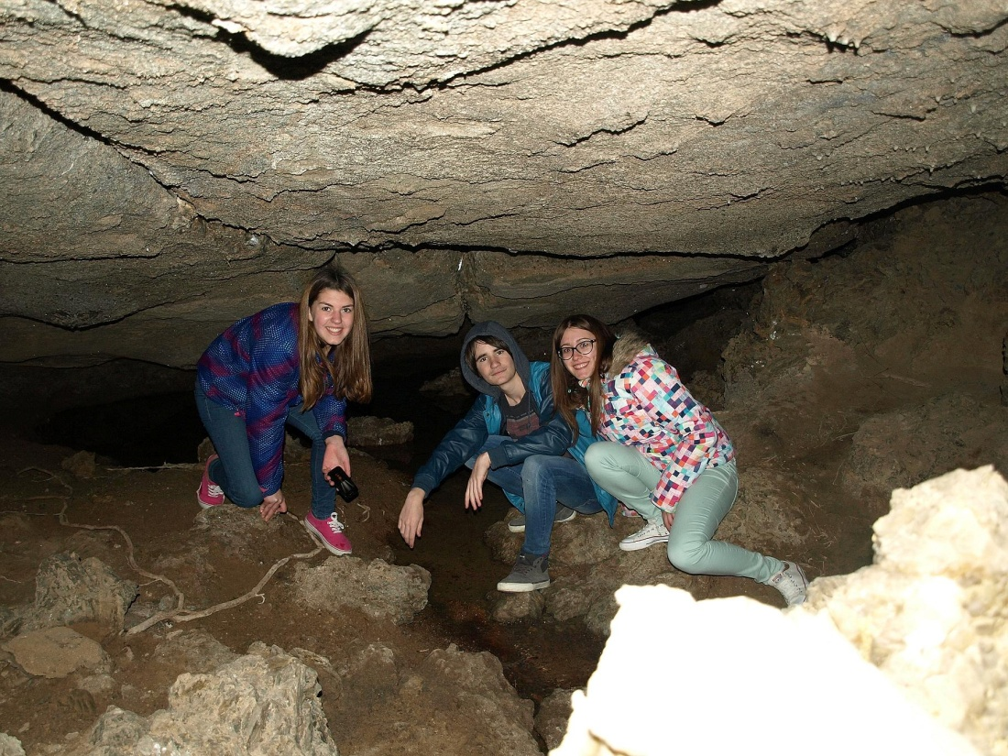
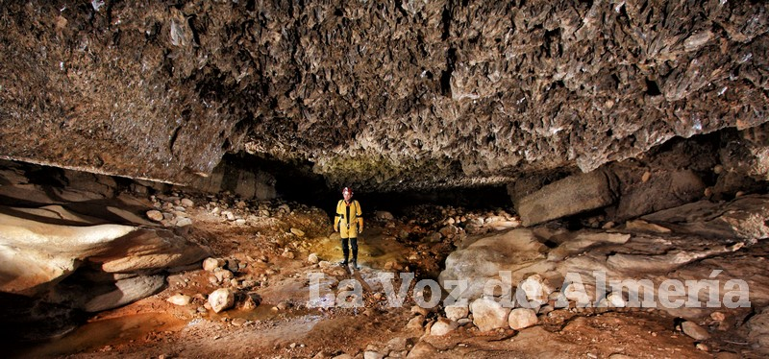
Basin of Sorbas
Carst of Gypsum

Slide 25
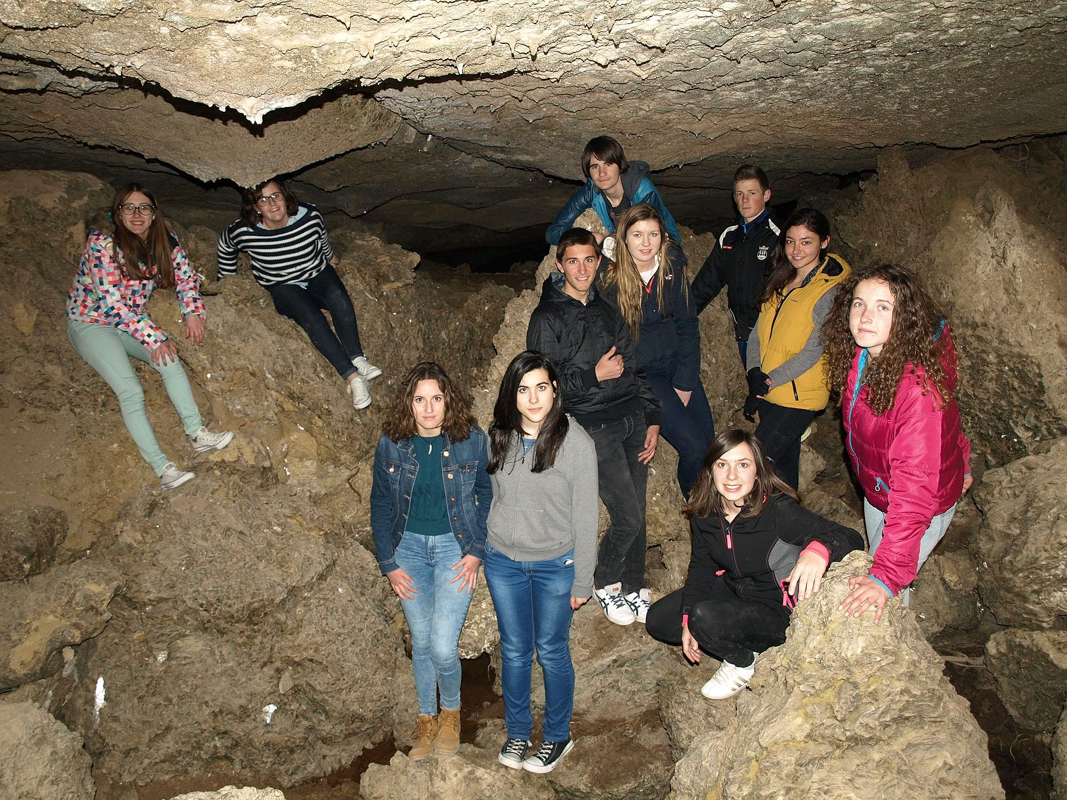
It is a complex of caves, canyons, dolines, geodes, and other karst phenomena, dug by the river Río Aguas in a deposit of gypsum to the South of the town of Sorbas, in Almería. It has an area of 12 square kilometers with more than 1,000 dug cavities with many galleries full of stalactites and stalagmites.

Slide 26
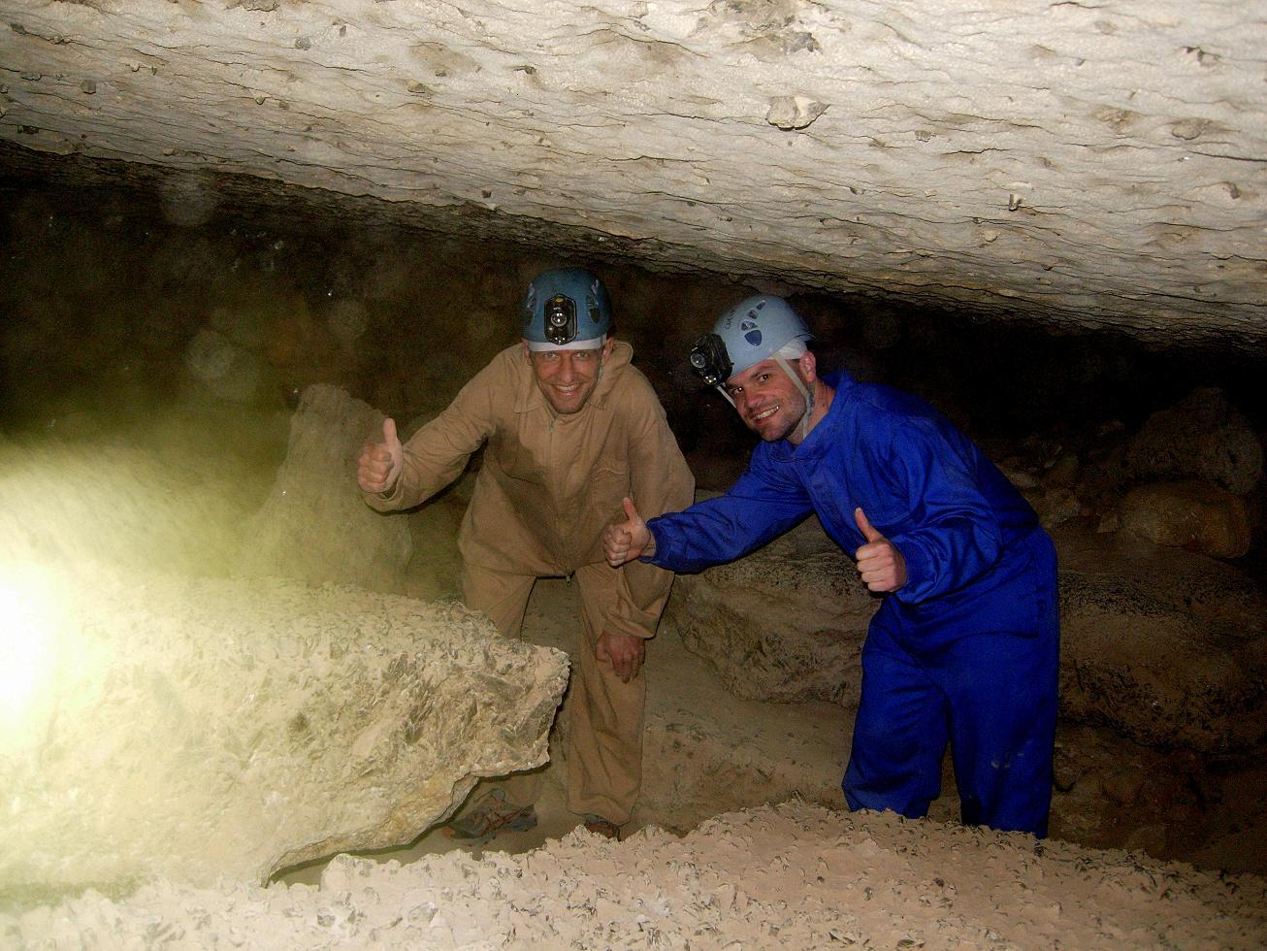
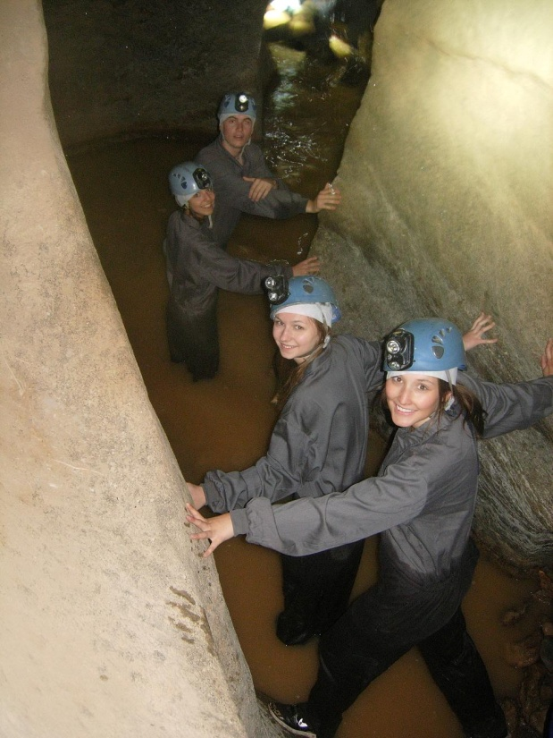
It is one of the most important evaporite carst in the world. The network of underground caves extends tens of kilometers under the desert of gypsum. It was declared a nature reserve by the Junta de Andalucía in 1989

Slide 27
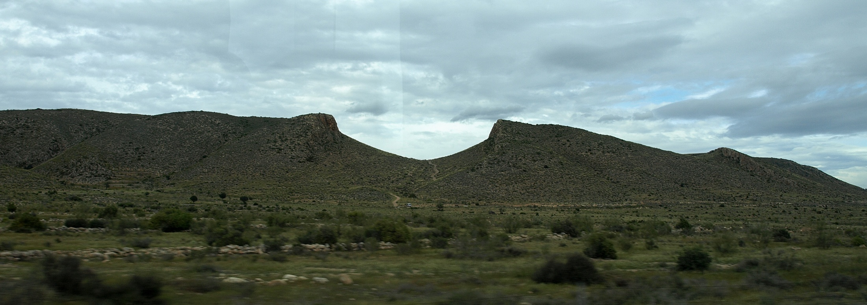
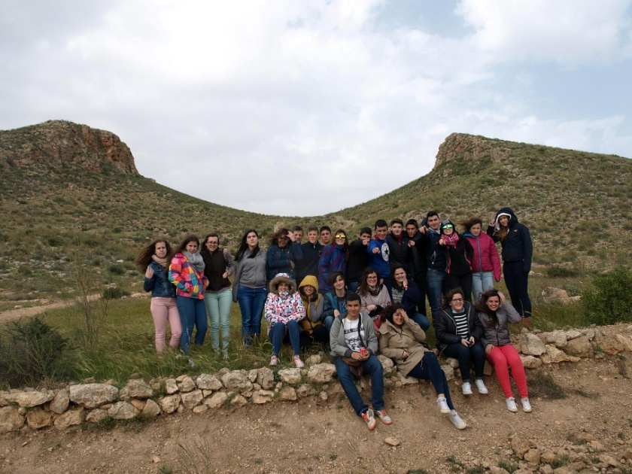
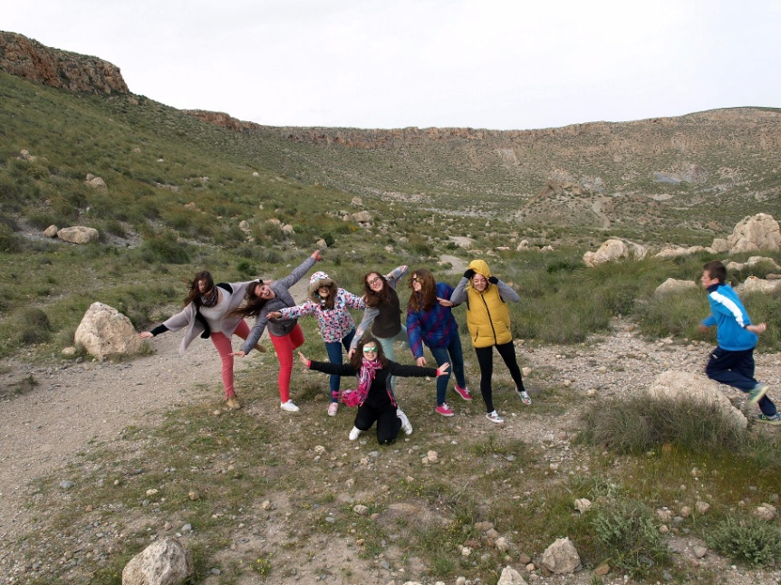
Volcanoes of Cabo de Gata
Magmatic rocks of Cabo de Gata are of volcanic nature. From 15 to 9 million years ago, it started the magmatic activity in the Alborán Sea and corals, marine sediments among others were deposited on the volcanic bottom. Later, about 8 million years ago, a second volcanic cycle was produced.

Slide 28
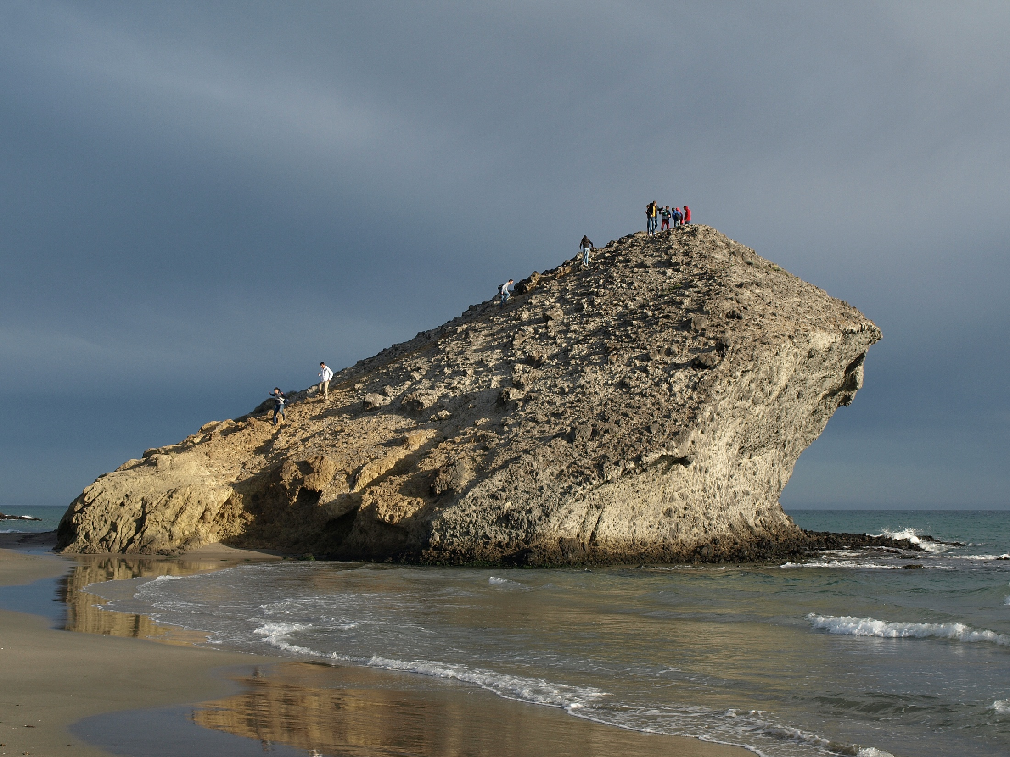
Some volcanic buildings emerge, giving rise to air eruptions. It occurs in the Tertiary Age, when it begins the opening of the Mediterranean Sea. The original relief forms have practically disappeared, although we can find remains of basaltic columns.

Slide 29
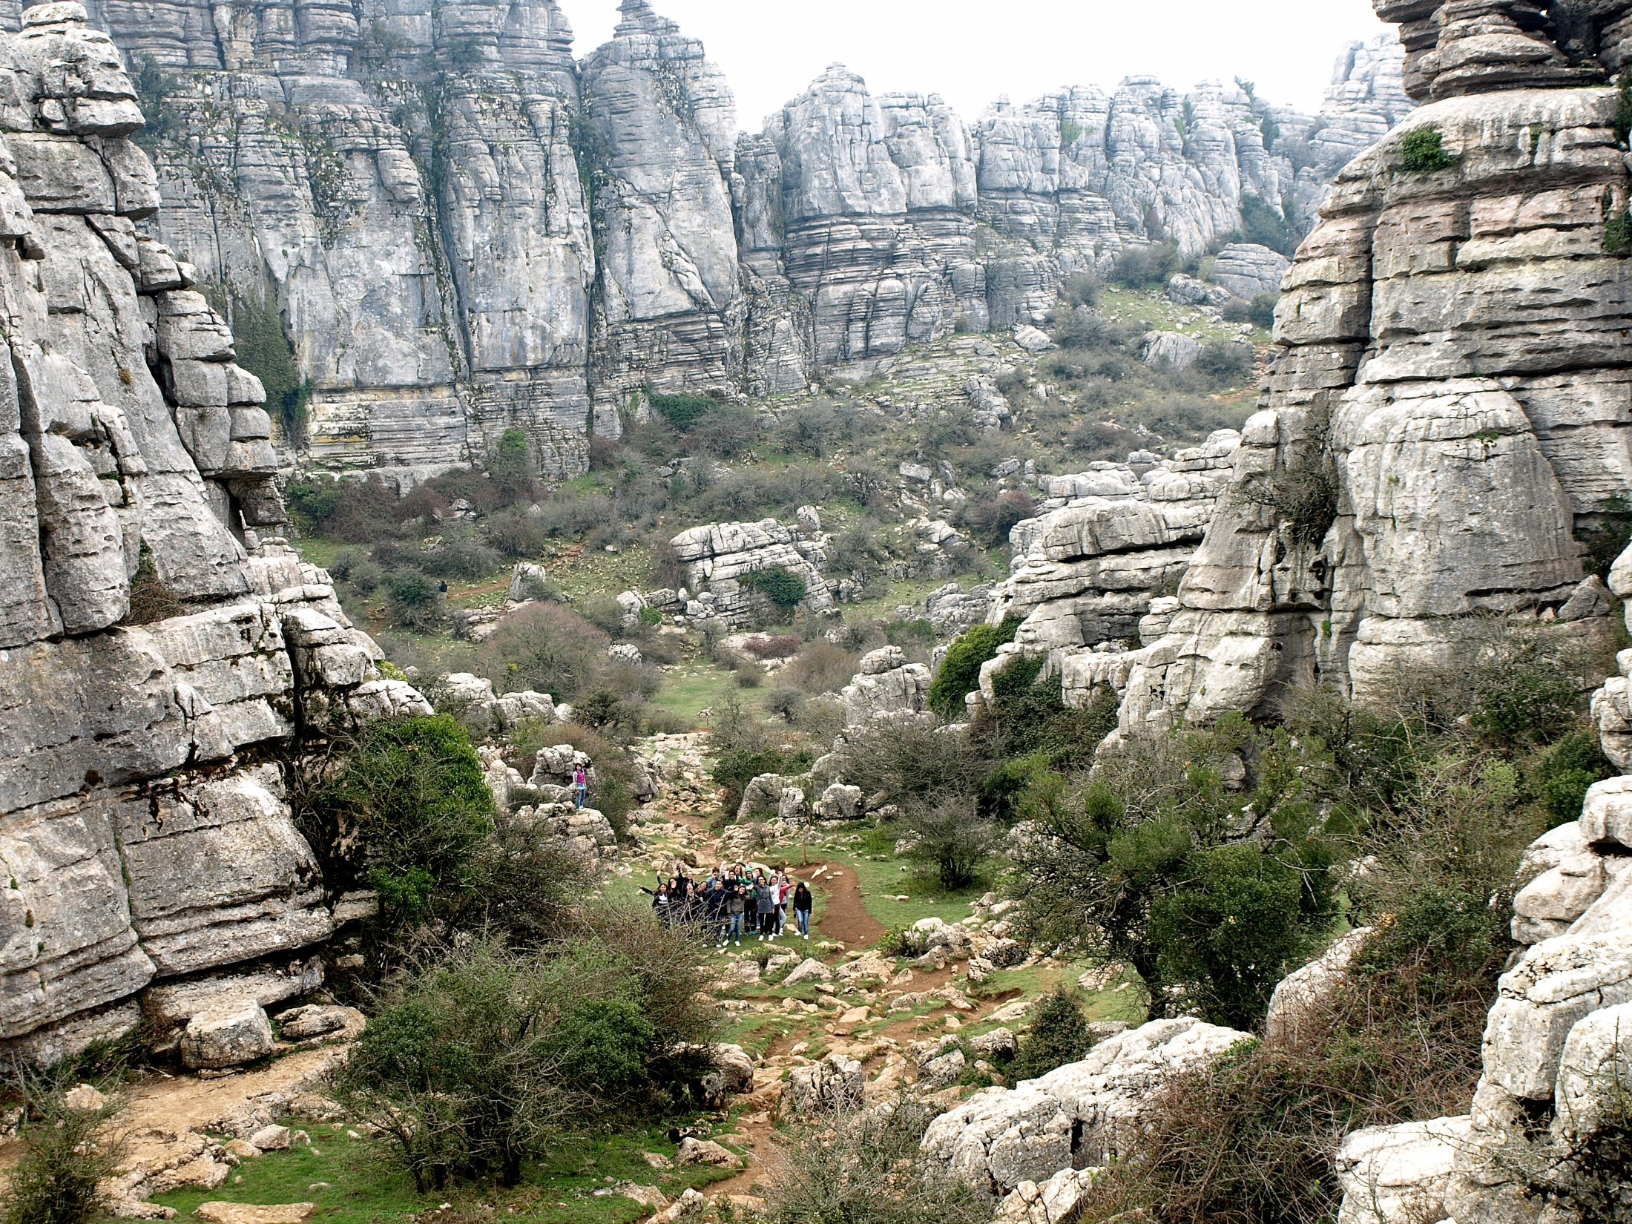
GEOLOGICAL HERITAGE OF ANDALUSIA (III)
The Carstic Landscape

Slide 30
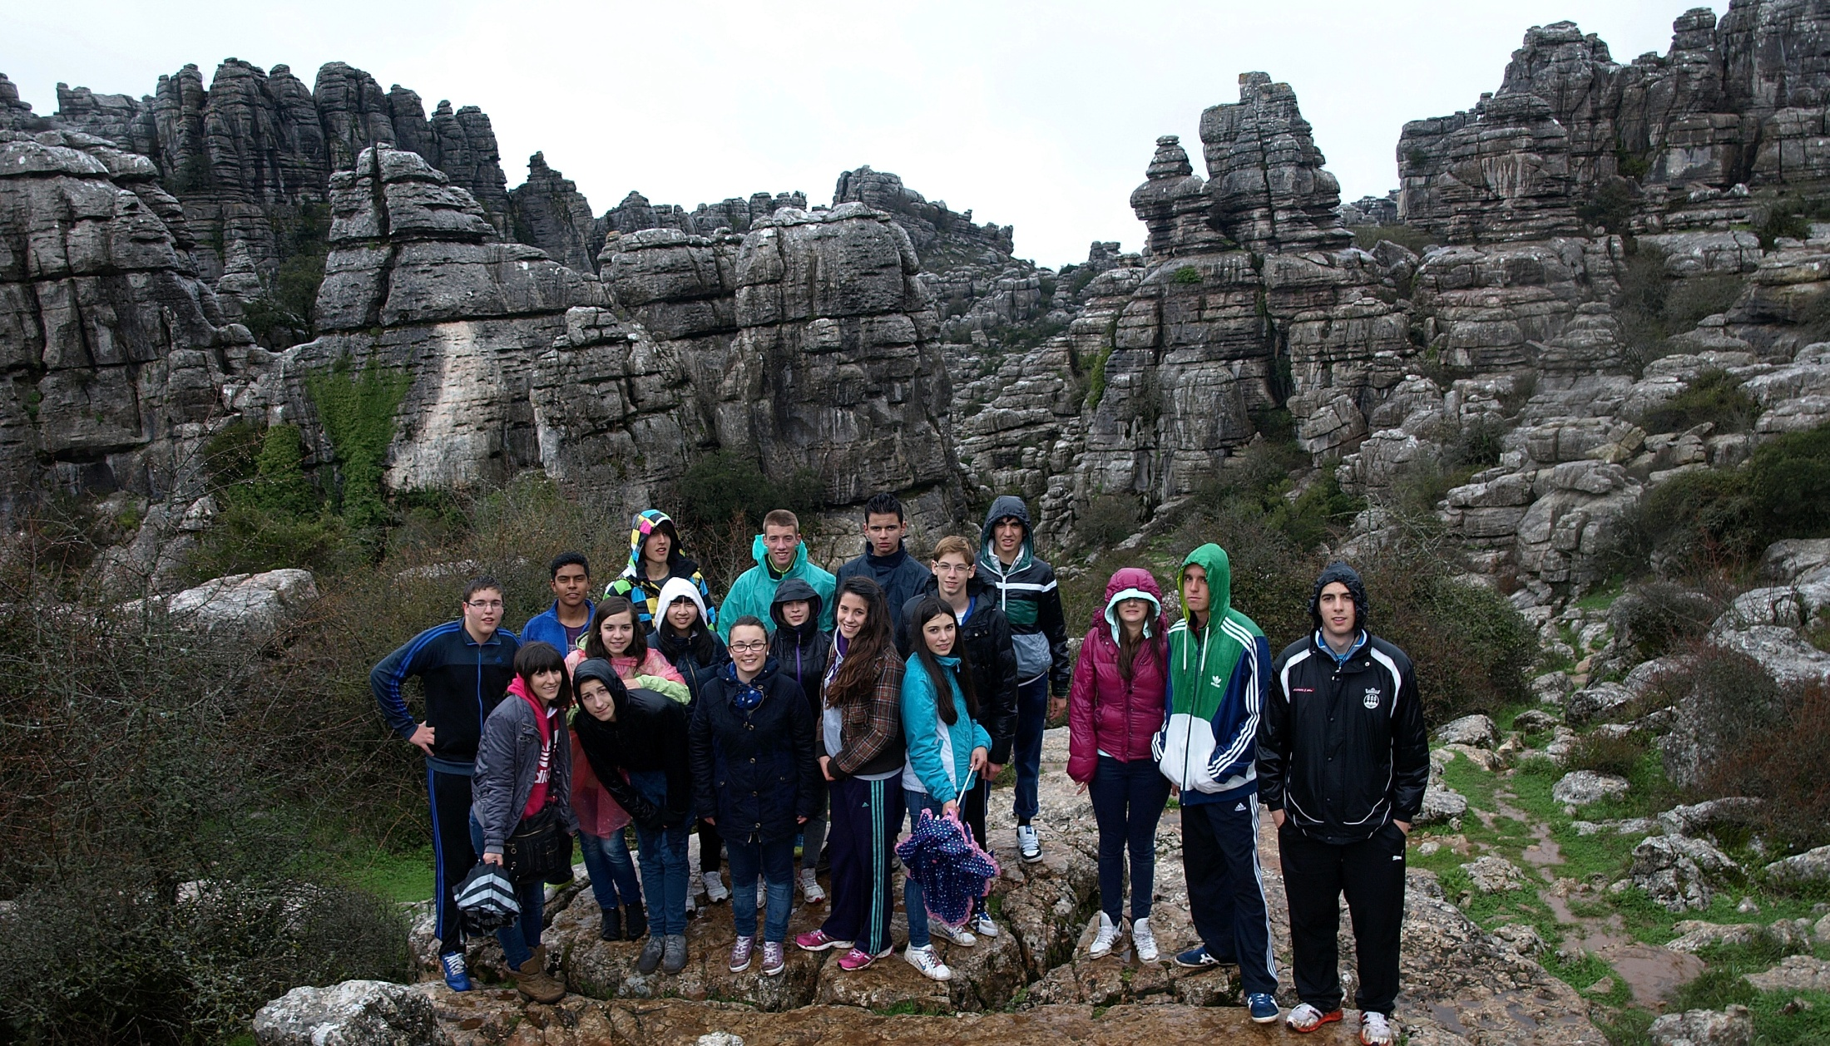
The Torcal of Antequera
It is a Natural area of 1,171 hectares. It is located in Antequera, in the province of Málaga. It is known for the whimsical shapes modeled by the different erosive agents in its limestone, making up an outstanding example of carst landscape

Slide 31
Sierra de María and Maimón aquifer
This aquifer covers an area of 200 square kilometers, from the Natural Park of Sierra María to Orce. It supplies water to Vélez-Blanco and Vélez-Rubio, both for domestic consumption and irrigation

Slide 32
Carstic phenomena in los Vélez
Cave of LaGitana (The gipsy woman)
This cave is located in the town of María and is one of the largest in the province. It contains columns, stalactites and stalagmites

Slide 33
Sinkhole of Roquez
This pothole is located in the town of Chirivel. It contains some of the best formations of a carst landscape in the province. Its genesis is currently finished, since it is completely dry

Slide 34
PREHISTORIC AND HISTORIC HERITAGE OF ANDALUSIA AND LOS VÉLEZ
The Cave of Ambrosio

Slide 35
Painting of a horse of 18,000 years old
The Natural Monument of the Cave of Ambrosio opens onto a cliff of almost 100 m high in Vélez Blanco. It's one of the most important Paleolithic sites in the Spanish Southeast with paintings of 18,000 years old

Slide 36
Cave of Los Letreros
The cave of Los Letreros is in the municipality of Vélez-Blanco. Its dimensions are 25 feet wide by about 6 of depth and a height that ranges in the middle area between 8 and 10 meters.

Slide 37
It contains a number of figures dating around 5,000 BC. Among them "El BRUJO“ can be seen.

Slide 38
DOLMENS
Dolmen of Menga. Antequera. Málaga.
Its function was to serve as a collective grave. They were built during the final Neolithic and the Chalcolithic. A megalithic construction consisted of several slabs wedged into the ground in a vertical position and a cover slab supported on them in a horizontal position. The whole set makes up a camera.

Slide 39
DOLMENS
The Dolmen of Viera (Antequera. Málaga), belongs to the category of Chamber and corridor, showing a long corridor.

Slide 40
The Megalithic Park of Gorafe (Granada), is an area with more than 190 dolmens, prehistoric vestiges dating from the end of the Neolithic age to the bronze age. These megalithic tombs (dolmens) make up one of the funeral grouping of greater importance in Europe. Surrounded by an extraordinary landscape called Bad Lands.

Slide 41
Roman villa of El Villar. Chirivel
It is a Roman villa of the first century A.C. located at the foot of the Via Augusta, where interesting geometric pavements have been found: Ceramic vessels and remains of a furnace

Slide 42
And two pieces of marble from the High Empire period: the left foot of a sculpture belonging to a male statue and a statue representing the God Dionysus.

Slide 43
The Alhambra Palace in Granada
The Alhambra is an extraordinary palace-fortress located in Granada.

Slide 44
It was the palace-fortress of the Nasrid Sultans, rulers of the last Spanish Muslim kingdom, and in its construction Moorish art reached a spectacular and serene climax. The building reveals the spirit of Moorish life and culture.

Slide 45
El Castellón
El Castellón is one of the surrounding mountains in Vélez Rubio. At the top, the ruins of the first Vélez Rubio are located there, the Muslim Alcazaba (citadel) Velad al Hamar (Red land)

Slide 46
The Citadel of El Castellón is from the Muslim period (711-1492)

Slide 47
The Hill of the Jewish Muslim Necropolis
It is located in Vélez Blanco. It is a Muslim cemetery, characterized by narrow graves where the bodies were buried facing toward Mecca

Slide 48
Vélez Blanco Castle
It was ordered to be built in 1506 by Don Pedro Fajardo, Marquis of the Vélez

Slide 49
Its building finished in 1515. The Castle combines Gothic and Renaissance styles

Slide 50
In 1905 the courtyard of the castle was sold and it is currently assembled, as you can see in the image, in the Metropolitan Museum of New York.

Slide 51
Church of the Encarnación
Seen from anywhere inside or outside Vélez Rubio. It was built between 1753 and 1768. Built by the Marquis of los Vélez X after the earthquake of 1751, which ruined the original church of San Pedro. The facade owns a real decorative collection of the era, highlighting the coat of arms of the House and the Annunciation on top. It is the most characteristic, spectacular and valuable religious building of the Baroque from the 18th century in Almería. It is also a historical national monument since 1981.

Slide 52
Doors of Lorca and Church of the Encarnación

Slide 53
MANSIONS OF VÉLEZ RUBIO
They have got a Baroque and modernist style. The most highlighted of these houses and public buildings are their facades painted in colors and their many decorative elements. The inside is also decorated with paintings
Old Royal Hospital, now a museum. Civil Baroque

Slide 54
Art Nouveau mansion with murals

Slide 55
Vélez Rubio Health Center
The young architectural firm designed the new health center and the nursery of Vélez Rubio. The idea is inspired by the weathering rocks of Maimón, an important fact to connect with the people and the environment.

Slide 56
New Municipal Nursery

Slide 57
JOSÉ MARÍN SECONDARY SCHOOL
The José Marín secondary school is located in Vélez Rubio, Almería. It is 60 years of age. It is the only school in the region of Los Vélez in which compulsory secondary education, Sixth Form and some vocational training courses are taught.

Slide 58
The José Marín secondary school was founded in 1954. It owes its name to the illustrious velezano D. José Marín, orphan and poor before being a wealthy philanthropist. In August 1958, 26,905 square meters were purchased for an amount of 403,375 pesetas and 3,942,418 pesetas more were invested in the building and improvement of a field of agricultural practices

Slide 59
The school has currently got more than 600 students, mostly from Vélez Rubio, los Vélez region and the surroundings. Students from Topares, Cañadas of Canepla, María, Vélez-Blanco, Chirivel, El Contador, Las Vertientes, Los Cerricos, Los Gatos, Fuente Grande and Los Asensios are picked up by the bus

Slide 60
In our school the teachings of the following departments are taught: philosophy, biology and geology, classics, Spanish language and literature, geography and history, mathematics, physics and chemistry, languages, art, physical education, orienteering, technology, administration, training and vocational guidance, management of natural resources, out-of-school activities and training, assessment and innovation activities.

Slide 61
In our school a large amount of activities are carried out, in which many students participate each year and do their bit.

Slide 62
These activities are:
Maths Olympiad (regional level)
Christmas postcard contest
Biology and Geology tour across Eastern Andalusia
Contest of photography for gender equality
Football League during the recess
The 4th ESO study trip
School exchange with Germany

Slide 63
THIS HAS BEEN A BRIEF REVIEW OF OUR COUNTRY AND OUR SCHOOL.
SEE YOU SOON!

