Slide 1
ERASMUS+
IF THE EARTH SHAKES! WILL YOU BE READY?
ITALY GREECE SPAIN FRANCE

Slide 2
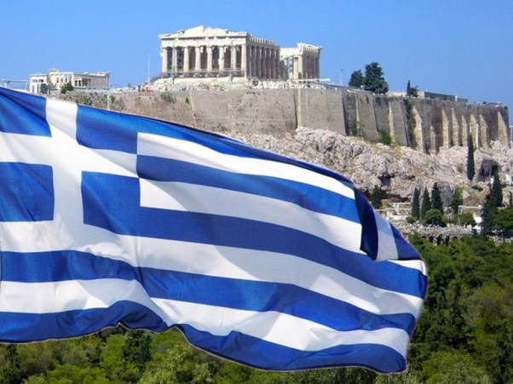
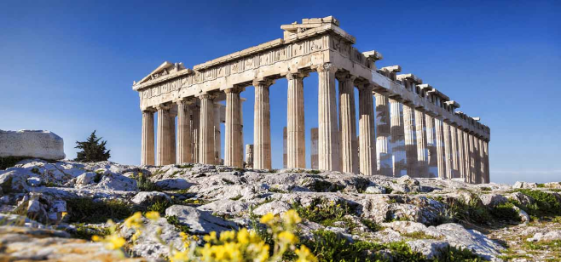
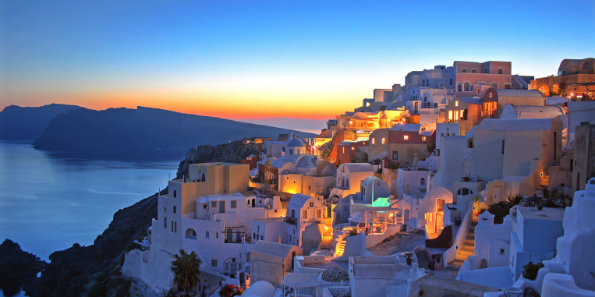
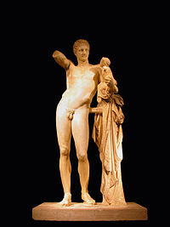
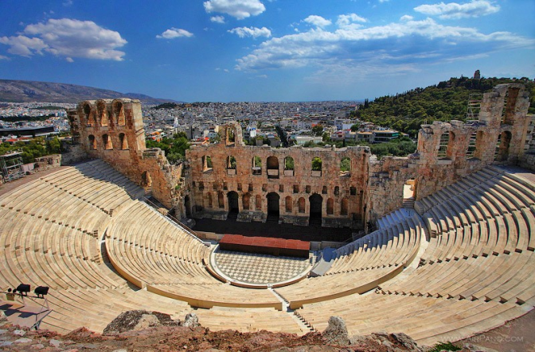
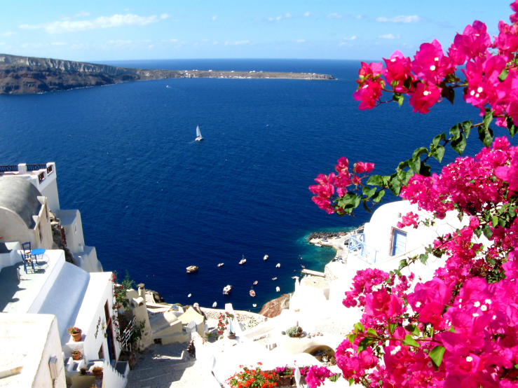
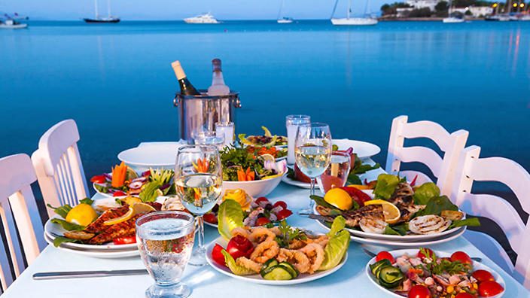
GREECE

Slide 3
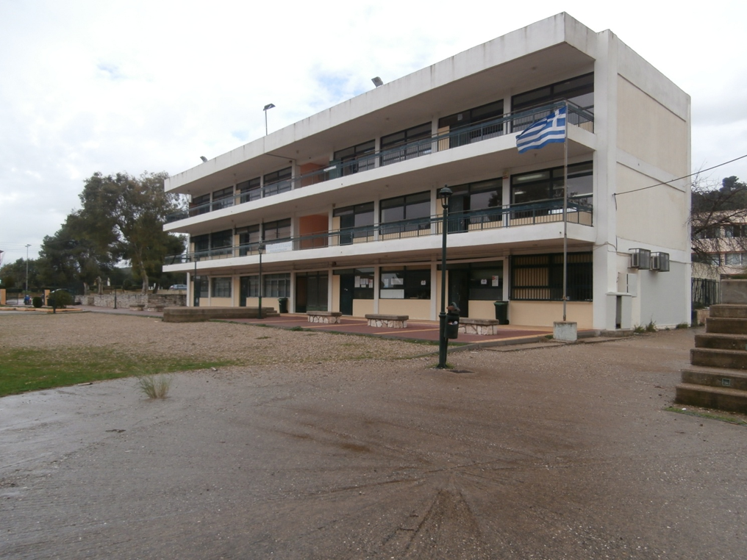
PELOPIO HIGH SCHOOL
Our school

Slide 4
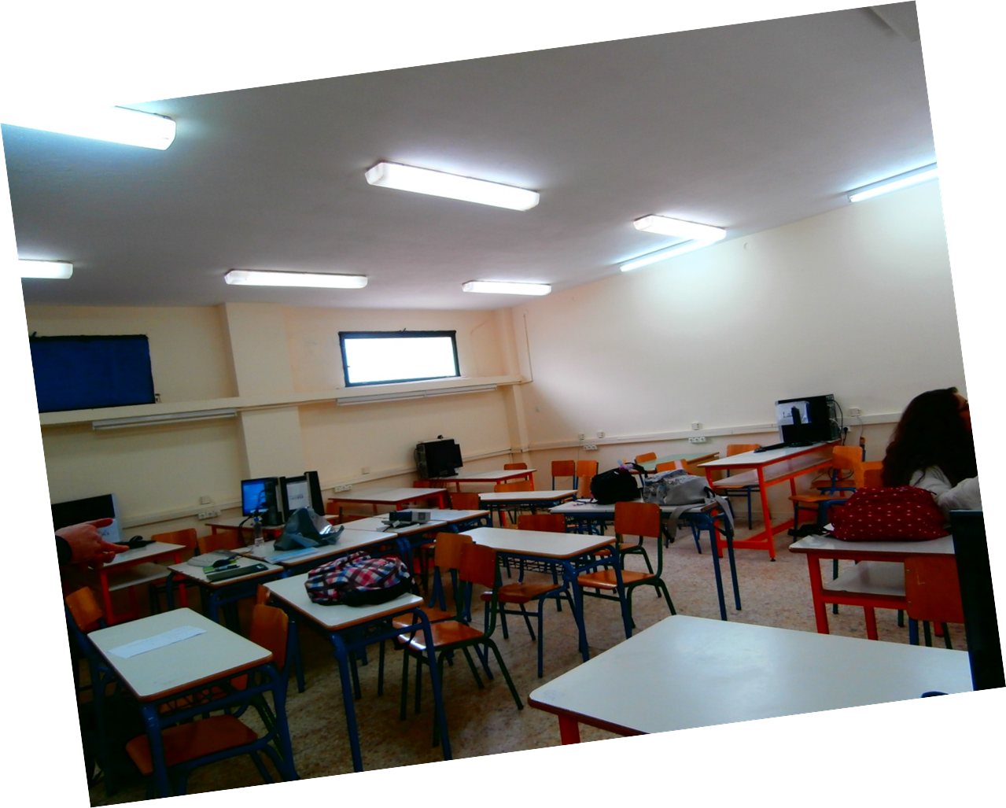
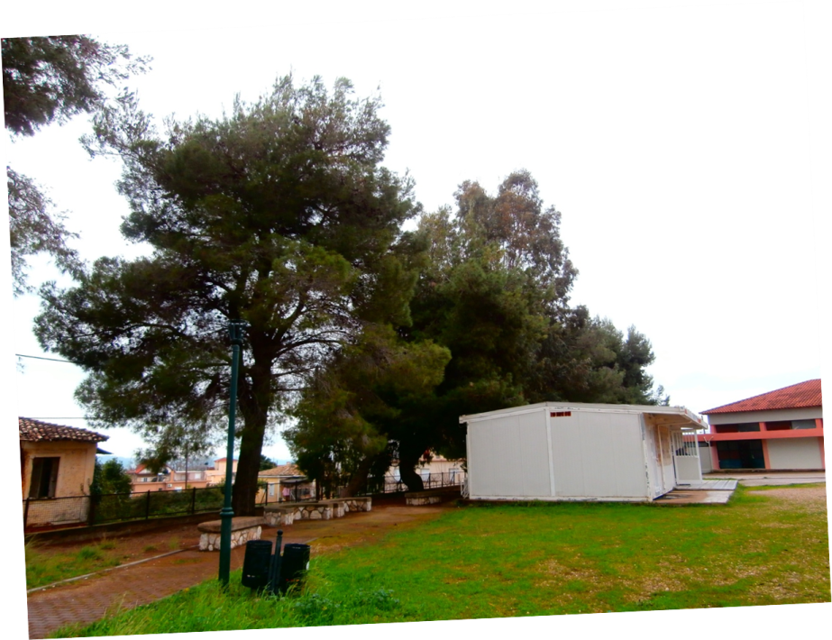
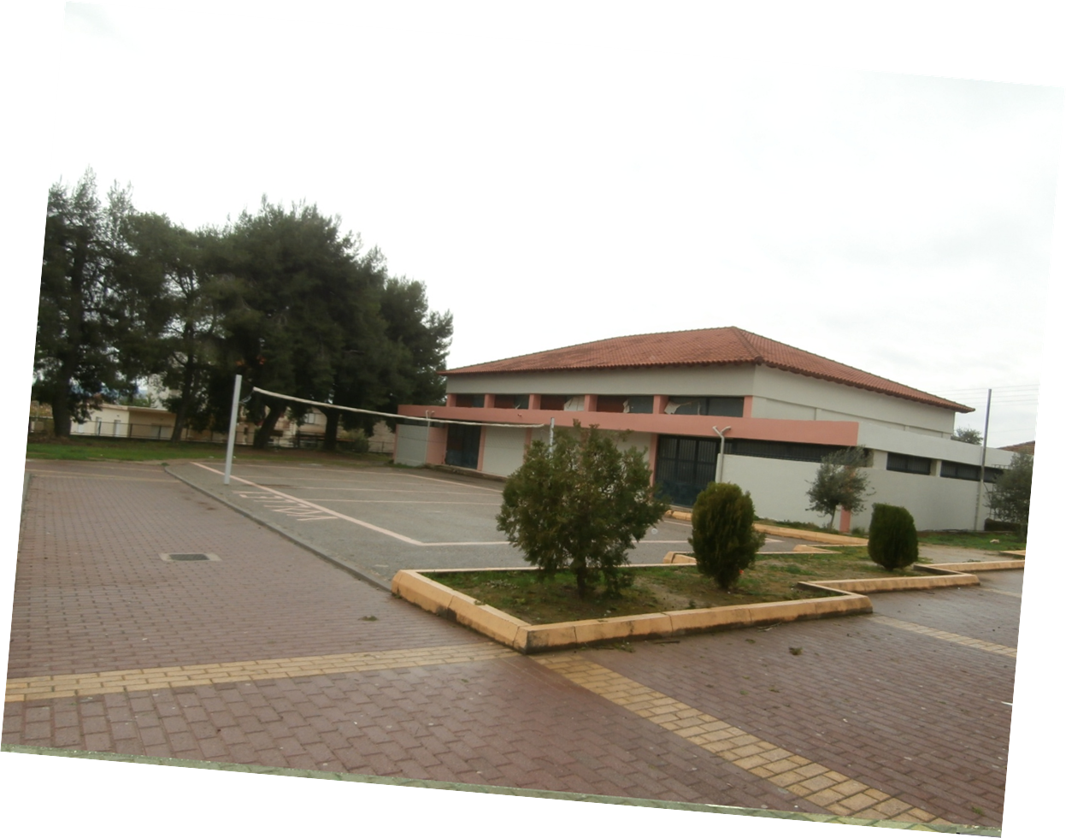
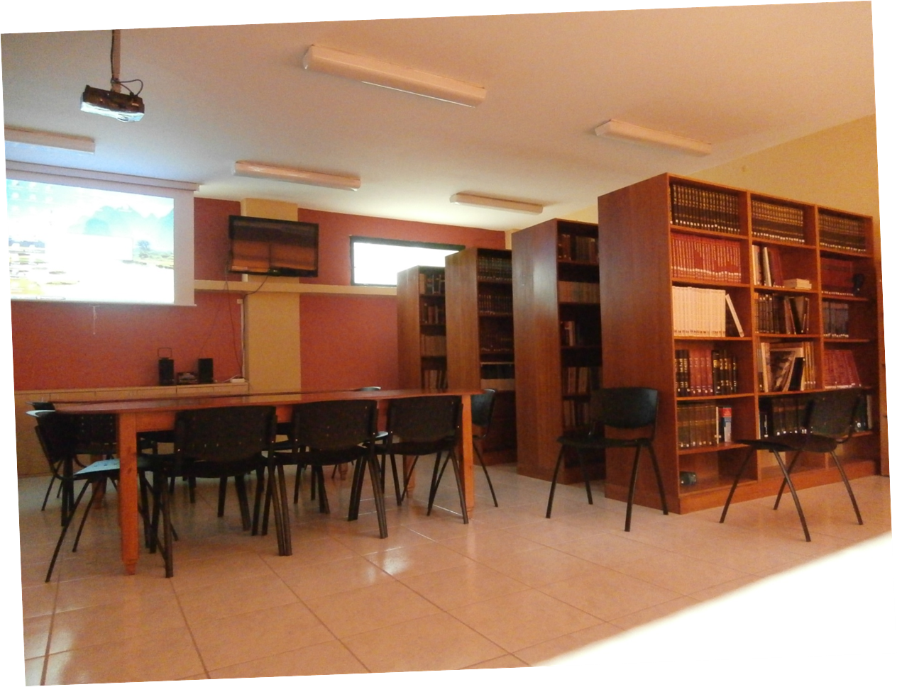
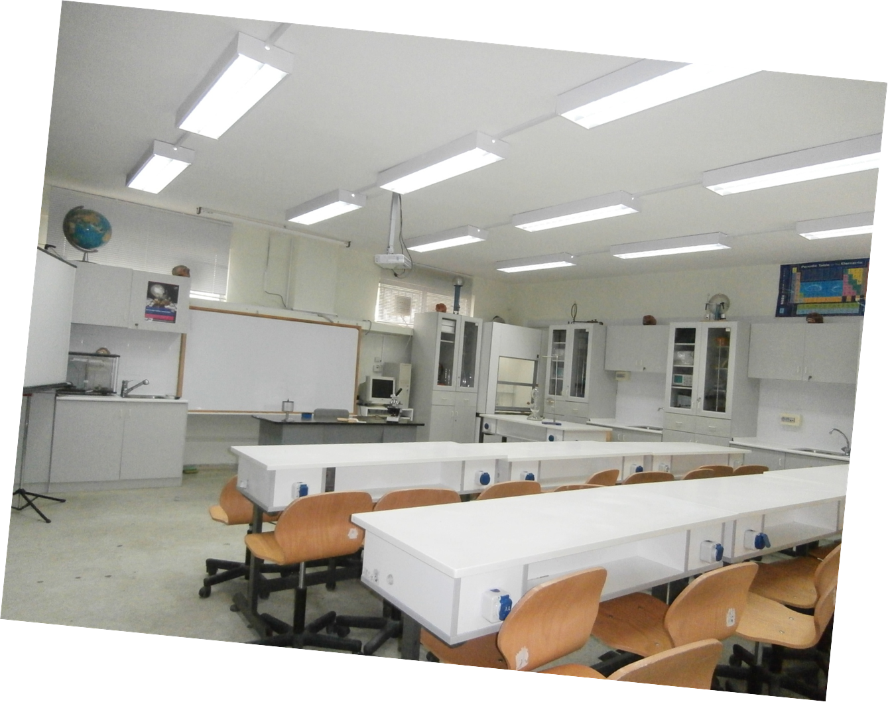

Slide 5
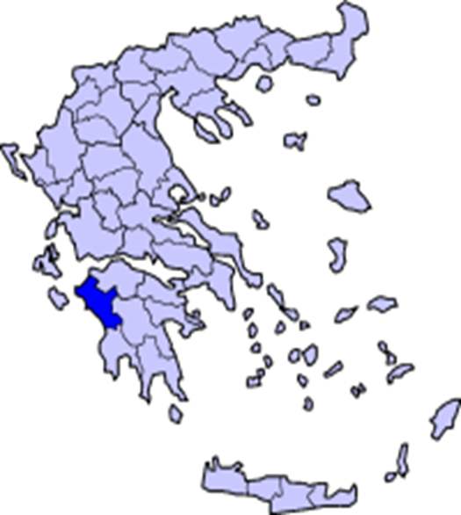
ILEIA, Greece
Ileia is located in Peloponnese.
Capital: Pyrgos

Slide 6
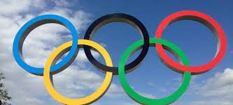
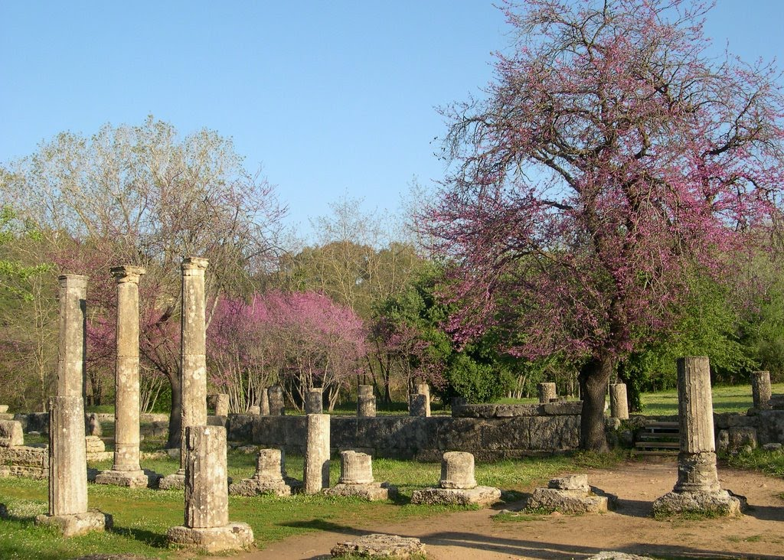
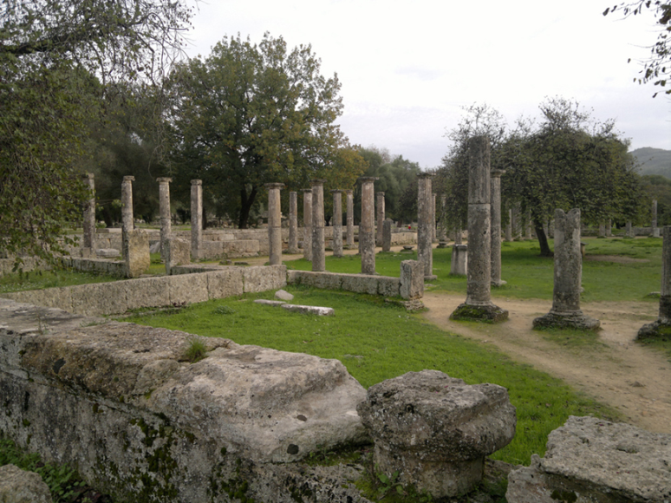
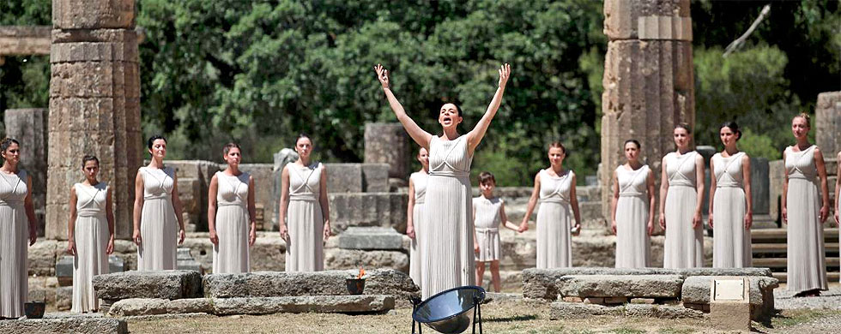
We live in Ancient Olympia, the place where the Olympic Games were born.

Slide 7
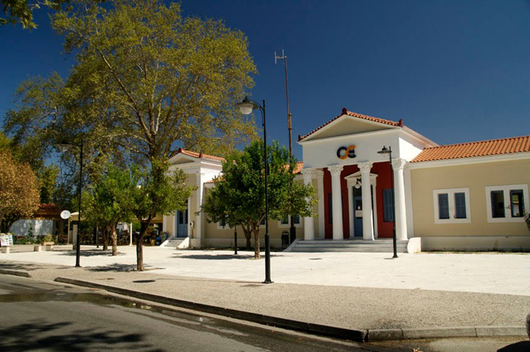
Our region is a very beautiful place. Not only are the archaeological sites unique, but also are there many places to visit and enjoy.

Slide 8
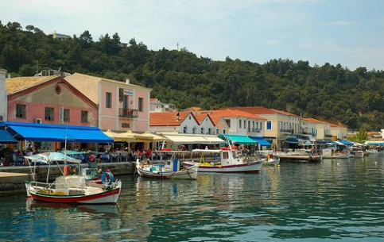
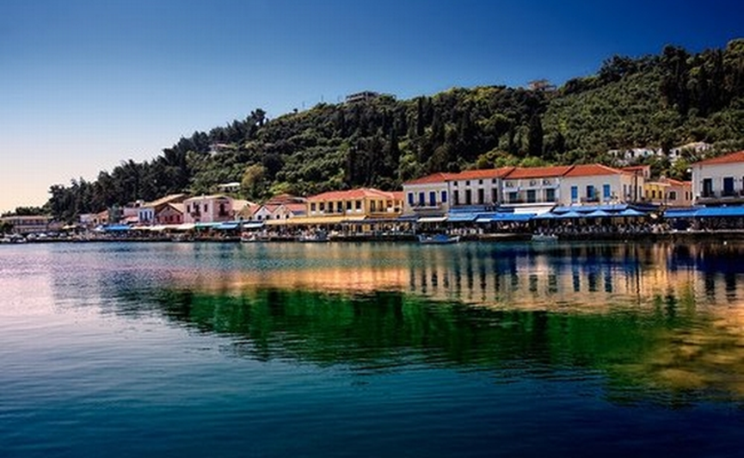
Katakolo is a seaside town in the municipality of Pyrgos in western Elis, Greece. It is situated on a headland overlooking the Ionian sea and separating the Gulf of Kyparissia from the rest of the Ionian. It is 11 km west of downtown Pyrgos. The small village of Agios Andreas, which in ancient times was the natural harbour for Ancient Olympia, lies northwest of Katakolo. A railway connects Katakolo with Pyrgos and Olympia.

Slide 9
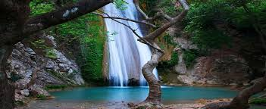
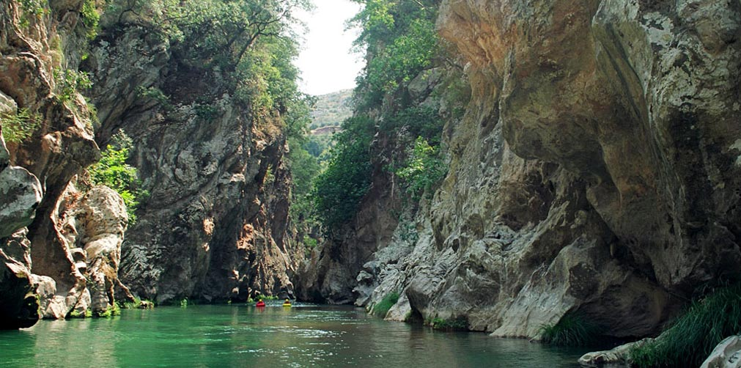
The Neda is a river in the western Peloponnese in Greece. It is unique in the sense that it is the only river in Greece with a feminine name.

Slide 10
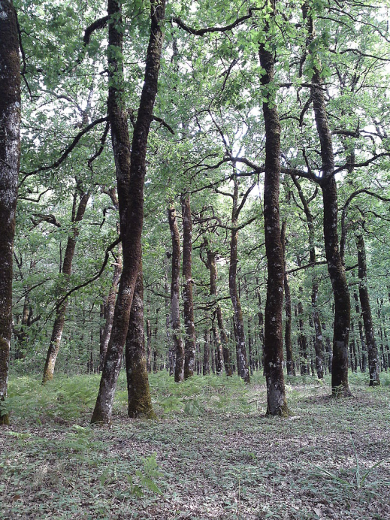
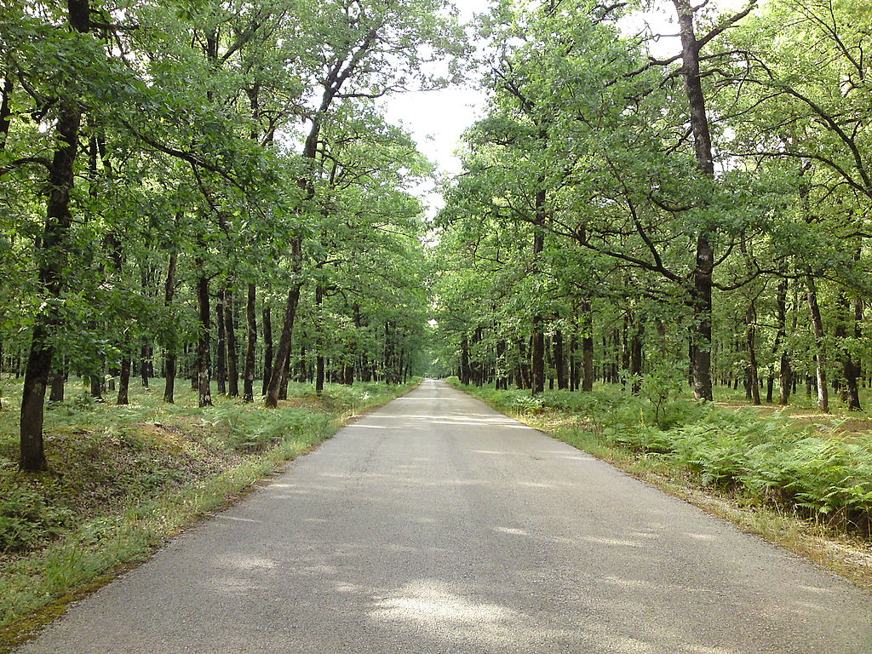
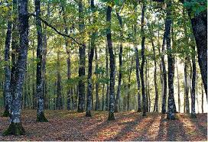
The Foloi oak forest is an oak forest in southwestern Greece. It is located in the municipal unit Foloi, Elis, in the western part of the Peloponnese peninsula. It is an ecosystem unique in the Balkan peninsula and consists of a territory of 9,900 acres, which is almost entirely covered by deciduous oaks that form a dense forest area.

Slide 11
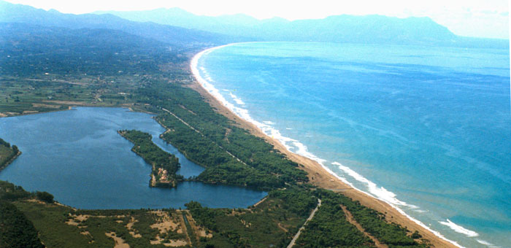
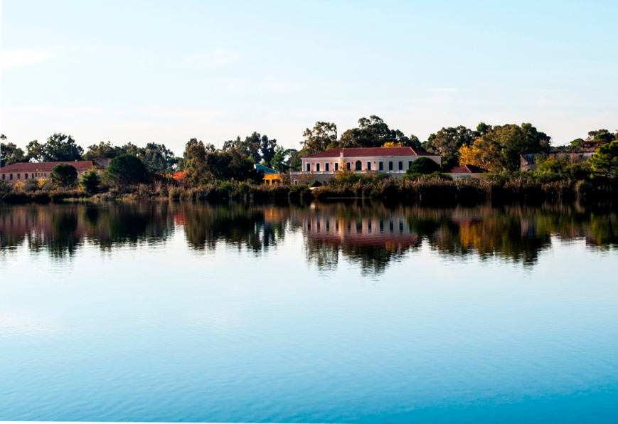
Kaiafas lake is a lake in Elis in southwestern Greece, extending north of the town of Zacharo. It lies between the Lapithas Mountains and the Ionian Sea.

Slide 12
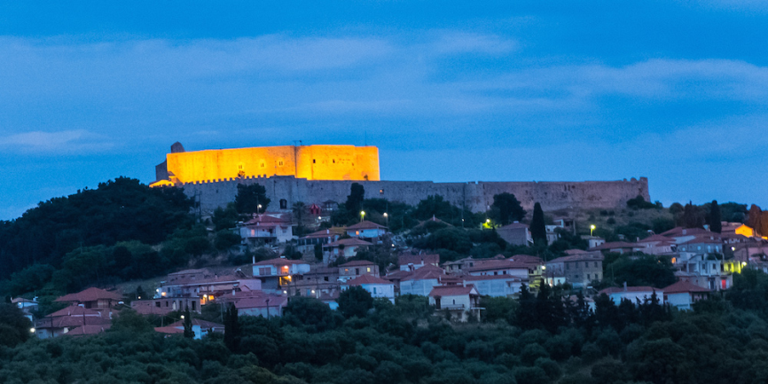
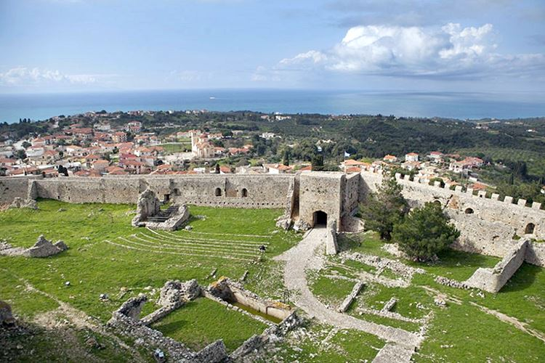
Chlemoutsi is a medieval castle in the northwest of the Elis regional unit in the Peloponnese peninsula of southern Greece, in the Kastro-Kyllini municipality.

Slide 13
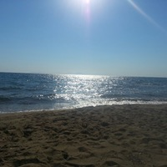
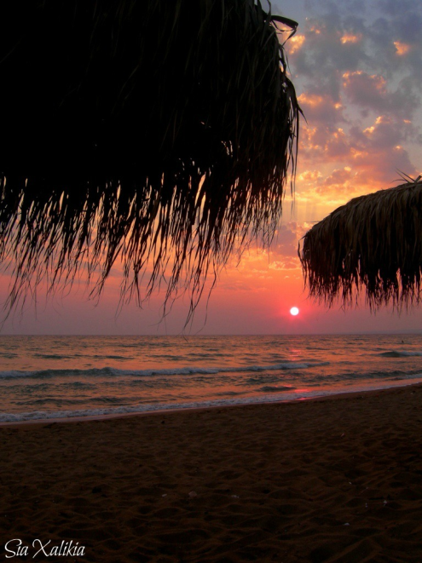
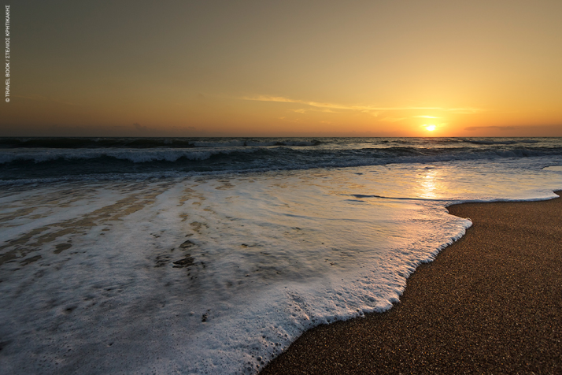
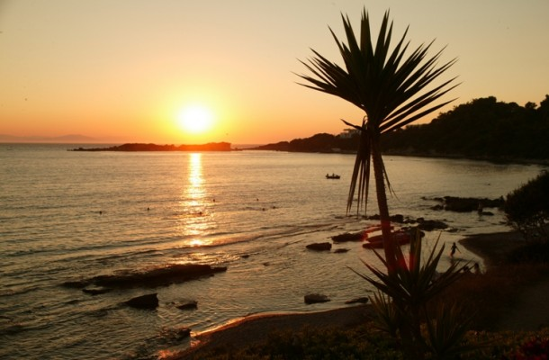
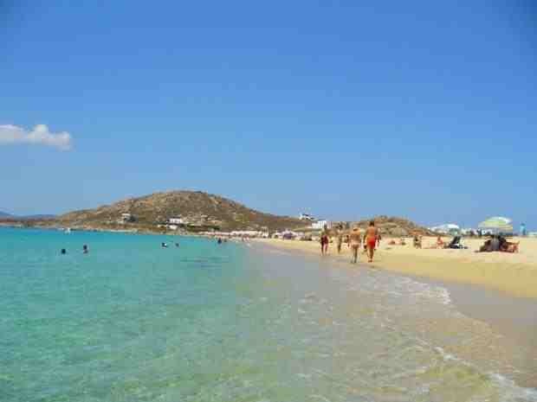
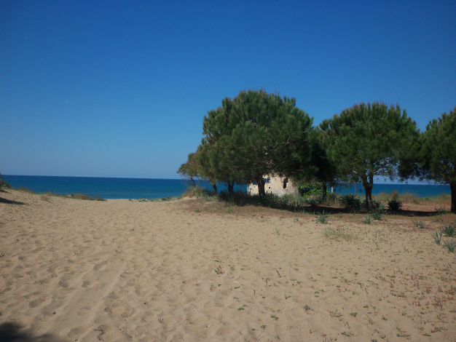
Our beaches are also wonderful

Slide 14
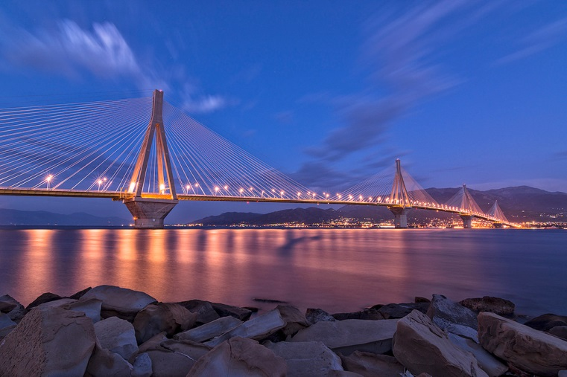
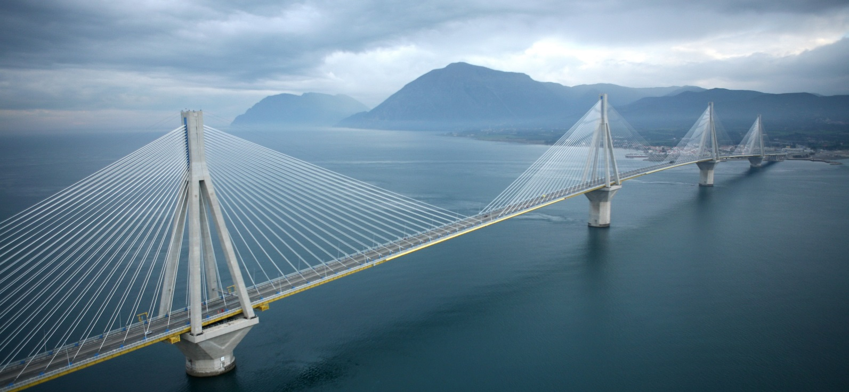
The Rio–Antirrio Bridge officially the Charilaos Trikoupis Bridge after the statesman who first envisaged it, is one of the world's longest multi-span cable-stayed bridges and the longest of the fully suspended type. It crosses the Gulf of Corinth near Patras, linking the town of Rio on the Peloponnese peninsula to Antirrio on mainland Greece by road.

Slide 15
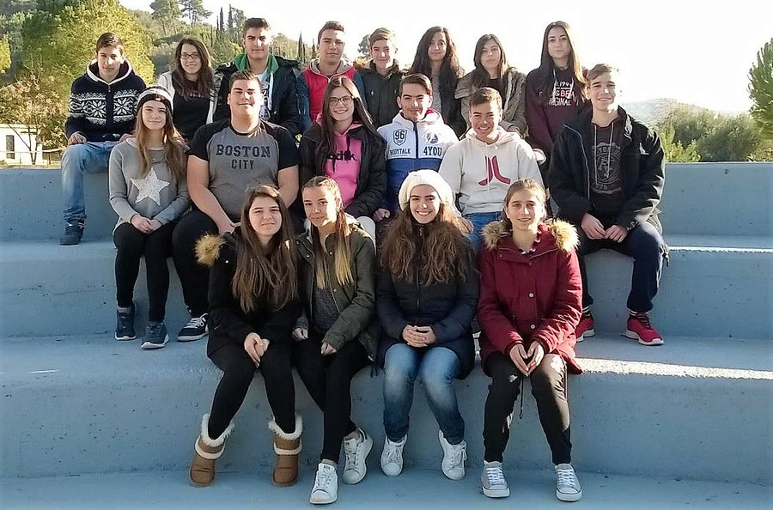
We are all looking forward to seeing you in our country and town!
Asimakopoulou Vasiliki
Droulia Athina
Roumelioti Zoi
Roumeliotis Giorgos
Foteinou Dimitra
and teachers.

