Slide 1
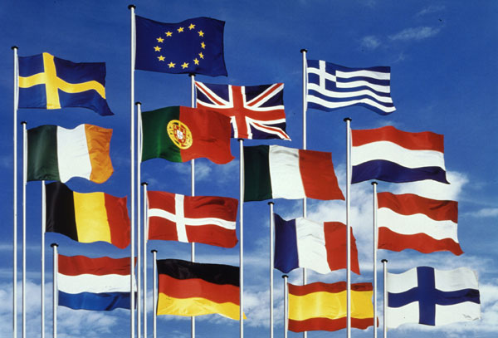
ERASMUS+

Slide 2
Cuando La Tierra Tiembla Estamos Preparados

Slide 3
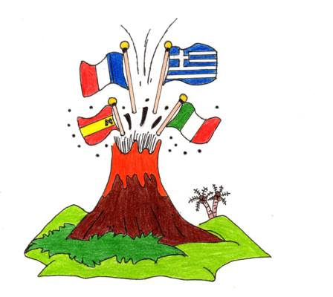

Slide 4
The volcano Vesuvius (Naples), whose eruption buried the Roman cities of Herculaneum and Pompeii in 79 AD.
Students:Vittoria Clemente Vasiliki Asimakopoulou

Slide 5
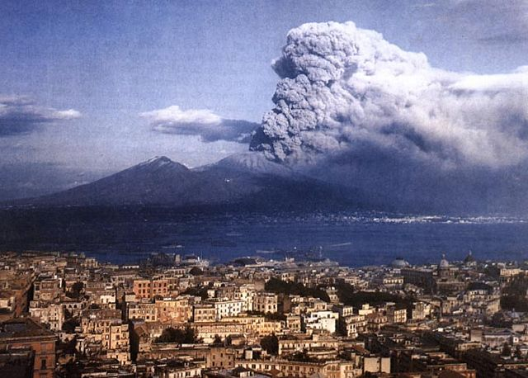
VESUVIUS
Mount Vesuvius is a volcano located on the Gulf of Naples in Campania, Italy, about 9 km east of Naples and a short distance from the shore.
Vesuvius is most famous for the 79 AD eruption which destroyed the Roman cities of Pompeii and Herculaneum.

Slide 6
POMPEII

Slide 7
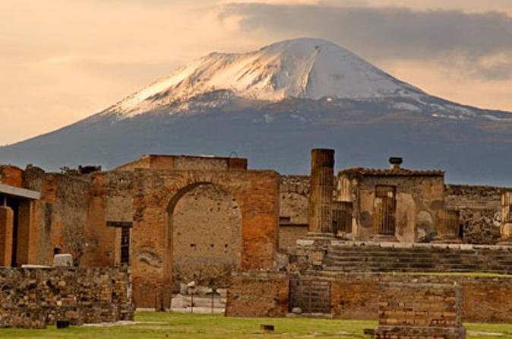

Slide 8
Pompeii was an ancient Roman town-city near modern Naples
in the Campania region of Italy, in the territory of the commune
of Pompeii.
Pompeii, along with Herculaneum and many villas in the
surrounding area, was mostly destroyed and buried under
4 to 6 m (13 to 20 ft) of volcanic ash and pumice in the
eruption of Mount Vesuvius in 79 AD.

Slide 9
In the roman years population of Pompeii was estimated at 11,000
people, and the city had a complex water system, an amphitheatre,
gymnasium, and a port.
The eruption destroyed the city, killing its inhabitants and burying
it under tons of ash.

Slide 10
The objects that lay beneath the city have been preserved for centuries because of the lack of air and moisture. These artefacts provide an extraordinarily detailed insight into the life of a city during the Pax Romana.
During the excavation, plaster was used to fill in the voids in the ash layers that once held human bodies. This allowed archaeologists to see the exact position the person was in when he or she died.

Slide 11
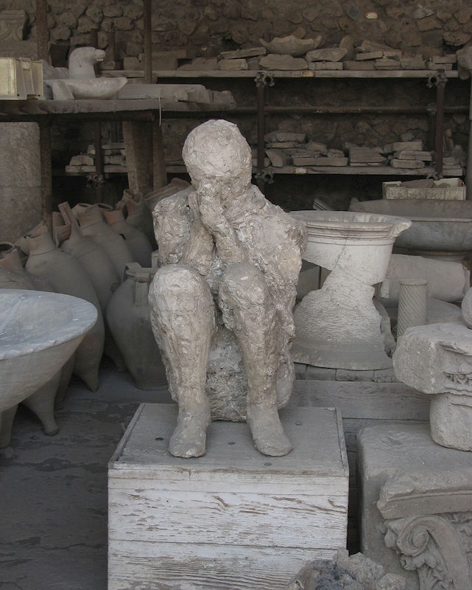
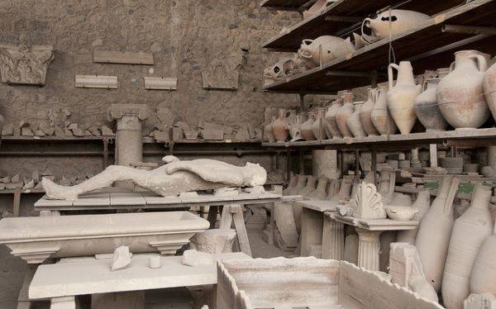
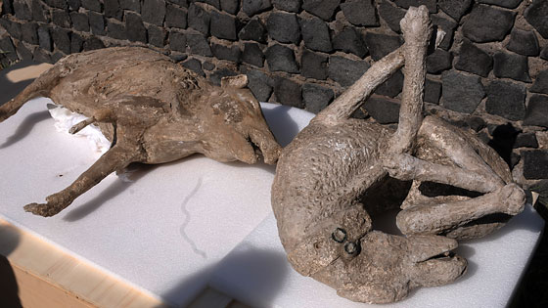

Slide 12
HERCULANEUM

Slide 13
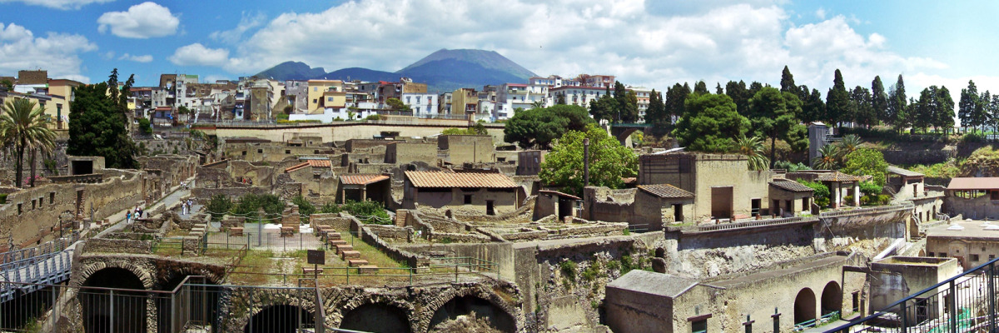

Slide 14
Ancient tradition connected Herculaneum with the name
of the Greek hero Herakles an indication that the city was
of Greek origin.
Located in the shadow of Mount Vesuvius, Herculaneum
(Italian: Ercolano) was an ancient Roman town destroyed
by volcanic pyroclastic flows in 79 AD. Its ruins are located
in the commune of Ercolano, Campania, Italy.

Slide 15
Located in the shadow of Mount Vesuvius, Herculaneum
(Italian: Ercolano) was an ancient Roman town destroyed by
volcanic pyroclastic flows in 79 AD. Its ruins are located in the
commune of Ercolano, Campania, Italy.
As a UNESCO World Heritage Site, it is famous as one of the few
ancient cities that can now be seen in much of its original
splendour, as well as for having been lost, along with Pompeii,
Stabiae, Oplontis and Boscoreale, in the eruption of Mount
Vesuvius in AD 79 that buried it. Unlike Pompeii, the deep
pyroclastic material which covered it preserved wooden and
other organic-based objects such as roofs, beds, doors, food and
even some 300 skeletons which were discovered in recent years
along the seashore. It had been thought until then that the town
had been evacuated by the inhabitants.
Herculaneum was a wealthier town than Pompeii, possessing an
extraordinary density of fine houses with, for example, far more
lavish use of coloured marble cladding.

Slide 16
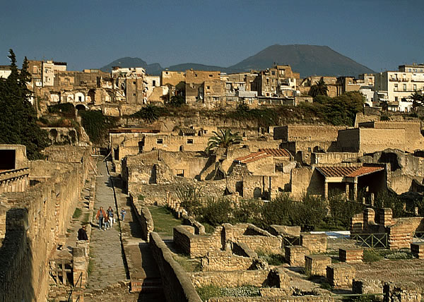
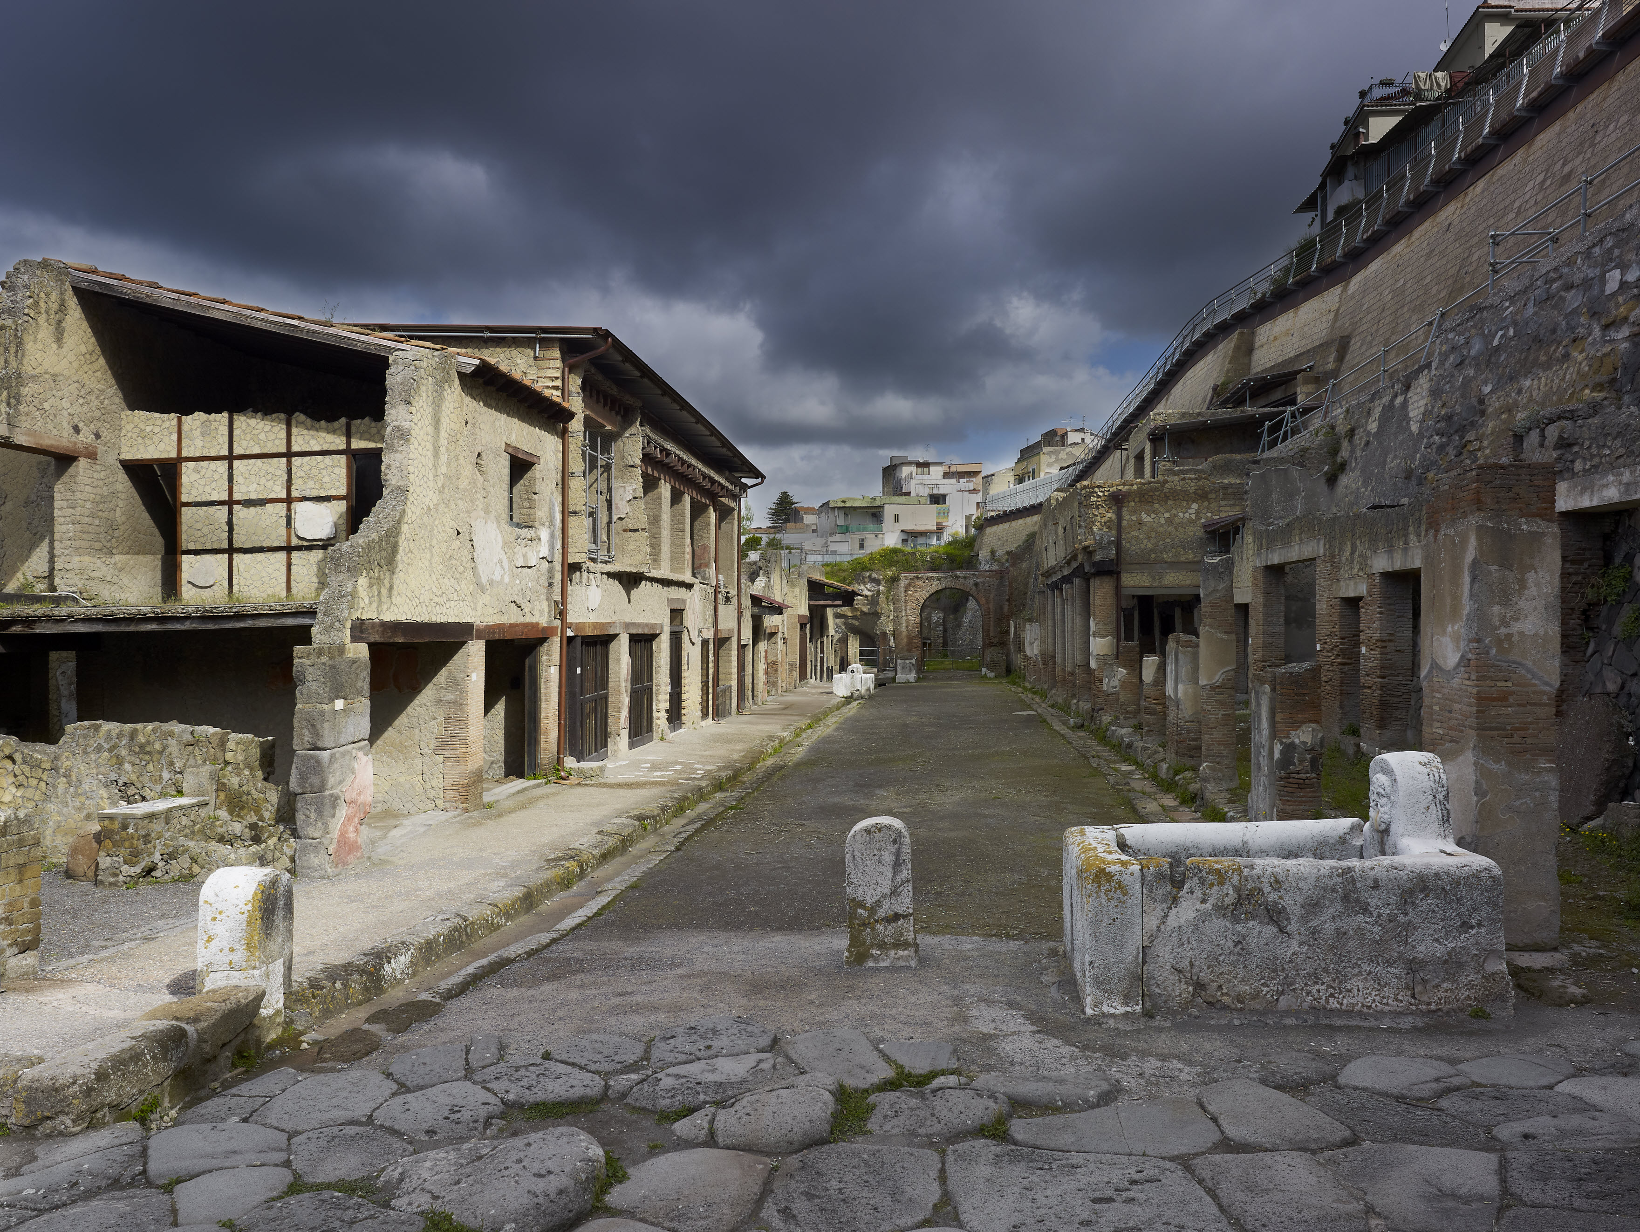
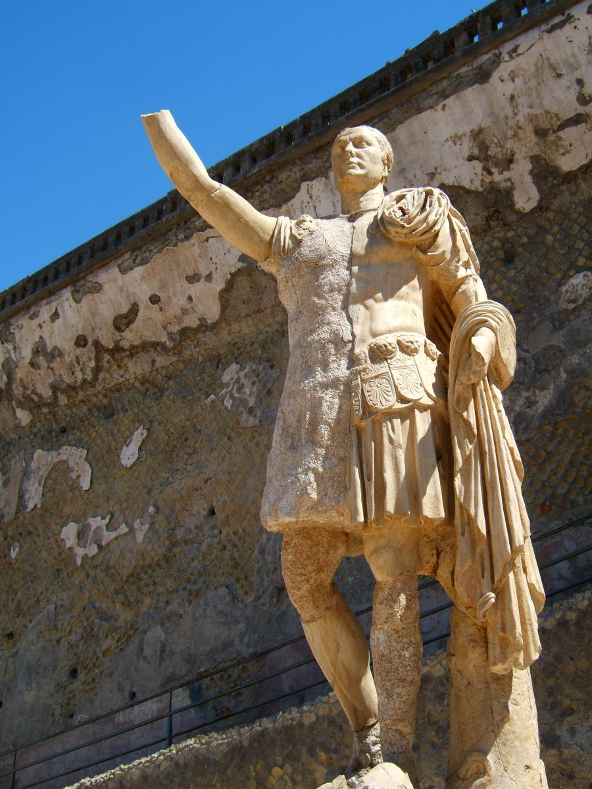

Slide 17
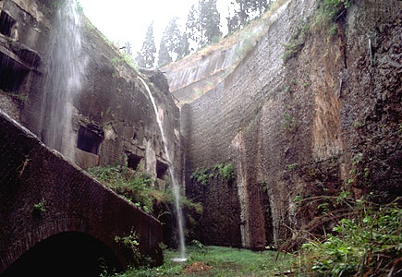
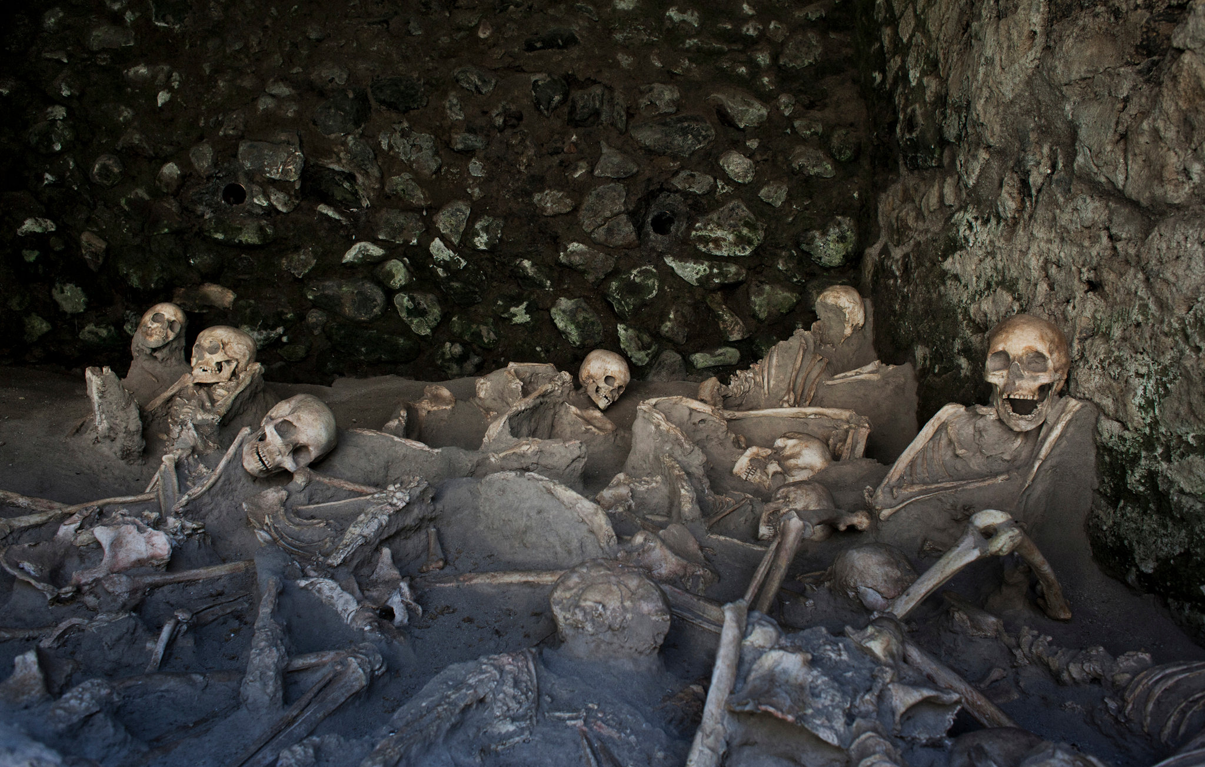

Slide 18
Thank you for your attention!!!!!

Slide 19
ERASMUS 2017
What if the earth shakes are we ready?

Slide 20
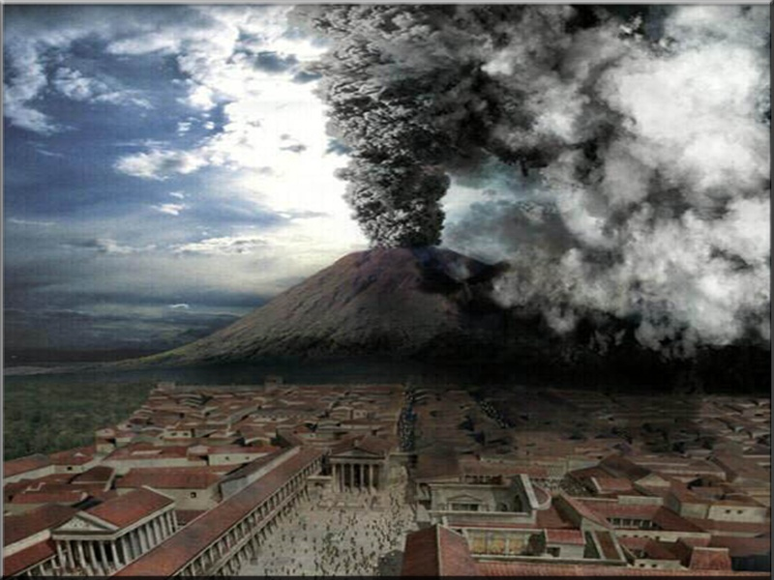
The eruption of Vesuvius in 79 AD

Slide 21
The Vesuvius is a mountain-volcano on the western coast of Italy and 12 km from Naples. By 79 AD it was considered as a single mountain. The first eruption of Vesuvius according to historians, who totally destroyed and disappear into the lava of the three major cities!

Slide 22
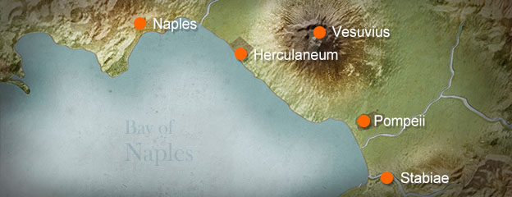

Slide 23
Around 13:00 on August 24, Vesuvius began spewing volcanic ash and stone thousands of meters into the sky. The winds prevailing at the time blew toward the southeast, causing the volcanic material to fall mainly in the city of Pompeii and the surrounding area. From Herculaneum lay to the west of Vesuvius, hardly it affected by the first phase of the eruption.

Slide 24
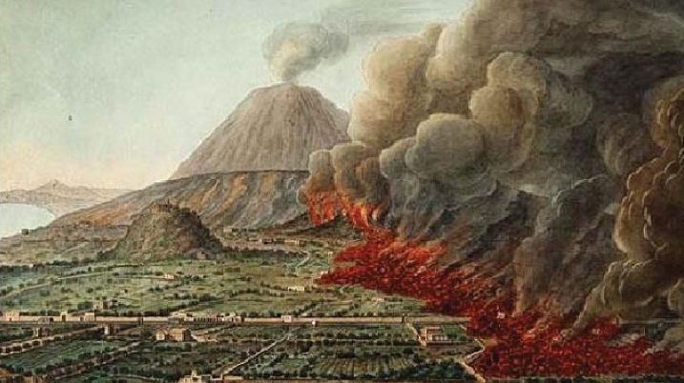

Slide 25
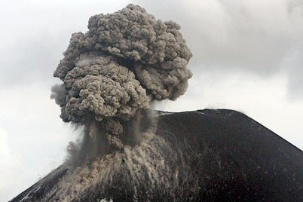
Vesuvius spewed a deadly cloud of volcanic gas, rocks and ash to a height of 33 km (21 miles), ejection of molten rock and powdered pumice of 1.5 million tonnes per second, finally, releasing a hundred thousand times the thermal energy of the bombardment of Hiroshima.

Slide 26
.
.

Slide 27
When "awakened" Vesuvius earth began to tremble from earthquakes, so some residents terrified left Pompeii. The following days thick clouds of poisonous gases coming out of the crater and ejected rocks. Ash covered the surrounding area and many people died from suffocation. Eventually, a thick layer of lava has covered Pompeii and those not caught up with him to escape.

Slide 28
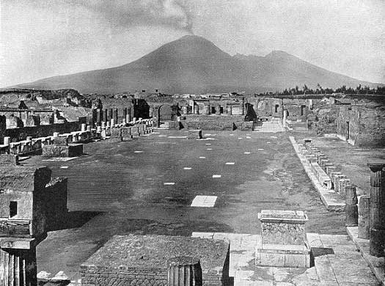

Slide 29
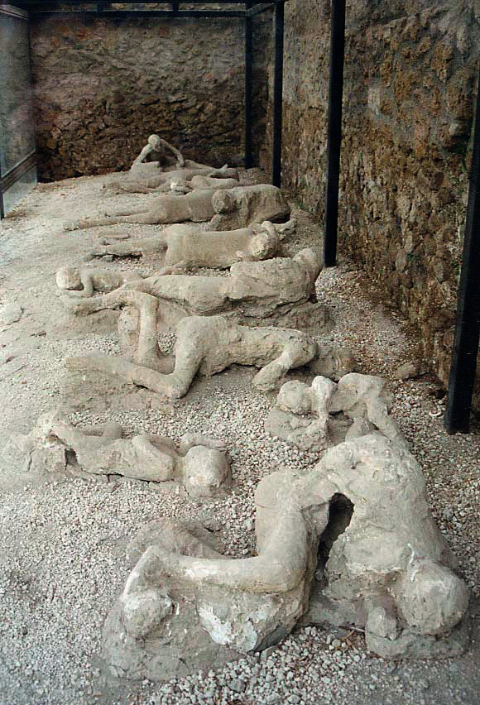
Many Roman settlements erased and buried under huge waves of pyroclastic and ashfall deposits, the most famous Pompeii and Herculaneum.

Slide 30
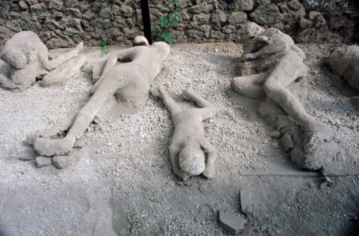
The remains of about 1,500 people have been found in Pompeii and Herculaneum, but the total number of dead is still unknown.

Slide 31
Recent interdisciplinary research on the lethal effects of pyroclastic surge in the Vesuvius area showed that in the area of Pompeii and Herculaneum, heat was the main cause of death of people who were previously believed to have died from suffocation ash. This study shows that exposure to waves, measuring at least 250 ° C, even at a distance of 10 kilometers from the vent was enough to cause the instantaneous death of all residents, even if it was protected inside buildings.

Slide 32
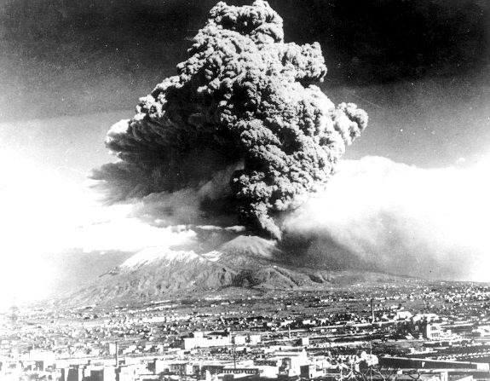

Slide 33
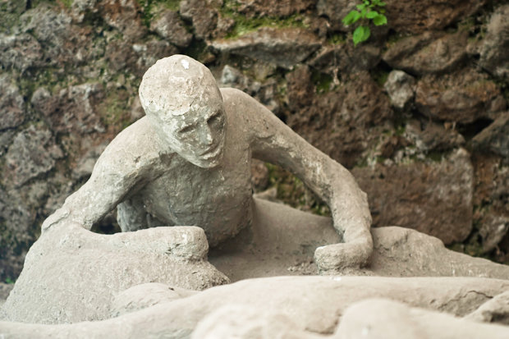
Years later archaeologists in excavations brought to light once the destroyed city and the skeletons of the people as it was at the time found their death. They made casts of their bodies, which impress every visitor.

Slide 34
But for think about that the inhabitants of Naples have to love too much this place, because they not leave but stay and do not leave their homes, although they have a volcano that makes various earthquakes and eruptions.

Slide 35
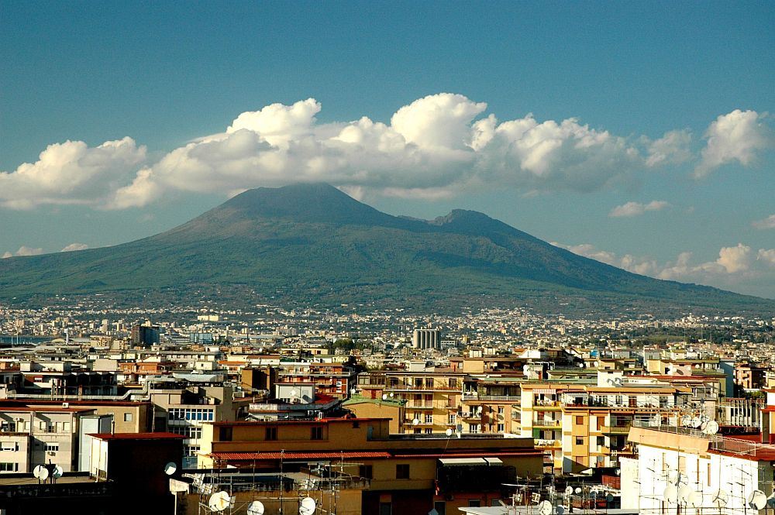
Vesuvius today!

Slide 36
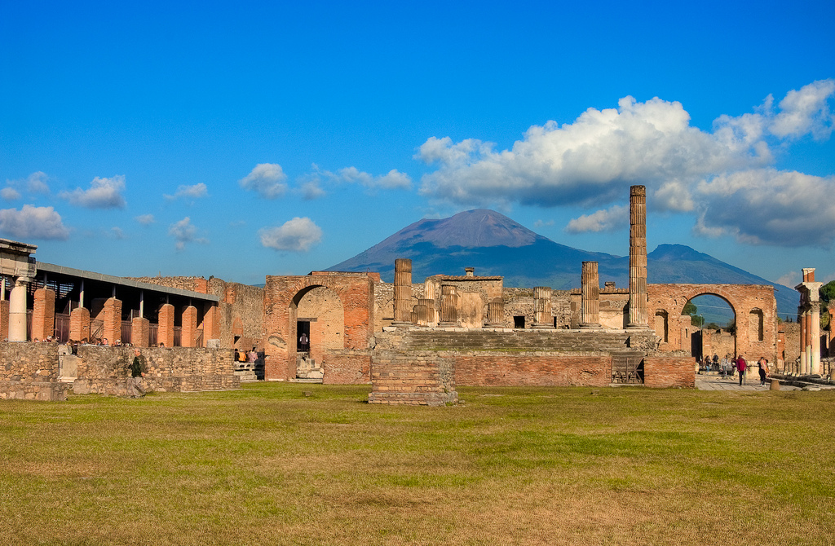

Slide 37
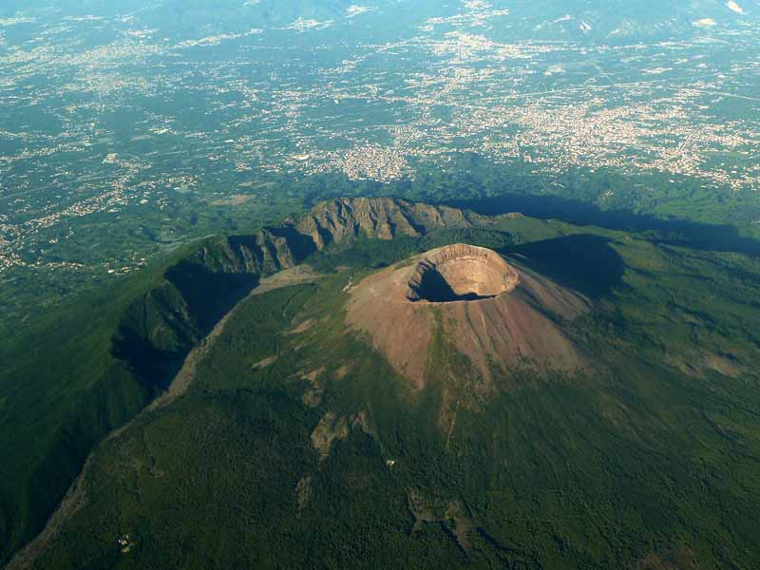
AΤΗΙΝΑ DROULIA
ASSUNTA DAMIANO

Slide 38
ERASMUS+
IF THE EARTH SHAKES! WILL YOU BE READY?
Veronica De Simone
Dimitra Foteinou

Slide 39
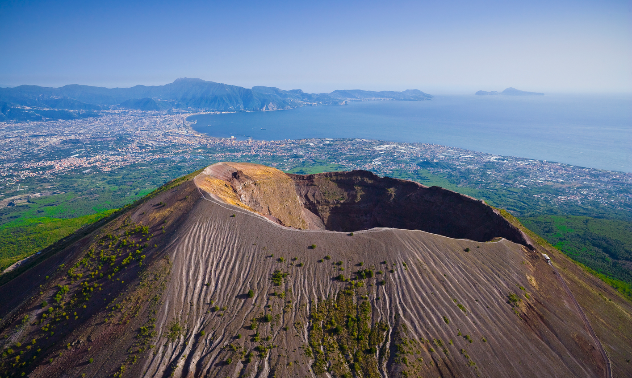
VESUVIUS ERUPTION IN 79 AD
Effects of ashes and gases in the Roman city of Pompeii

Slide 40
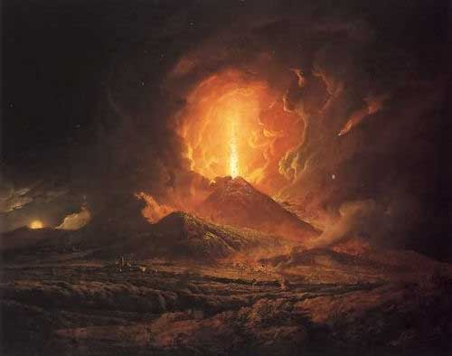
Mount Vesuvius, on the west coast of Italy, is the only active volcano on mainland Europe. It is best known because of the eruption in A.D. 79 that destroyed the cities of Pompeii and Herculaneum. Mount Vesuvius is considered to be one of the most dangerous volcanoes in the world due to the large population of the city of Naples and the surrounding towns on the slopes nearby.

Slide 41
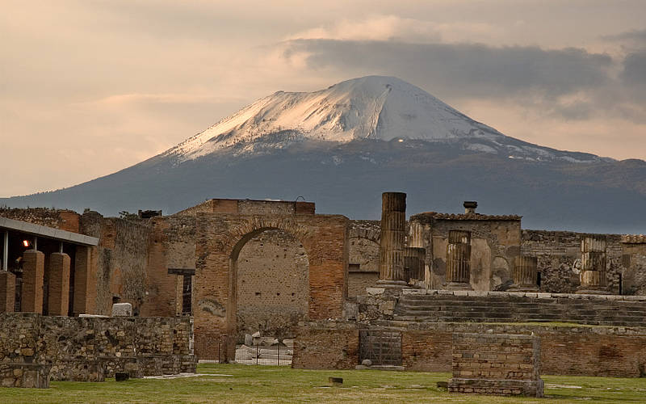
Mount Vesuvius destroyed the city of Pompeii in A.D. 79. Because the city was buried so quickly by volcanic ash, the site is a well-preserved snapshot of life in a Roman city.

Slide 42
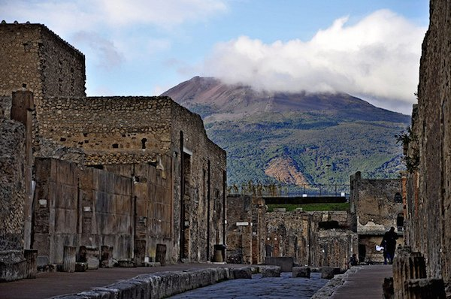
Pompeii was slowly recovering from a major earthquake that rocked the city in February of A.D. 62. The shallow quake, originating beneath Mount Vesuvius, had caused major damage to the springs and piping that provided the city’s water. Reconstruction was being carried out on several temples and public buildings.

Slide 43
Because seismic activity was so common in the area, citizens paid little attention in early August of 79 when several quakes shook the earth beneath Herculaneum and Pompeii. People were unprepared for the explosion that took place shortly after noon on the 24th of August. Pliny, watching from the town of Misenum, approximately 13 miles (21 kilometers) from Pompeii, described the massive debris cloud. “It resembled a (Mediterranean) pine more than any other tree. Like a very high tree the cloud went high and expanded in different branches…sometimes white, sometimes dark and stained by the sustained sand and ashes.”

Slide 44
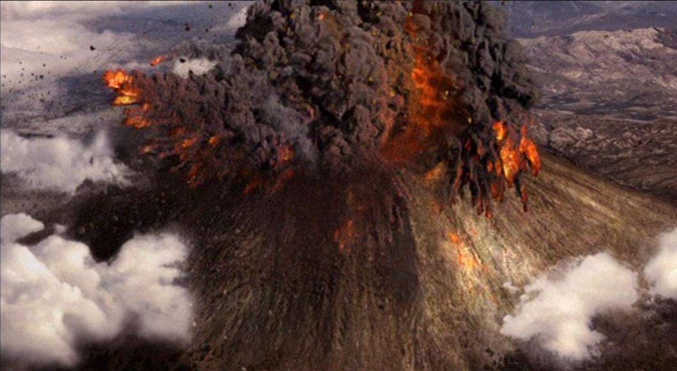
For the next 12 hours, volcanic ash and a hail of pumice stones up to 3 inches in diameter showered Pompeii, forcing the city’s occupants to flee in terror. Some 2,000 people stayed in Pompeii, holed up in cellars or stone structures, hoping to wait out the eruption.

Slide 45
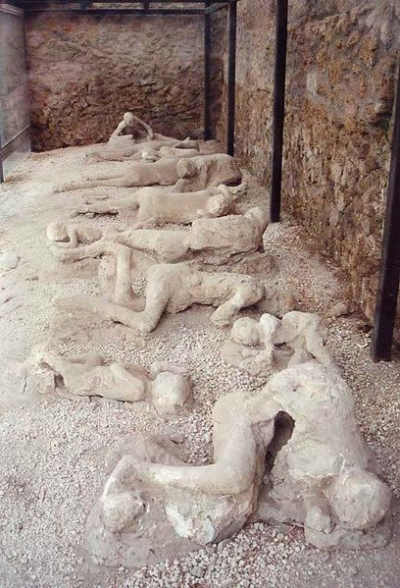
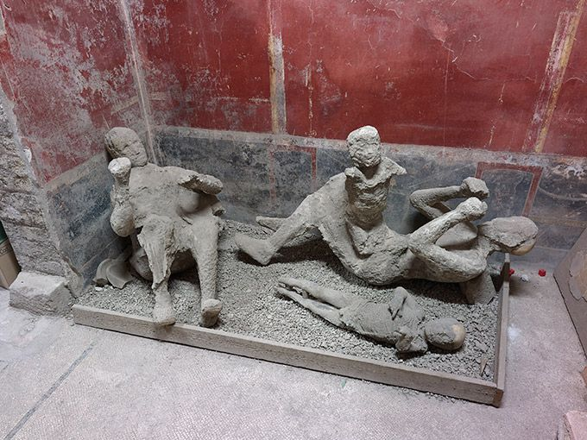
The people who remained in Pompeii were killed on the morning of August 25 when a cloud of toxic gas poured into the city, suffocating all that remained. A flow of rock and ash followed, collapsing roofs and walls and burying the dead.

Slide 46
The percentage of victims (38%) found in this deposit at Pompeii is anomalously high with respect to a mean of 4% of deaths caused by tephra fallout in the last four centuries during explosive eruptions (Blong, 1984; Tanguy et al., 1999). This high percentage of deaths is possibly due to the attempt of some people to take shelter into buildings where roofs and walls collapsed under the load of the pyroclastic material. It is estimated that about 16,000 people died in the eruption.

Slide 47
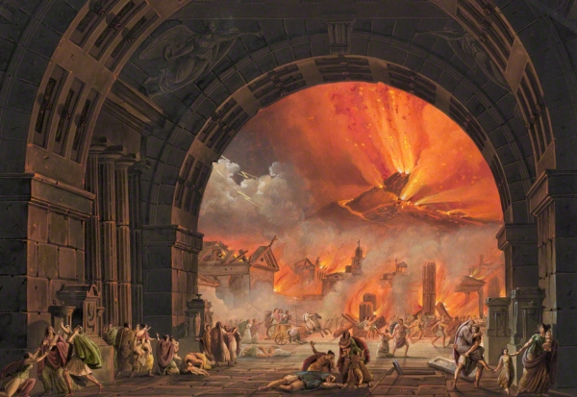
The small percentage of people found dead outdoor within the pumice fall deposit was probably killed by the rumbling roof tiles or by the largest lithic fragments following ballistic paths.

Slide 48
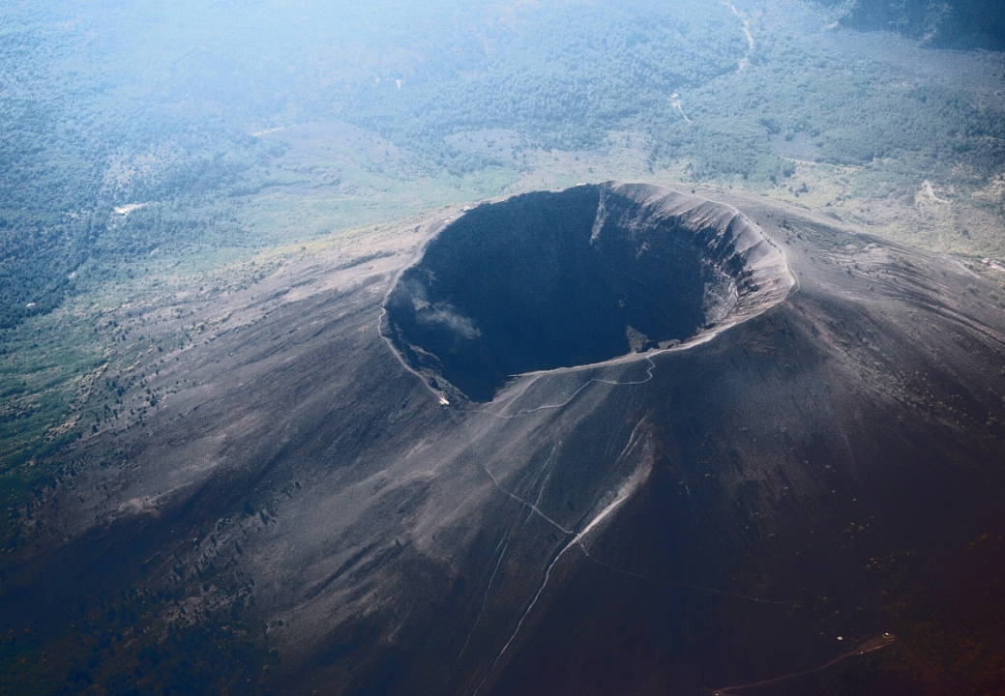
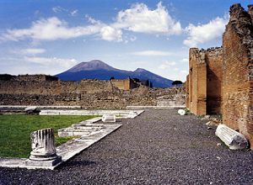

Slide 49
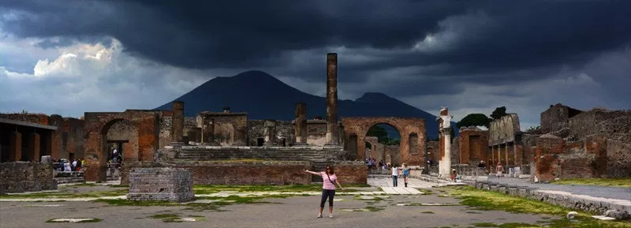
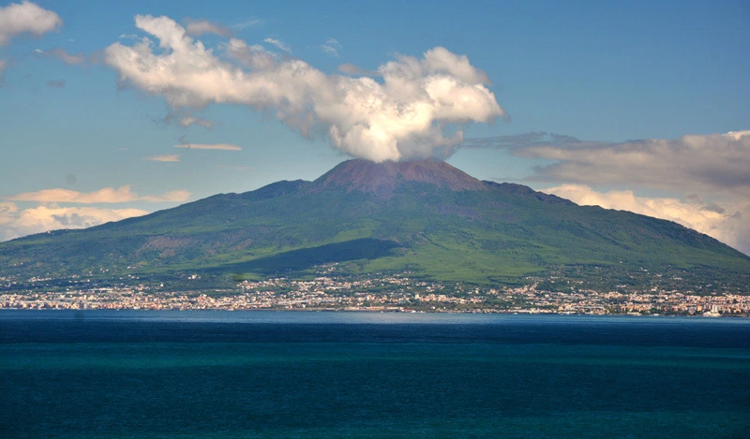

Slide 50
Vesuvius-pompeii

Slide 51
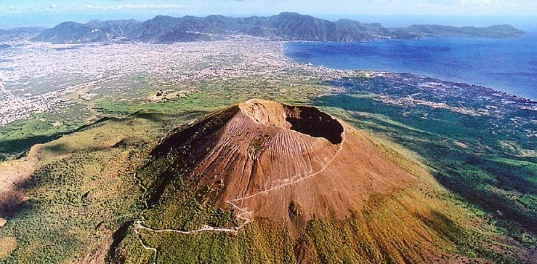
VESUVIUS

Slide 52
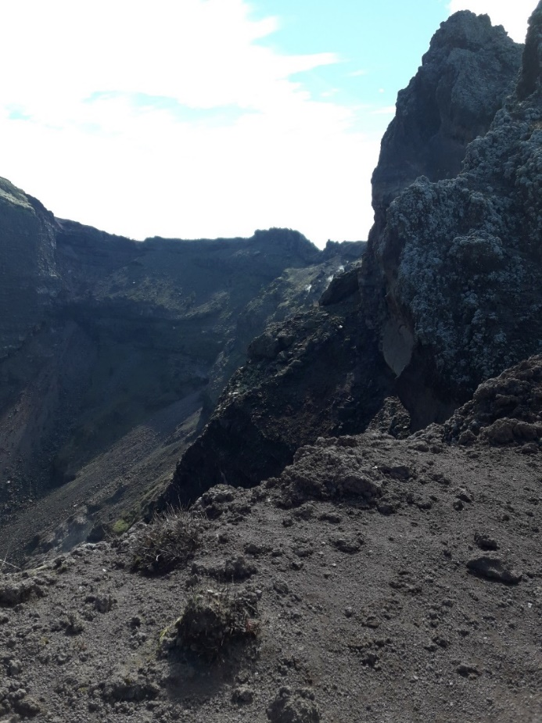
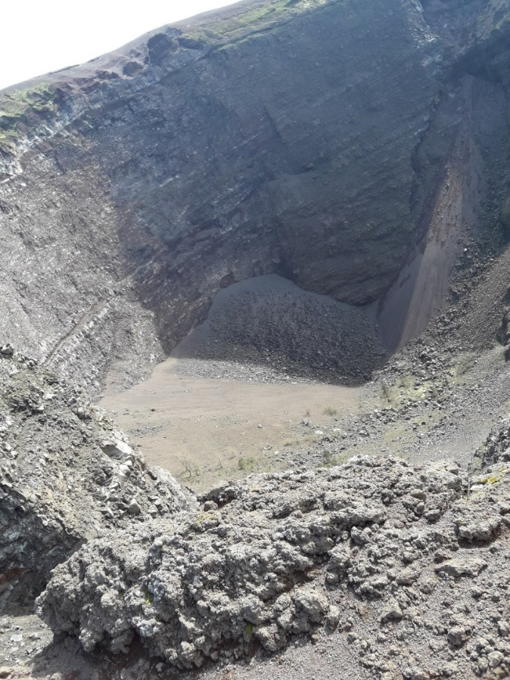
In the third day of our trip we visited Vesuvius.
We walked to the top of the mountain and saw the inside of the volcano.
The view was wonderful and in general everything was very interesting for us.

Slide 53
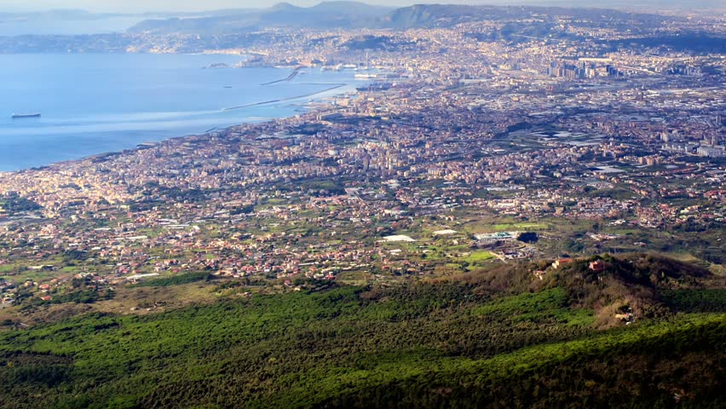

Slide 54
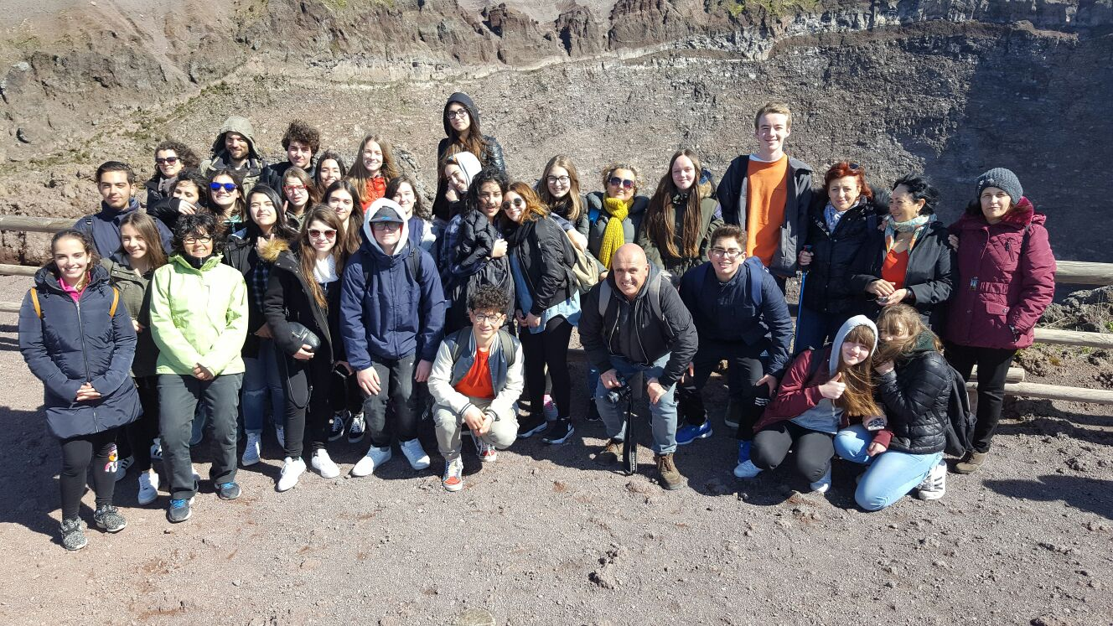
Although we had to walk much, what we saw was very impressive.

Slide 55
POMPEII

Slide 56
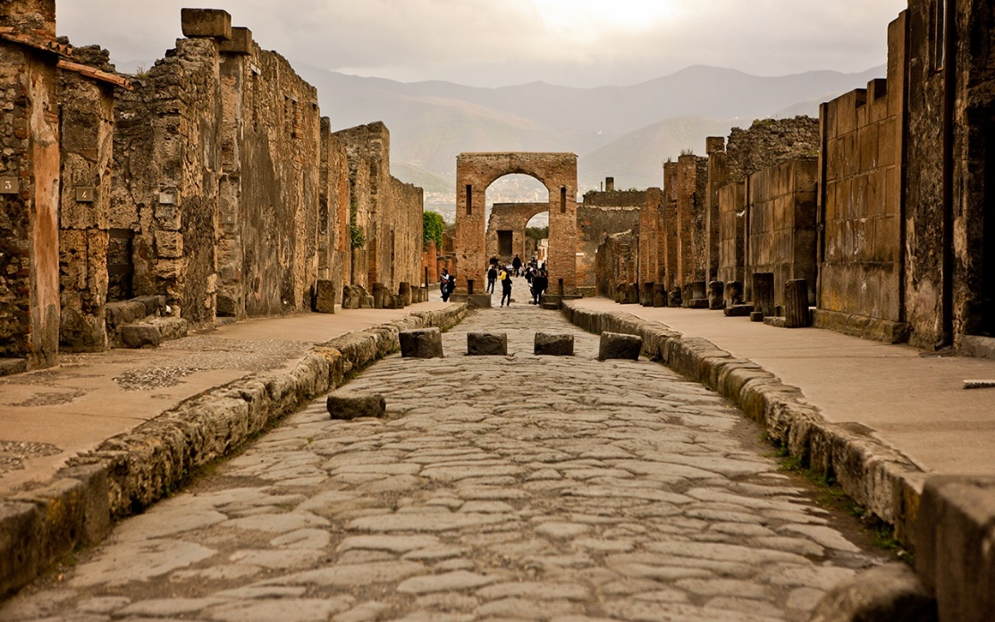
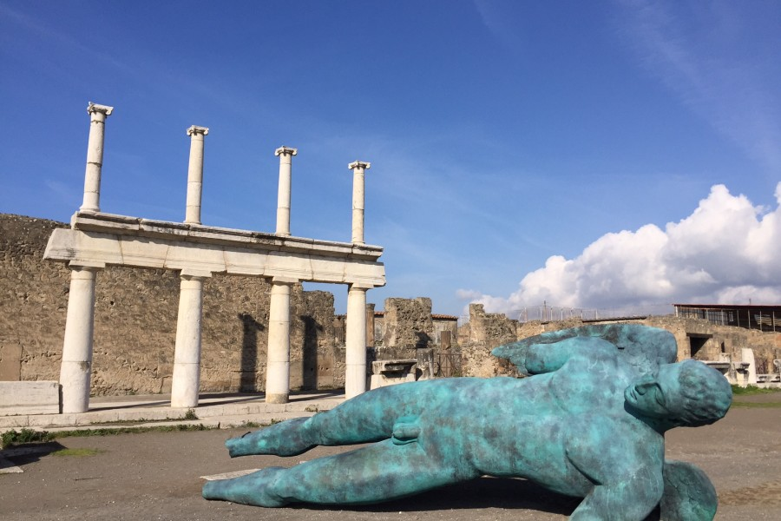
Then we visited Pompeii, an ancient city that was buried
by the Vesuvius eruption in 79 AD.
We walked through the ruins of the ancient city, learned about
how Pompeii was organized, but also took photos…

Slide 57
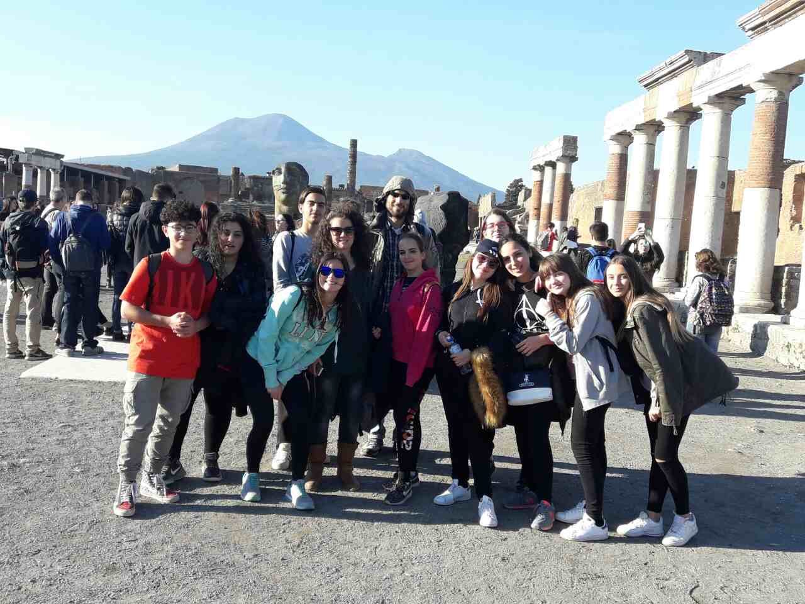

Slide 58
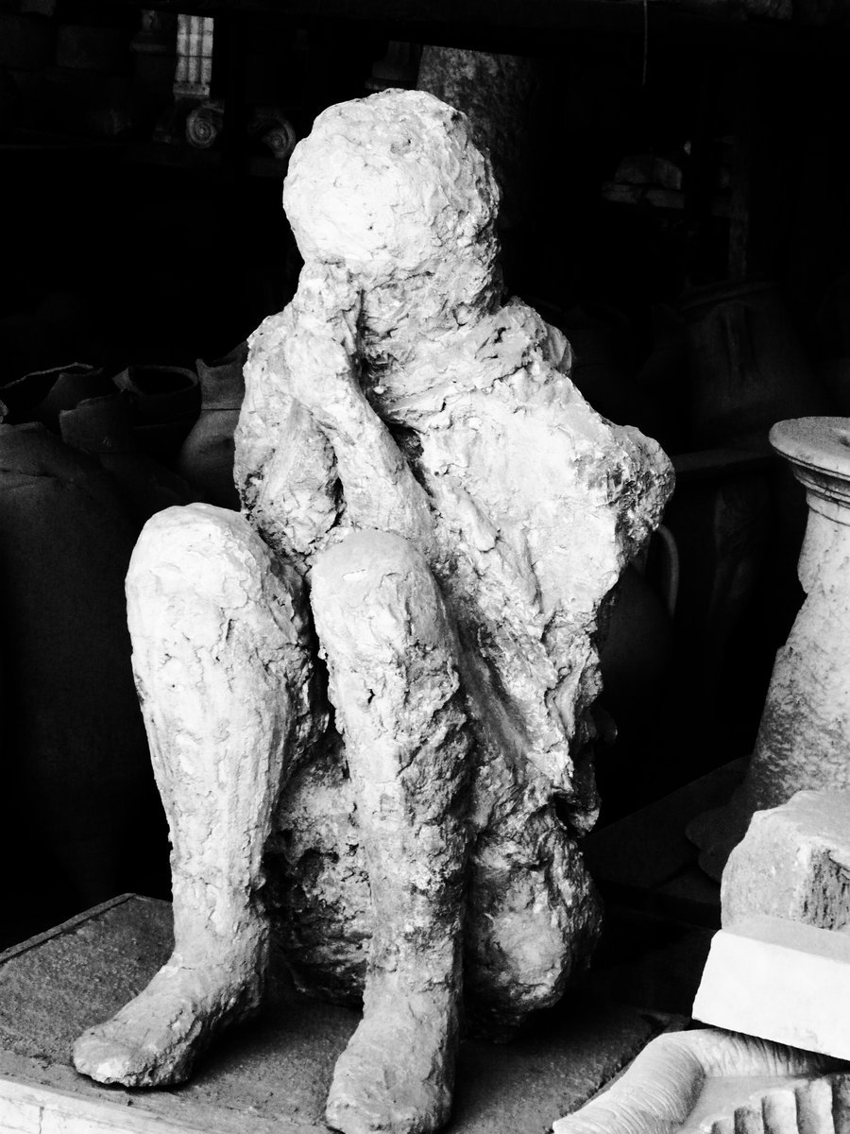
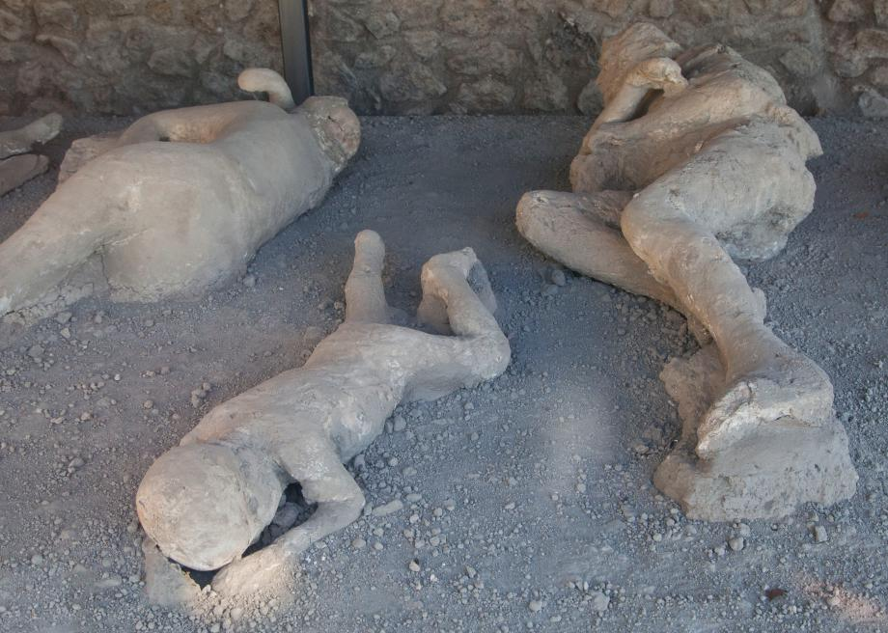
For us the most impressive but at the same time sad thing we
saw, were the dead bodies of the people buried alive during the eruption.

Slide 59
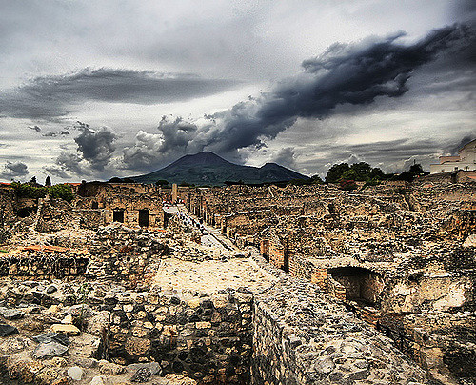
What we finally understood is that these places are worth visting
even for the very demanding visitors.

Slide 60

We want to thank the Erasmus project, the teachers and all the students
that gave us the opportunity to collect these beautiful moments
and memories …

