Slide 1
GUADELOUPE

Slide 2
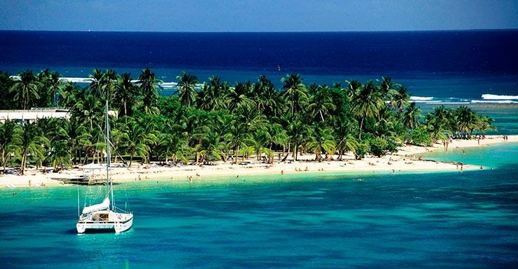
CARTE D'IDENTITÉ
Country: France
Department:Guadeloupe
Prefecture: Basse-Terre
Population: 472 375
Climate: Tropical
Language: French

Slide 3
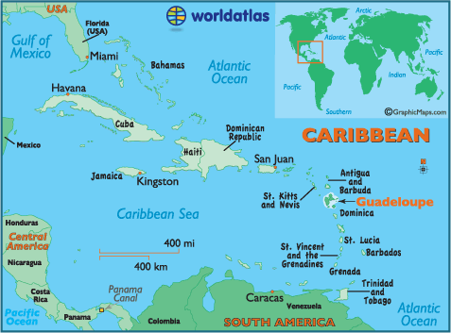
Where is it?
Guadeloupe is an island surrounded by the Atlantic Ocean and the Caribbean Sea.
This territory of the West Indies, is located approximately 6 200 km of metropolitan from France and 2 200 km from the United States. It comprises five islands with two major ones: Grande-Terre and Basse-Terre and then Les Saintes, la Désirade and Marie-Galante.

Slide 4
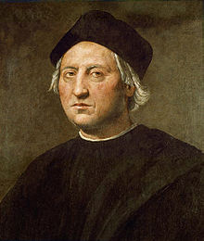
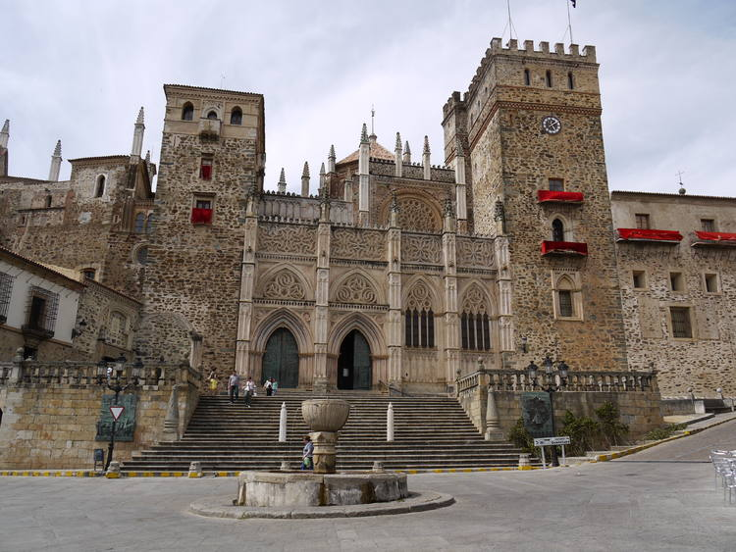
The word "Guadeloupe" was given to the island by
Christopher Columbus in 1493 to pay tribute to Santa Maria de Guadalupe of Estremadura (it was a promise made to the religious of Spain)
Guadeloupe (Gwadloup in Creole) is both overseas department and a European region of the Caribbean; its official departmental code is "971"
Christopher Colombus
Santa Maria de Guadalupe de Extremadura..

Slide 5
History
1492 1626 1636
C.Colomb lands in Guadeloupe Installation of French the beginning of slavery
1674
Colbert conceived the Code noir, which defined the relations between the masters and the slaves
1685
Colbert conceived the Code noir, which defined the relations between the masters and the slaves
1759-1763
The British occupy Guadeloupe
1794
Abolition of
slavery
1802
Guadeloupe is definitely French
1814
Guadeloupe is definitely French
1848
Abolition of slavery
1946
La Guadeloupe becomes a French department abroad

Slide 6
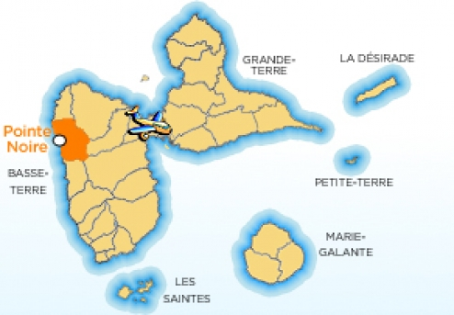
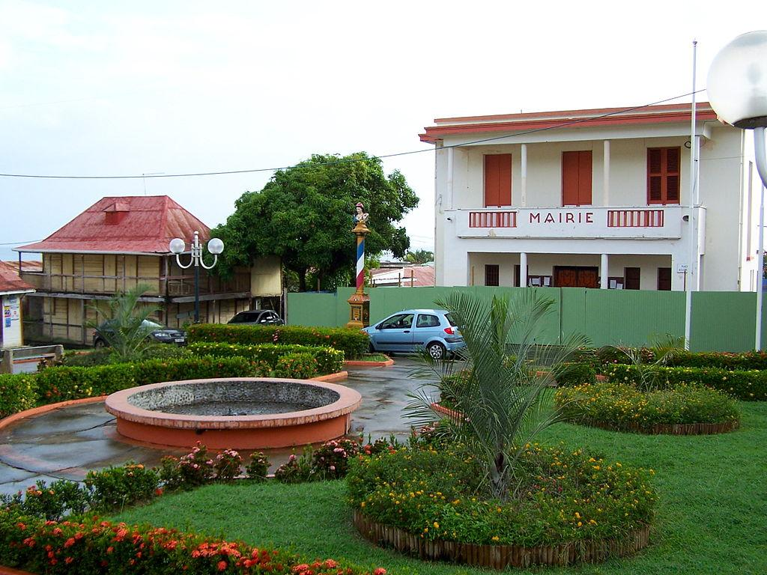
POINTE-NOIRE

Slide 7
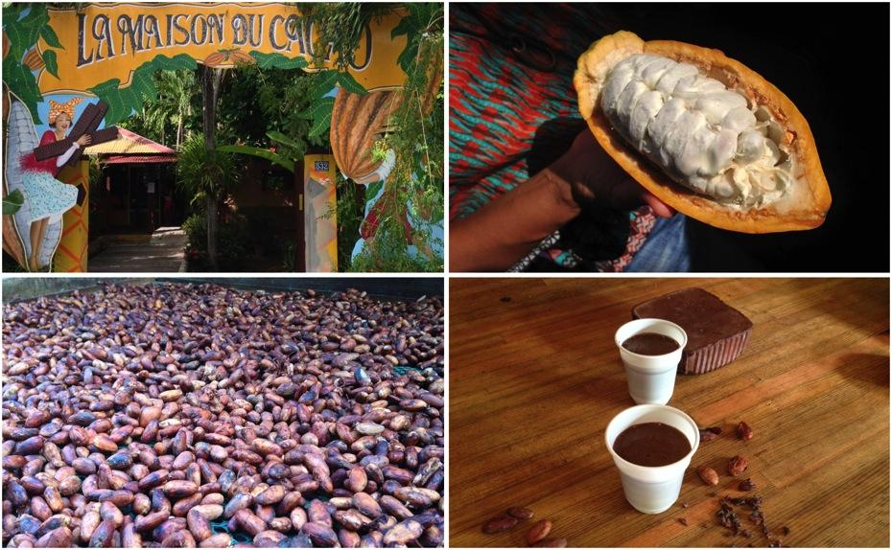
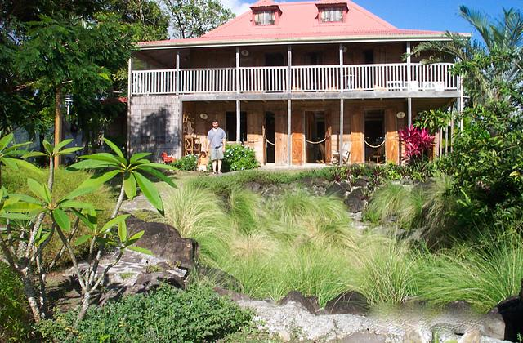
Pointe-noire owes its name to the volcanic rocks that lie north of the city, it is located on the west coast of the island of Basse-Terre, called coast-under-the-wind. It extends over the western slope of the volcanic massif of Basse-Terre, which flows abruptly into the Caribbean Sea
It is a city whose main activity is the woodworking for the construction of houses and the manufacture of furniture. It is known for the cultivation of cocoa and coffee.
The aquaculture park of Pointe Noire is a space designed to welcome you and discover aquaculture

Slide 8
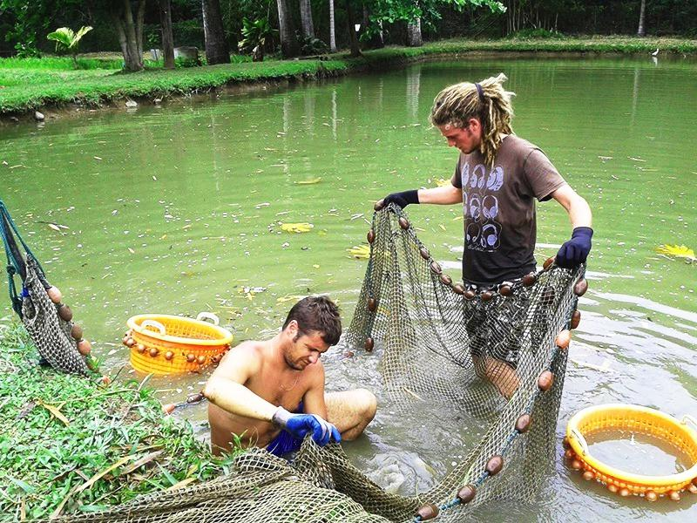
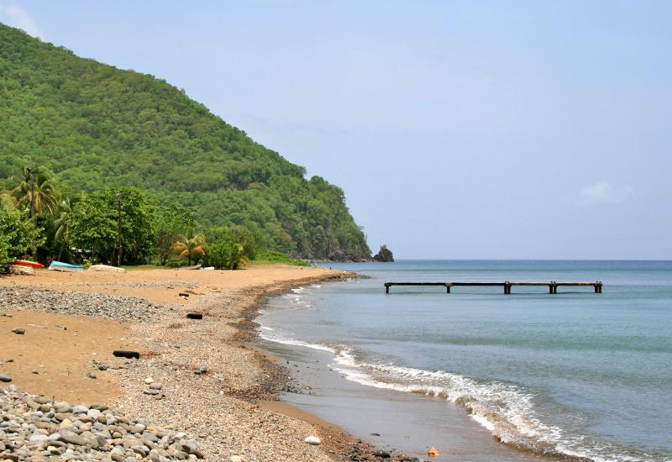
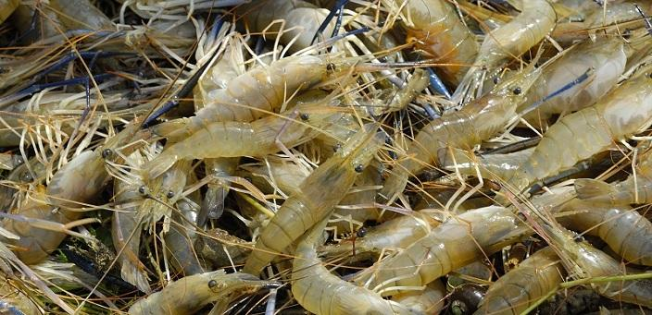
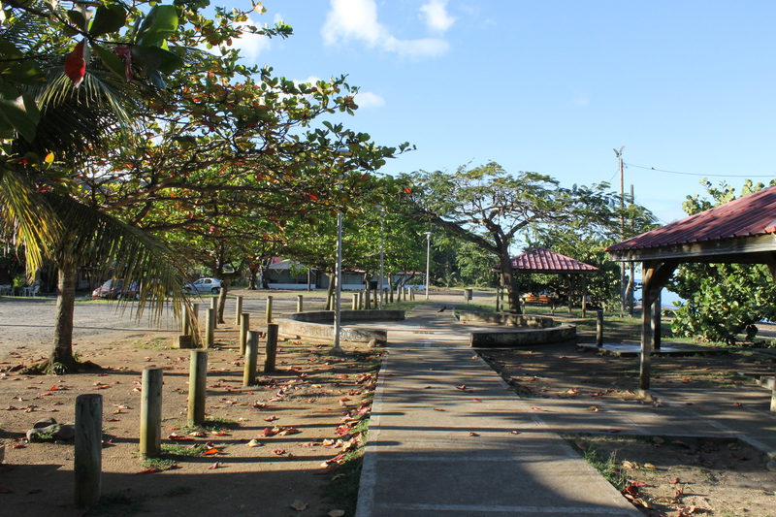
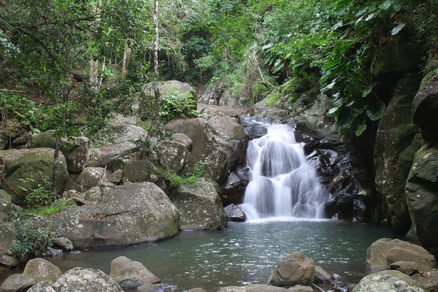
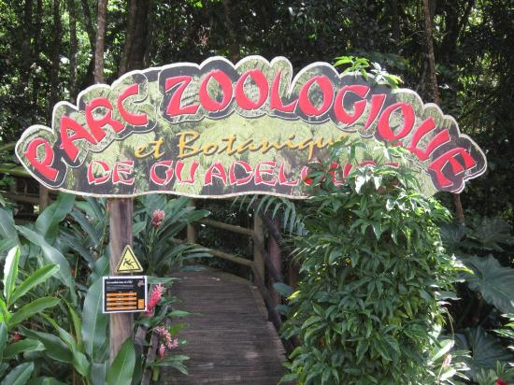
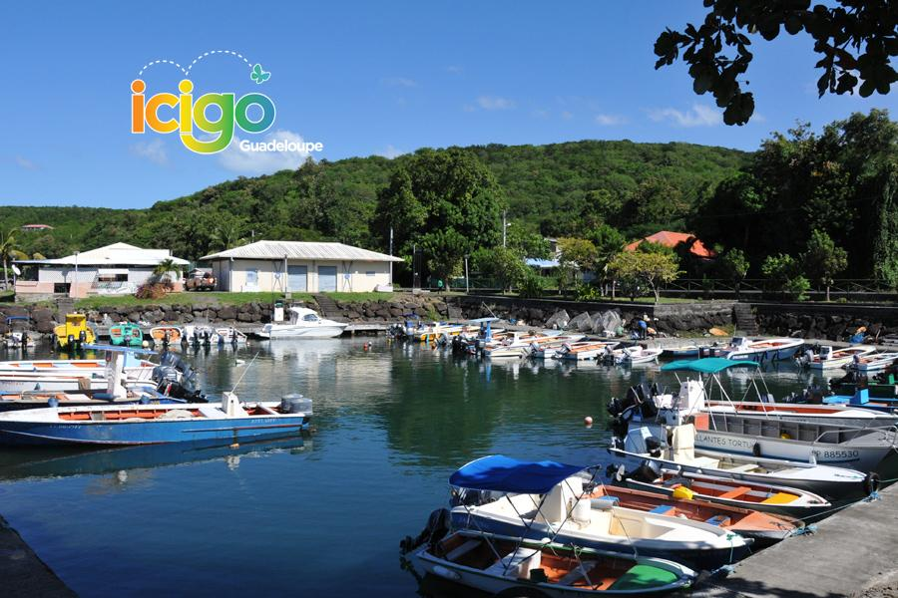
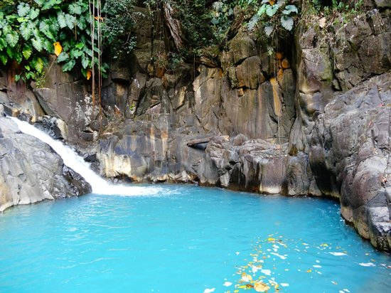
aquaculture park
ouassous
Caribbean beach
Fishing port of Baillargent
Acomat falls

Slide 9
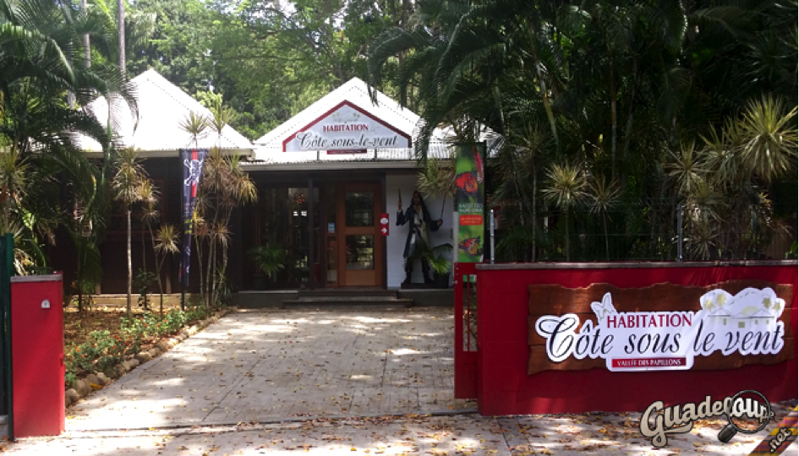
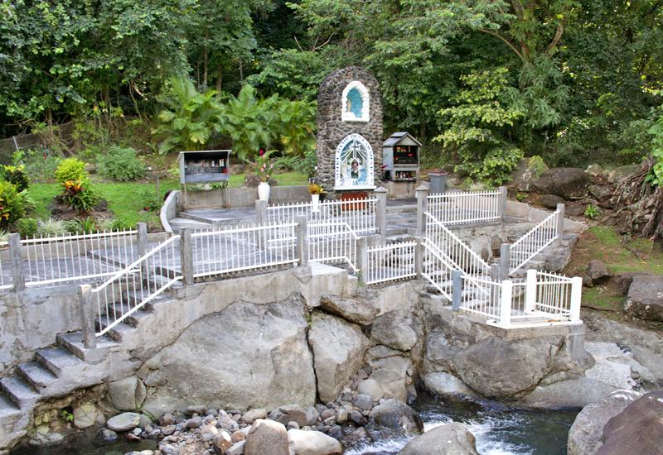
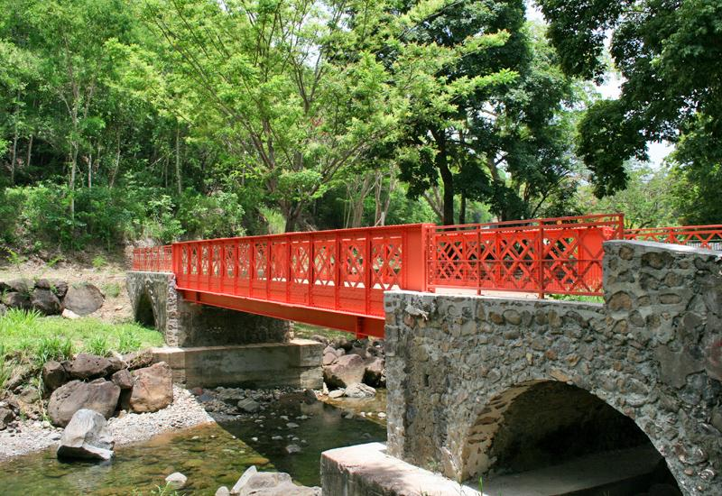
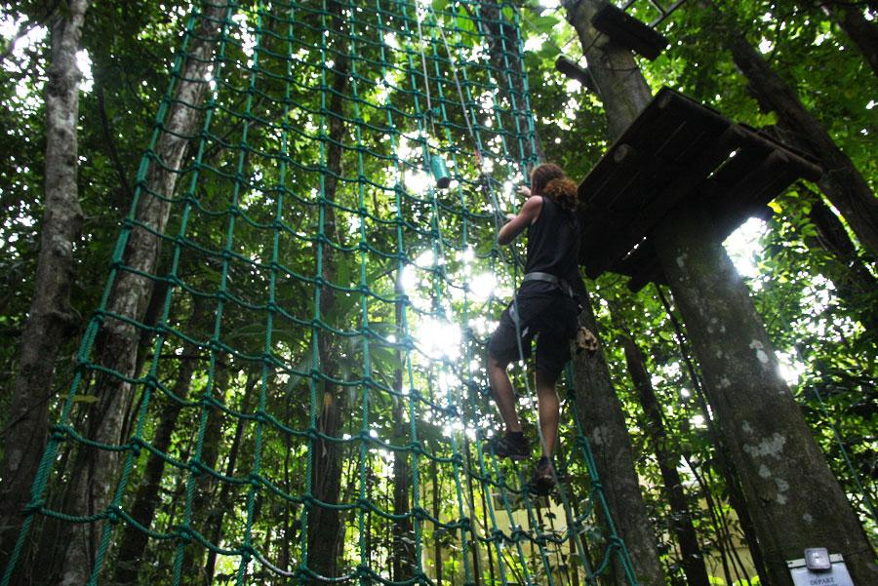
dwelling leeward coast
river sanctuary
of our Lady of Tears
zoo
Eiffel bridge
Zip line

Slide 10
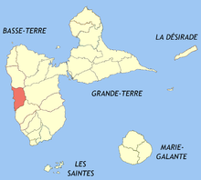
LPO POINTE-NOIRE
The polyvalent high school is located on two sites, the first, general and technological high school is located in Pointe-Noire and the section of vocational education is located in Bouillante

Slide 11
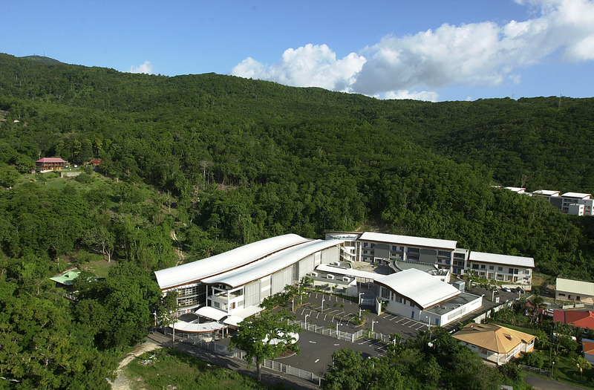
The headmaster, Mr Patrick LOVAL has been running the school since 2016
Since February 2017, the hight school has the institutional label of "Campus des Métiers de l'Audiovisuel du Cinéma et du Numérique". It prepares for a Technician brevet in Audiovisual

