Slide 1
1

Slide 2
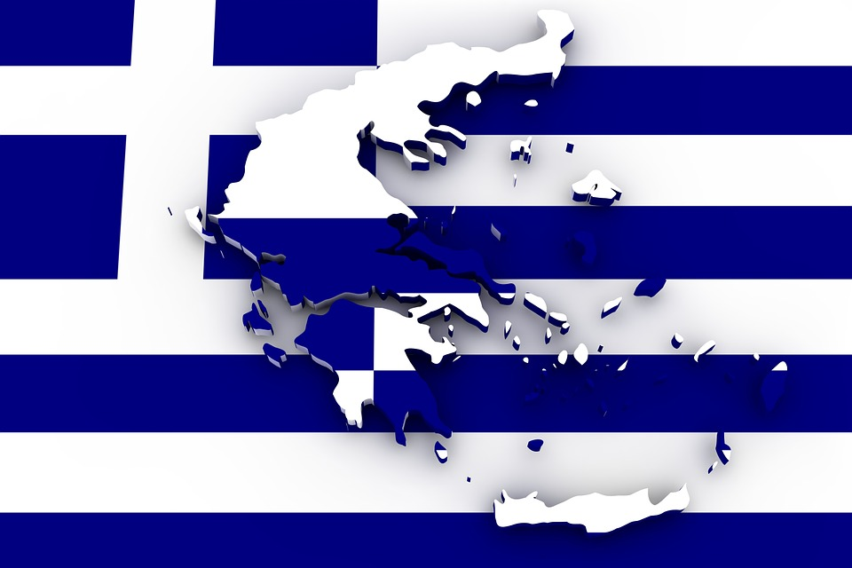
MOBILITY GREECE
2

Slide 3
CONTENTS
Santorini
The Island of Santorini
The Caldera
Nea Kameni
Akrotiri
Volcano arc of Aegean Sea
Pirgos
The earthquake in Pirgos
Ancient Olympia
3

Slide 4
SANTORINI
The island of Santorini, is also called Thera or Thira . It is a Greek island in the Aegean Sea. It is the largest island of a small, circular archipelago which bears the same name and is the remnant of a volcanic caldera.
4

Slide 5
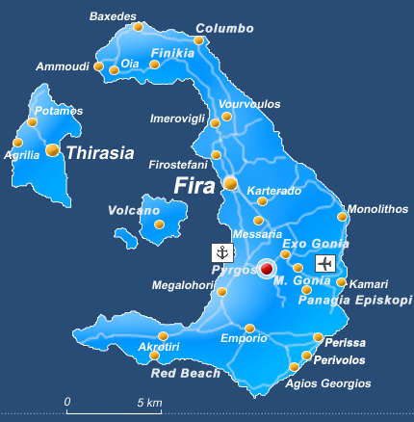
THE ISLAND OF SANTORINI
• The Minoan eruption (Thera eruption 1642-1540 BC) was one of the largest volcanic events on earth which devastated the island of Thera.
• The Minoan civilization collapsed due to the gigantic tsunami caused by the volcano eruption.
• Legends and myths were created regarding the eruption, like the legend of Atlantis.
5

Slide 6
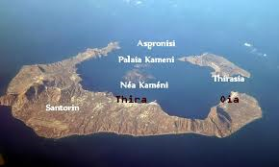
THE CALDERA
The formation of caldera is related to a volcanic eruption: such as the island of Santorini.
The magma chamber erupts, the ground surface collapses, leaving a massive depression at the surface.
In 1646 BC a massive volcanic eruption, probably one of the greatest that humanity has ever known, took place at Thera (Santorini Island). It is estimated that the explosion was equivalent to 40 atomic bombs, or 100 times stronger than the eruption in Pompeii.
6

Slide 7
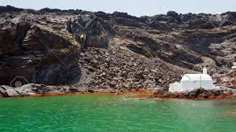
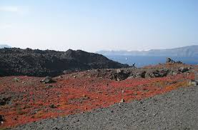
NEA KAMENI
• Nea Kameni is a volcano located in the center of the caldera of Santorini, 150 metres above sea level.
• Nea Kameni is a small uninhabited island of volcanic origin located in the Aegean Sea within the flooded Santorini caldera.
• The island has many active sulfur vents, as well as a carpet of red grassy succulents on the thin soil in the summertime.
• Nea Kameni especially is a pole of attraction for tourists thanks to healing hot springs.
7

Slide 8
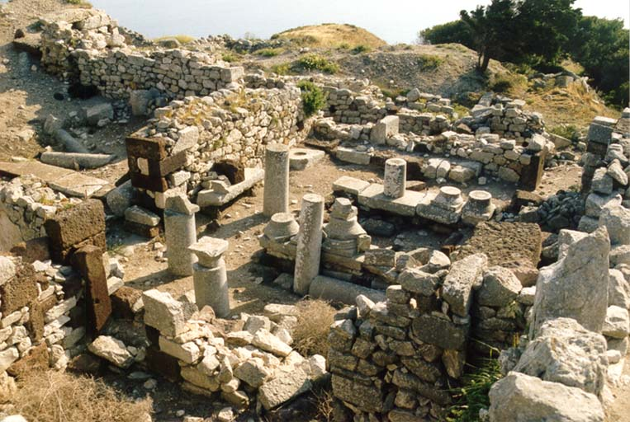
AKROTIRI
• The city is located on the island of Santorini. Akrotiri was buried under a thick layer of ash and pumice stones during a volcanic eruption.
• It was discovered accidentally 3,500 years after the eruption, during the construction of the Suez canal.
Akrotiri
8

Slide 9
VOLCANO ARC OF THE AEGEAN SEA
The South Aegean Volcanic Arc is a chain of volcanic islands in the South Aegean Sea formed by plate tectonics as a consequence of the subduction of the African tectonic plate beneath the Eurasian plate.
The Greek arc starts from Kefalonia, goes through the southern Ionian Sea, continues to southern Crete and ends up in Rhodes.
9

Slide 10
PIRGOS
Pyrgos is the capital of the Elias prefecture of Greece. The city is located in the western part of the Peloponnese, in the middle of a plain.
10

Slide 11
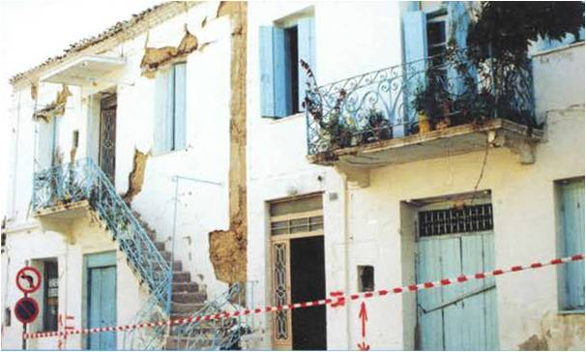
THE EARTHQUAKE
IN PIRGOS
In 26 March of 1993 the city of Pirgos was hit by several earthquakes, the strongest one was 5,5 on the Richter scale of earthquake intensity.
Tragic consequences:
1 dead woman
16 injured persons
Critical building damages
11

Slide 12
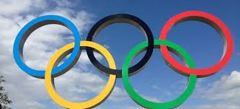
ANCIENT OLYMPIA :
Ancient Olympia is located in Greece, in the Peloponnese. Olympia hosted the first Olympic Games in classical times. The Olympic Games are held every four years. The Olympic flame is lit by reflection of sunlight in a parabolic mirror in front of the Temple of Hera.
12

Slide 13
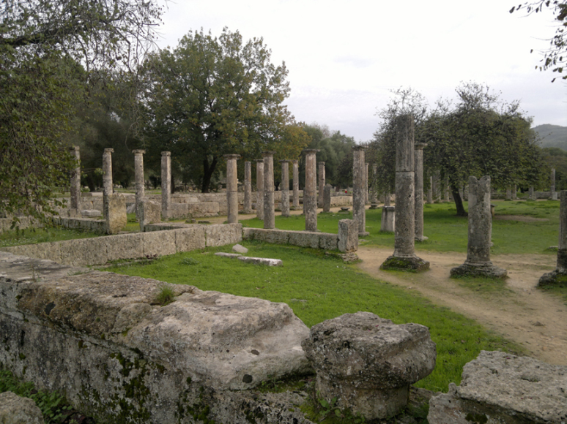
ANCIENT OLYMPIA :
Olympia a sanctuary of ancient Greece in Elis on the Peloponnese peninsula, is known for having been the site of the Olympic Games in classical times. The classical period, between the 5th and 4th centuries BC, was the golden age of the site at Olympia. A wide range of new religious and secular buildings and structures were constructed.
13

Slide 14
LITERATURE
https://en.wikipedia.org/wiki/South_Aegean_Volcanic_Arc
https://en.wikipedia.org/wiki/Island_arc
https://en.wikipedia.org/wiki/Olympia,_Greece
https://en.wikipedia.org/wiki/Pyrgos,_Elis
http://www.patrisnews.com/23-hronia-apo-ton-katastrofiko-seismo-toy-1993-photos/
https://en.wikipedia.org/wiki/Santorini
https://en.wikipedia.org/wiki/Akrotiri_(Santorini)
https://en.wikipedia.org/wiki/Nea_Kameni
https://en.wikipedia.org/wiki/Minoan_eruption
https://www.greeka.com/cyclades/santorini/santorini-excursions/santorini-volcano.htm
https://www.volcanodiscovery.com/santorini/1950-eruption.html
https://www.in2greece.com/english/places/summer/islands/santorini.htm
14

Slide 15
Thank You!
Baptiste Renodino
Eugene Kakalis
15

