Slide 1
Italy
France
Greece
Spain
2017-2018

Slide 2
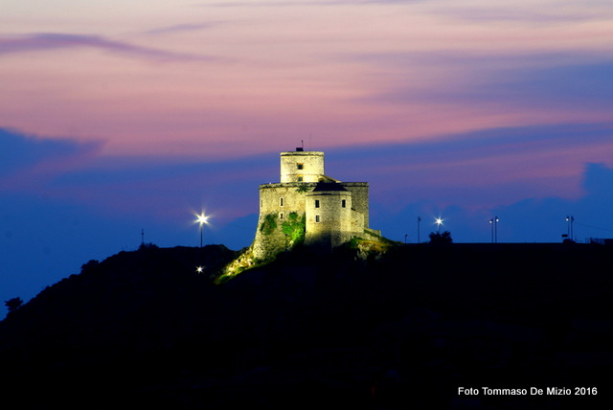
Welcome to Montesarchio

Slide 3
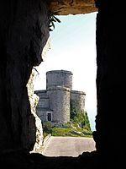
The story of our city
The area of ​​Montesarchio, is habited since the Neolithic, is identified with the Sanniti town of «Caudium», destroyed after the defeat of the Sannitic League in the 4th century. Numerous archaeological finds date back to Roman times such as the excavations of Caudium. Under the domination of the Lombards was born the urban agglomeration called "Latovetere", typically medieval, with houses attached to the castle and to the tower. In the Norman period, thanks to the demographic increase, the "Latonuovo" quarter was born. Montesarchio was a feudal possession of the Della Leonessa or de Lagonissa from 1278 to 1480, of the Carafa from 1480 until 1528 when he passed to D'Avalos who held it until the end of feudality in 1806

Slide 4
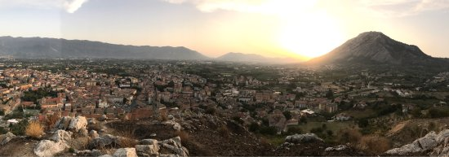
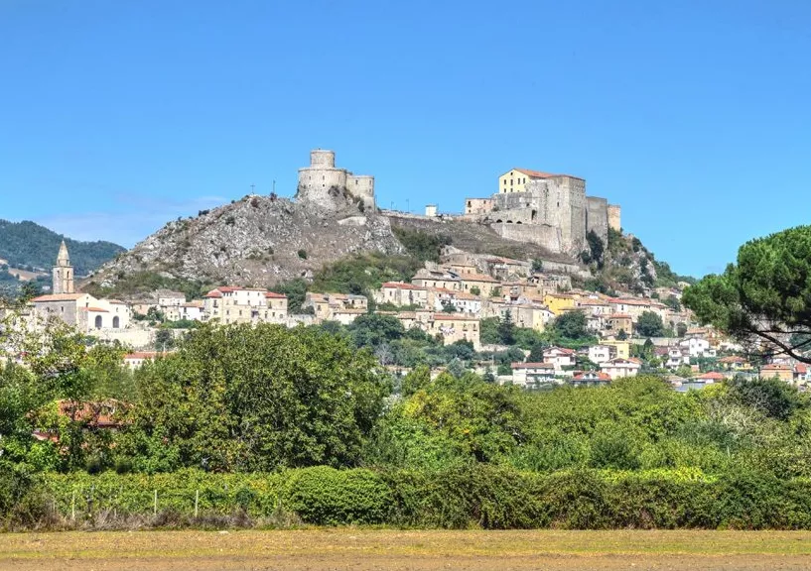
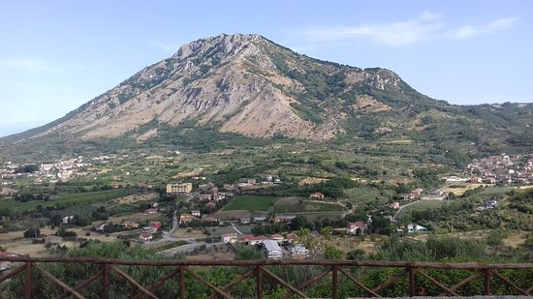
Montesarchio is a comune municipality of 12628 inhabitants, covering an area of ​​26.26 km and an altitude of 300 m.

Slide 5
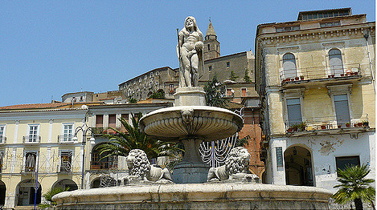
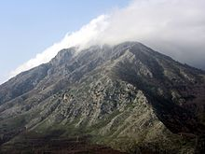
The most important monuments in our city are:
The fountain in Umberto I‘s square was built during the Baroque period.
The Taburno Camposauro is an isolated calcareous massif of the Campania Apennines. It is located just west of Benevento.It is tall about 1000 m.

Slide 6
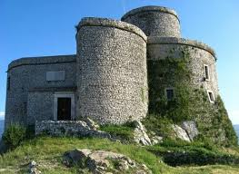
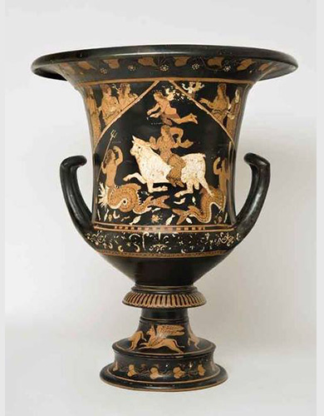
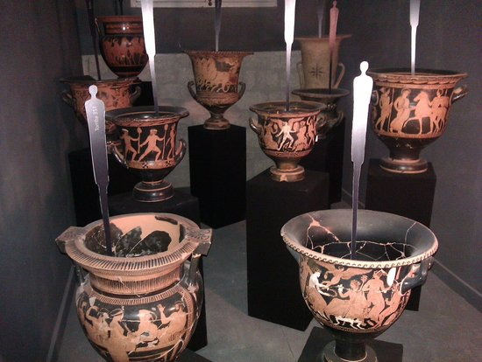
These are some wonders that are in Caudium museum:

Slide 7
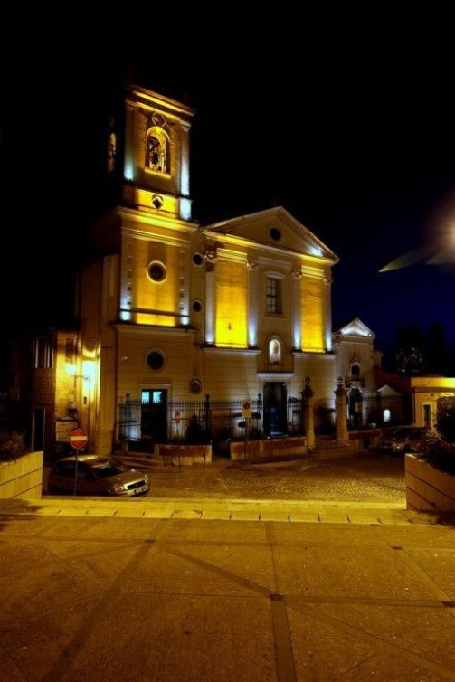
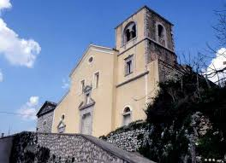
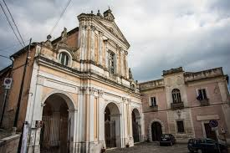
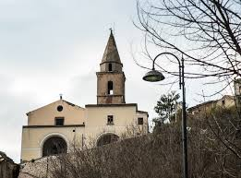
In our country there are a lot of church that which date back a long time ago:

Slide 8
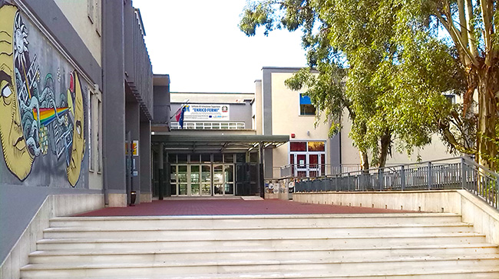
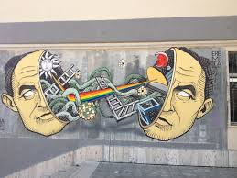
WELCOME TO OUR SCHOOL
High School «Enrico Fermi» in Montesarchio (BN)

Slide 9
In our school there are some rooms that the students can use in some subjects ,for example: phisic, biology, chemestry , gym or rooms for the meetings.

Slide 10
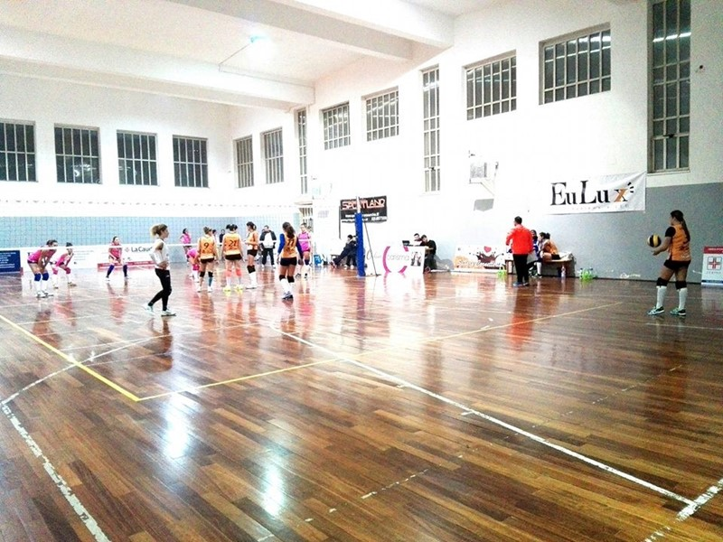
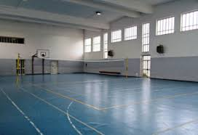
These are the gyms
Here the students can partecipe in some races of footbal or volleyball and in this place they can do PE.

Slide 11
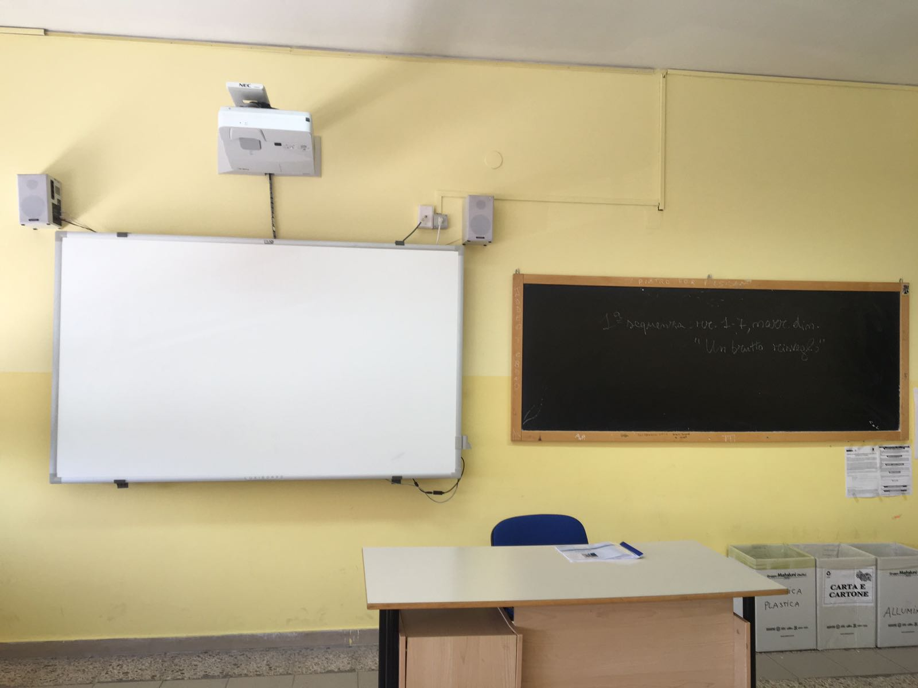
This is a classroom
In every classroom there are a lym and a blackboard. All students are invited to respect the different collection and for this reason in all classroom there are some basckets.

Slide 12
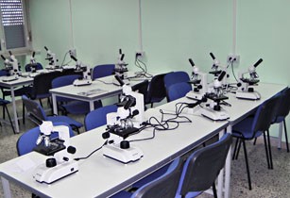
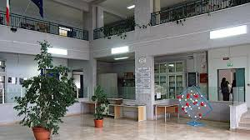
This is Biology Room

Slide 13
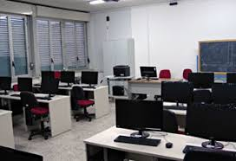
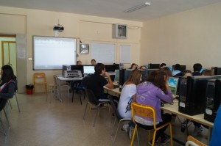
This is informatic Room

Slide 14
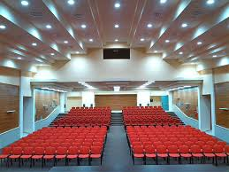
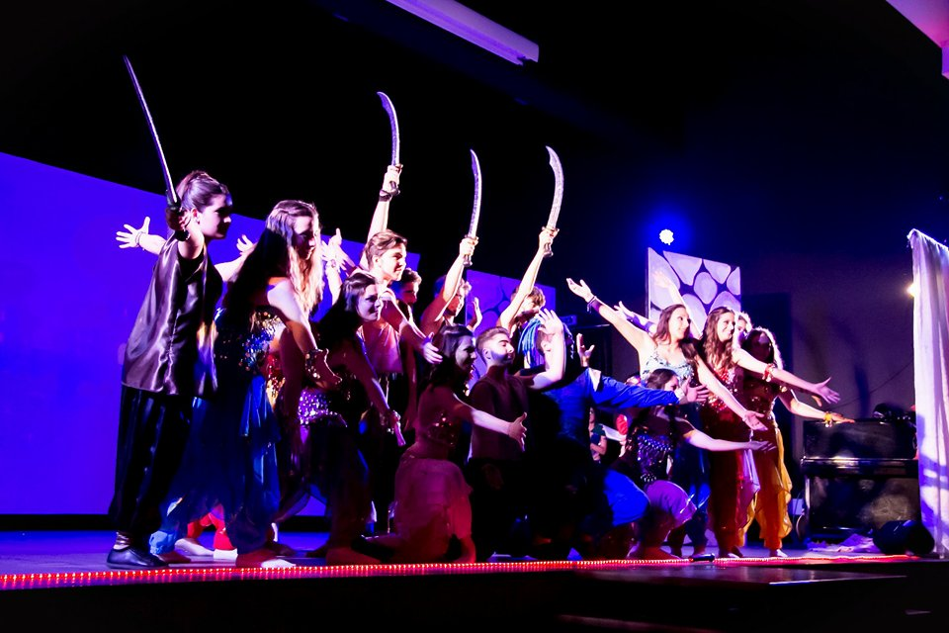
Auditorium
In this place the students can partecipe at some meetings and every year the can partecipe to sing or dance at a musical in english language, for example, this year some students have partecipeted at the musical «Grease».

Slide 15
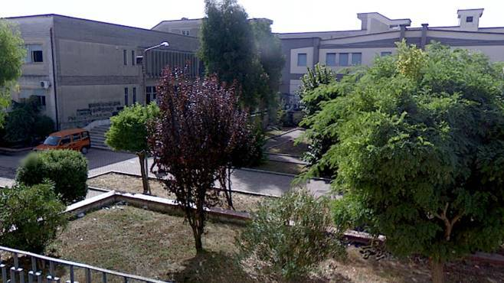
And finally, this is our school seen from above!

Slide 16
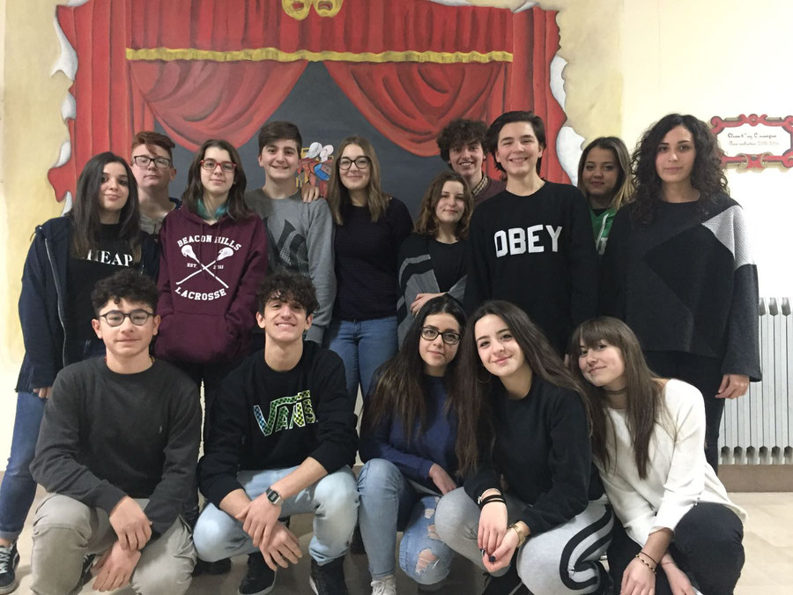

Slide 17
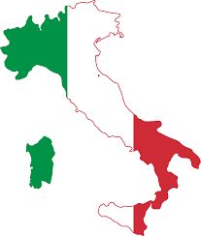
THE END
Made by:
Vittoria Clemente
Veronica De Simone
Vincenzo De Mizio
Assunta Damiano
Gaia Valeria Gallo

