Slide 1
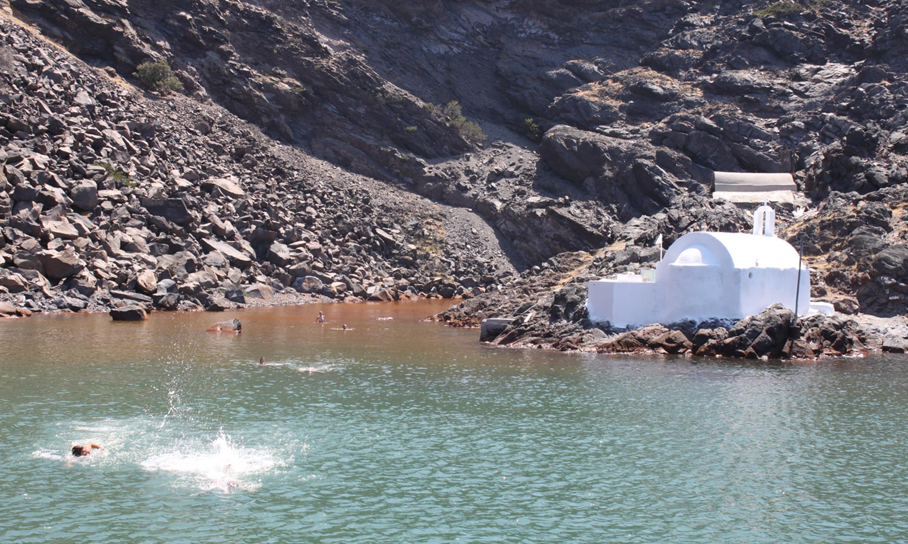
Santorini hot springs

Slide 2
The island of Nea Kameni, also known as the Santorini volcano, is a volcanic island in the centre of the impressive Santorini caldera. Nea Kameni was formed around 1570 after a series of volcanic eruptions. Its highest point is 127 m above the sea level and it has two ports east (cove of Taxiarchis) and north (cove of Erinia)

Slide 3
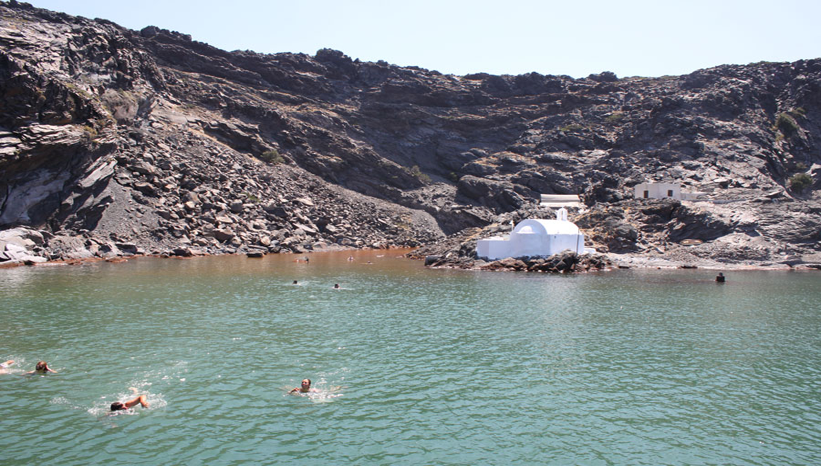
Nea Kameni is surrounded by warm dark waters which are known for their therapeutic benefits.
People can reach the islet with the traditional caiques that deoart from the old port of Fira and enjoy a bath in the hot springs. The healing waters of Nea Kameni consist of iron and manganese which act against many diseases that older older poeple usually suffer from.

Slide 4
Nea Kameni also hosts the famous volcano that visitors an walk up to. However, careful walking is required on the volcano as it is still active.
The last eruptions happened in 1953.
There are 3 craters on the island:

Slide 5
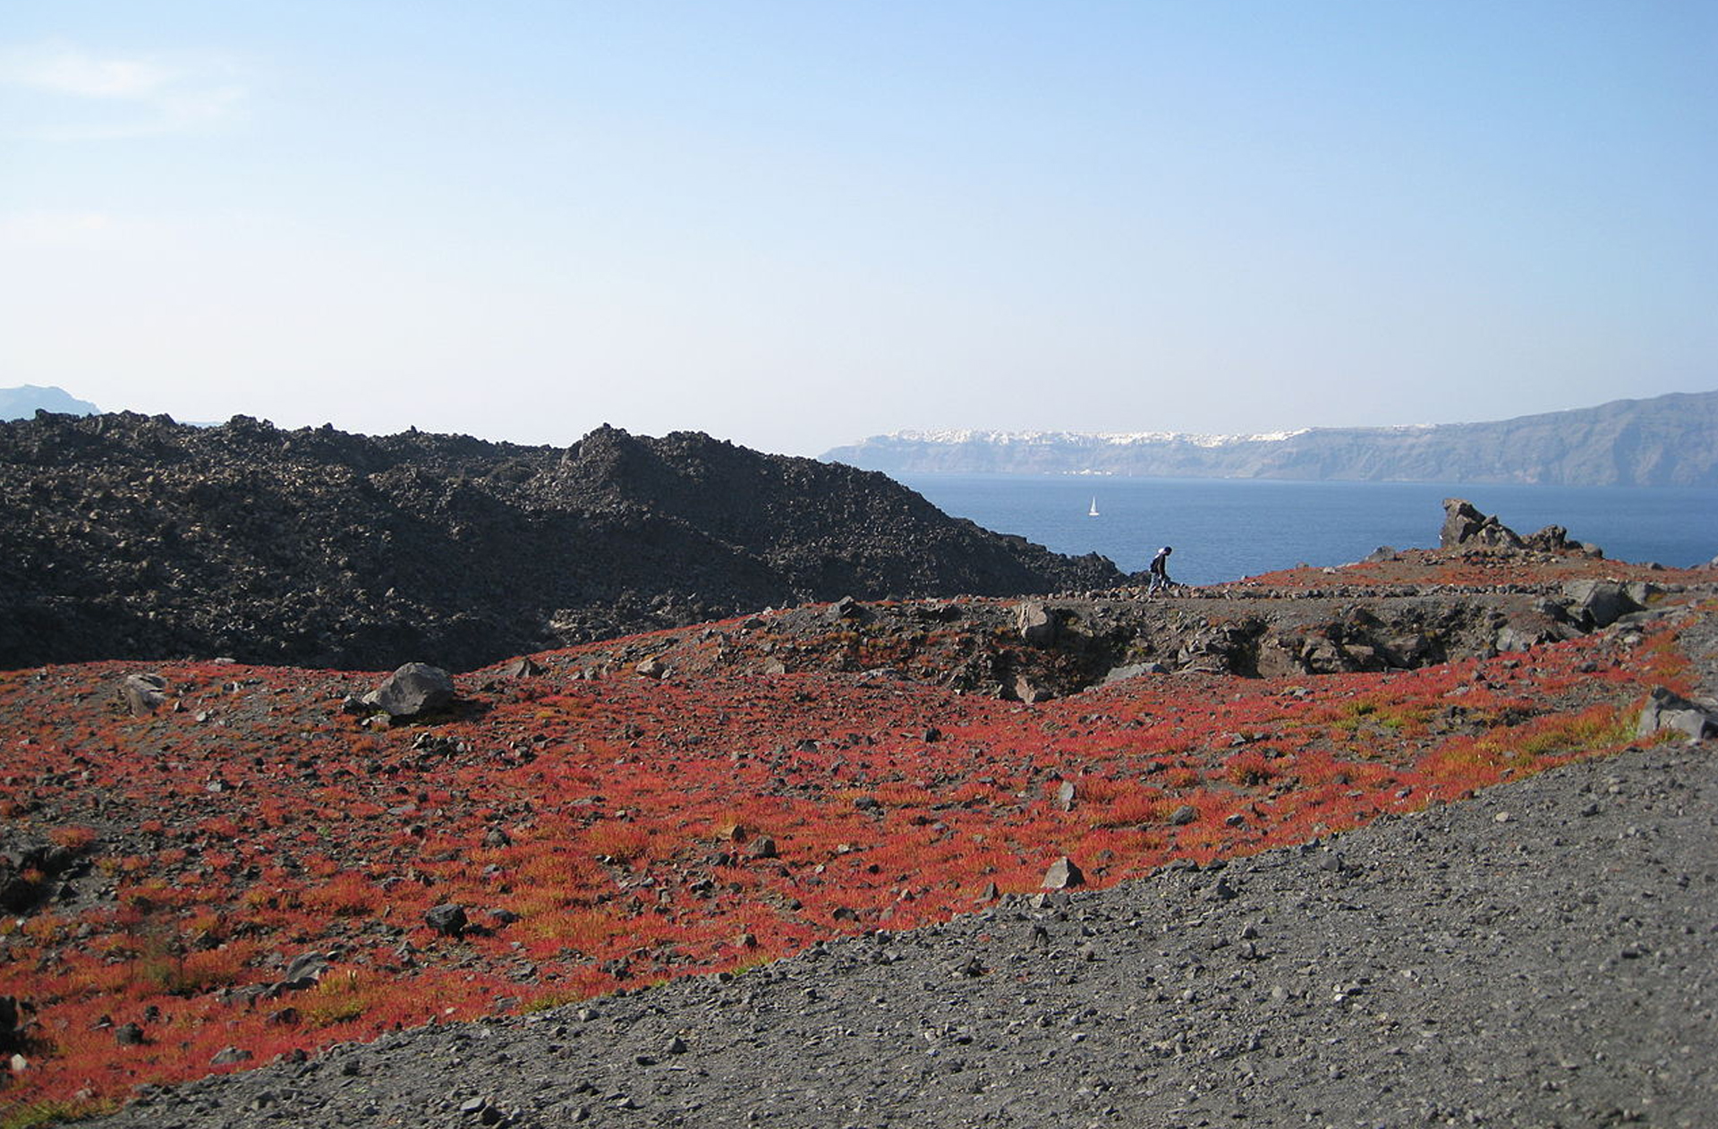
First
-Mikri kameni, created in 1570

Slide 6
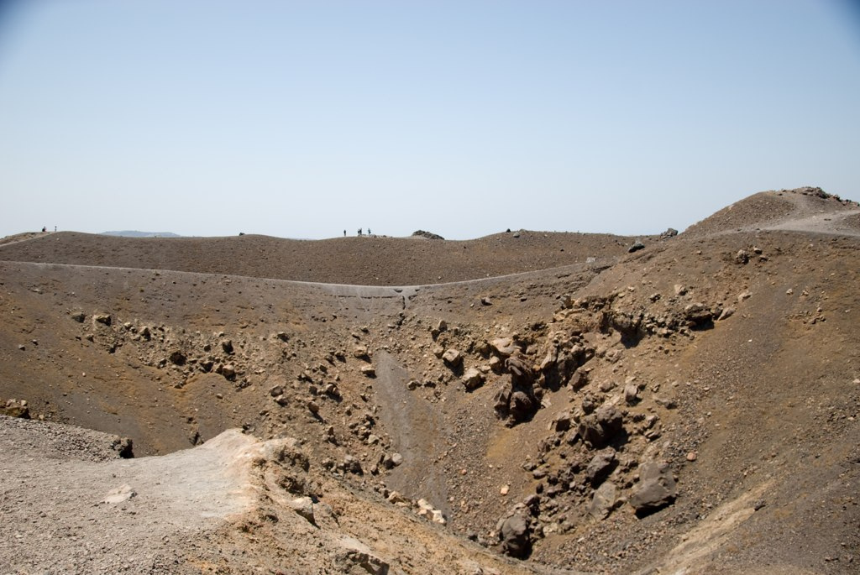
Second:
the central crater created in 1940 by two great hydrothermal eruptions.

Slide 7
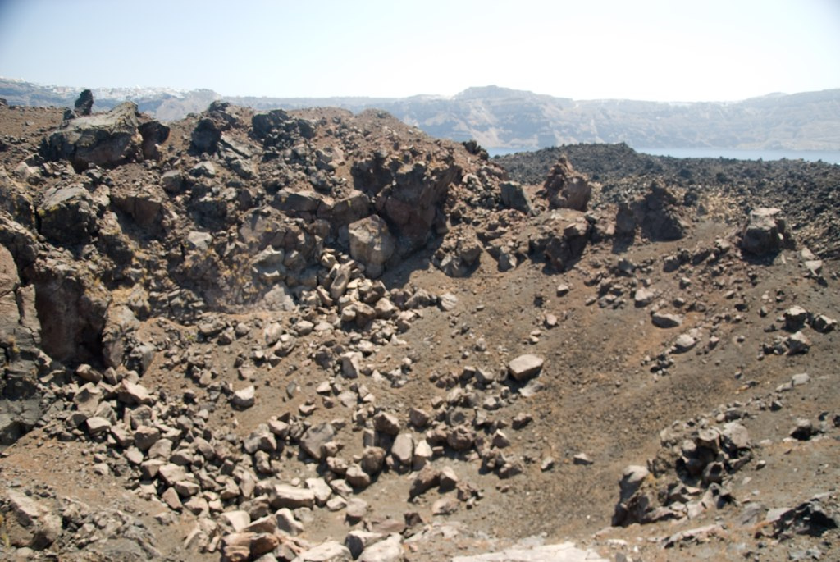
Third:
Dafne's crater, born with the eruptions of 1925-26

