Slide 1
ERASMUS 2017
ATHINA DROULIA ASSUNTA DAMIANO

Slide 2
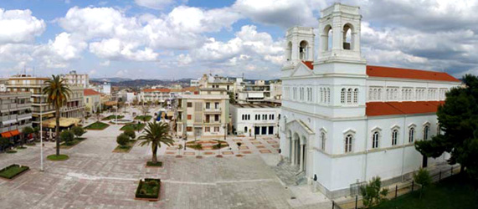
26 MARCH 1993
THE DAY WHEN PYRGOS WAS DESTROYED!

Slide 3
Twenty-four years have been completed since the day when "Enceladus" marked the city of Pyrgos.

Slide 4
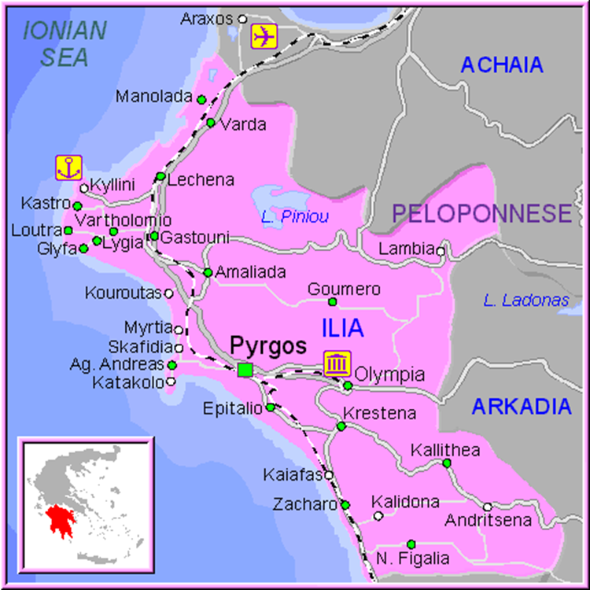
On 26 march 1993 Pyrgos,a municipality in western Greece , and the western part of the Peloponnese were shocked from an earthquake of magnitude 5.5 on Richter’s scale ,the last of the many that happened since the end of 1992

Slide 5
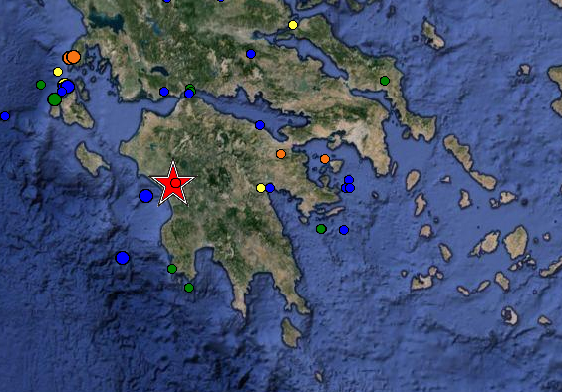

Slide 6
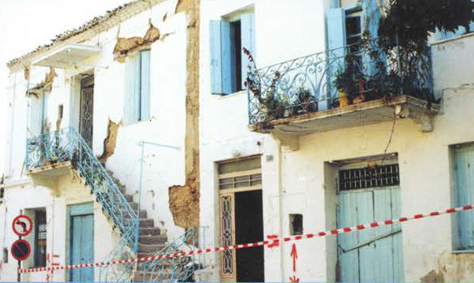
At 2:10 pm on 26 March 1993, the capital was vibrated by a total of 6 earthquakes, the strongest and most destructive of which was 5.5 degrees.

Slide 7
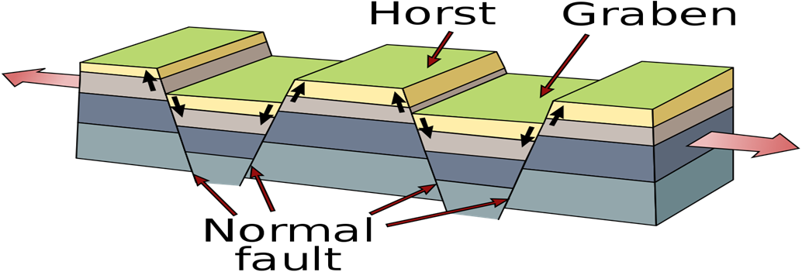
The earthquake was caused by oblique-normal split on a north-dipping and WNW tranding fault,it has also reactivated the Alfio and Grape grabens .The Alfio graben is the most active structure in the basin of Pyrgos ,it is long 25 km and is segmented along its strike by transfer zones. Activity in this graben shows that transfer zones are the focus for the concentration of seismic activity
and thus the concept of transfer zones is important for understanding the Pyrgos earthquake.

Slide 8
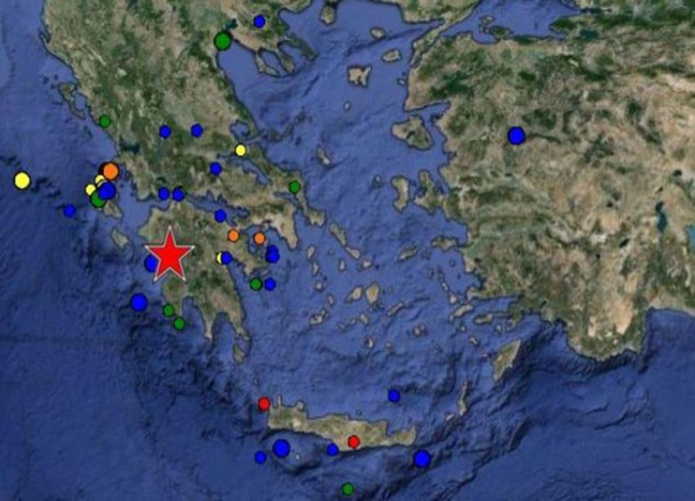
The main shock caused serious damage in Pyrgos and the surrounding area
within a radius of 15–20 km. Landslides at 47 locations and liquefaction phenomena at 7 localities
within an area of 145 km‘ were caused by the earthquake. The most severe damages were observed in Pyrgos,
where at least 50% of the buildings were considerably hit.

Slide 9
Damages in the surrounding area was significant, especially in settlements
and population centres that consisted of old, stone buildings.
The geographical distribution of the damage was not uniform in the affected
area. Specifically, impressively unequal geographical distribution of damage was
observed in Pyrgos . In the broader region there was an equivalent
differentiation in the geographical distribution of damage.

Slide 10
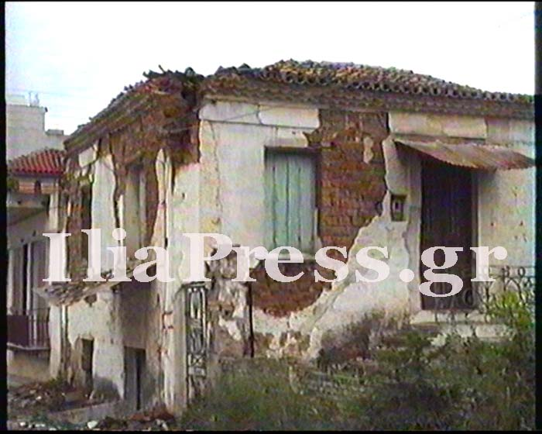
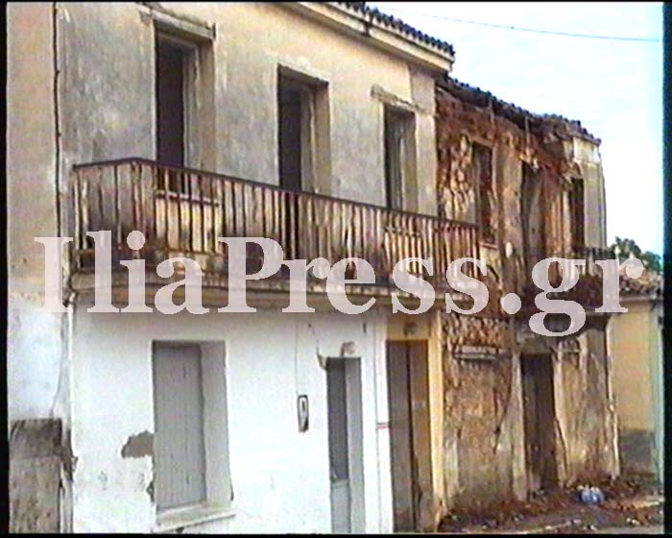
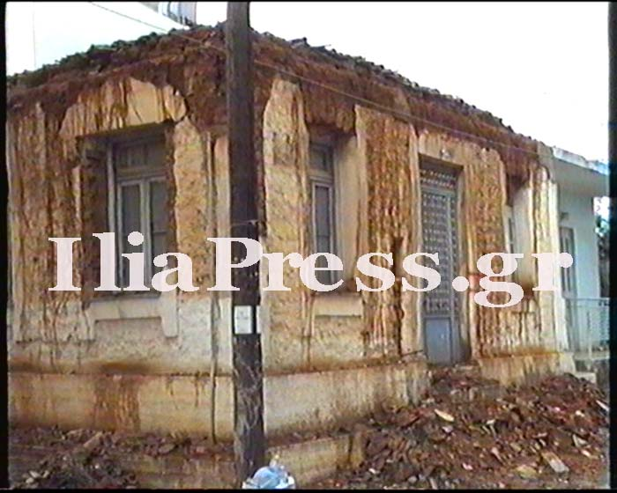
The report was a dead, 16 injured and extensive disaster in many public and private buildings.

Slide 11
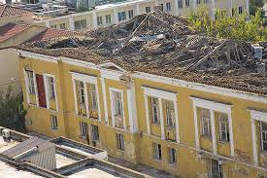
The city's hospital, churches, schools, neoclassical in a few minutes.

Slide 12
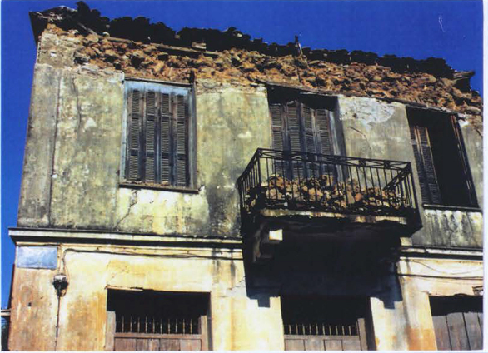
It is estimated that 50% of the Pyrgos buildings were damaged,while the direct economic cost "reached" 60 billion drachmas.

Slide 13
Suddenly several citizens found themselves homeless and slept in scenes or abandoned the city.

Slide 14
Tents set up in open spaces after the earthquake.

Slide 15
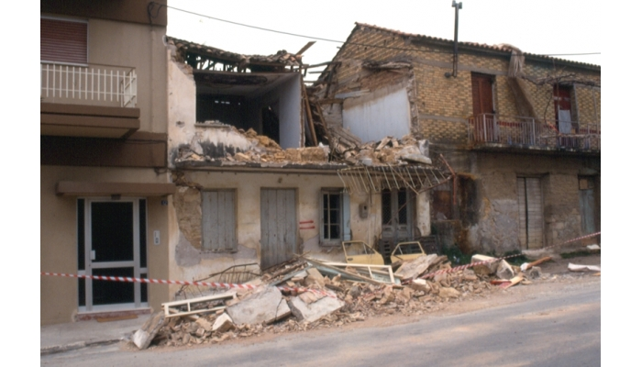
The students had lessons in solitude, while the veil of fear and worry splashed the city for a very long time, after the "wounds" were very late to heal.

Slide 16
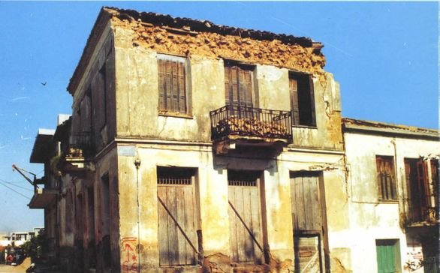
Seismic building

Slide 17
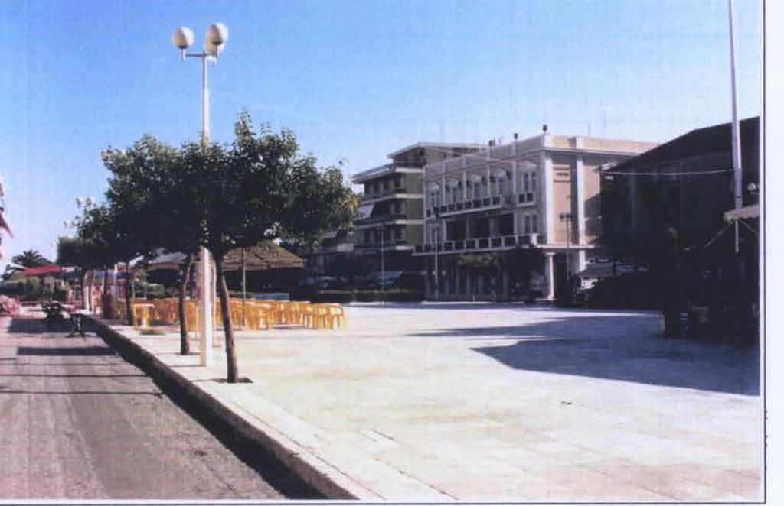
Finally, the earthquake sharpened the social fabric and became a break in the history of the city.
https://www.youtube.com/watch?v=wnfBNPcEDOE

