Slide 1
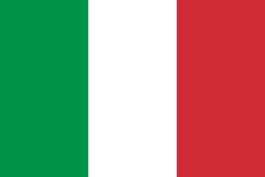
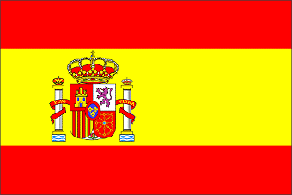
ERASMUS+

Slide 2
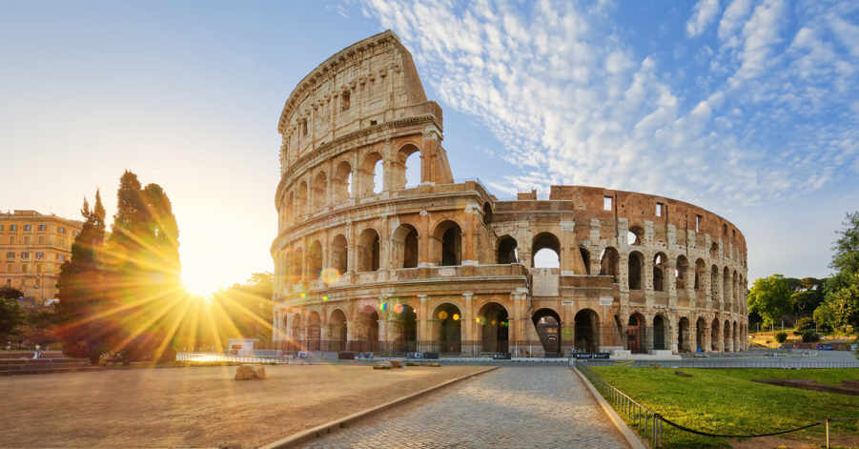
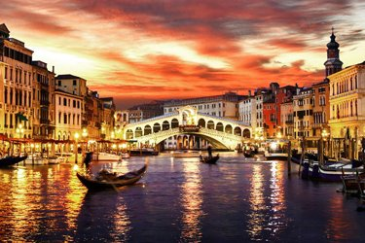
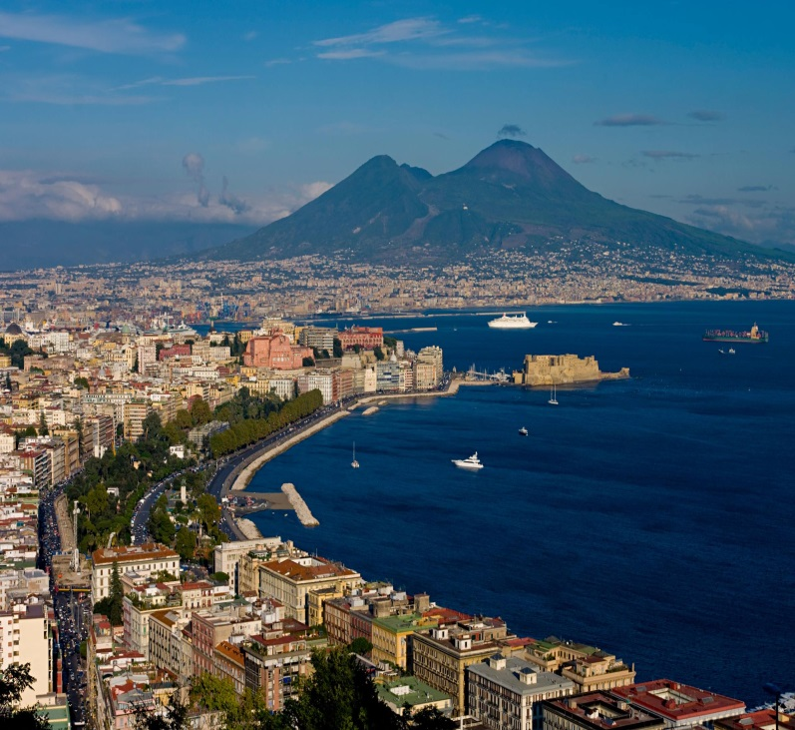
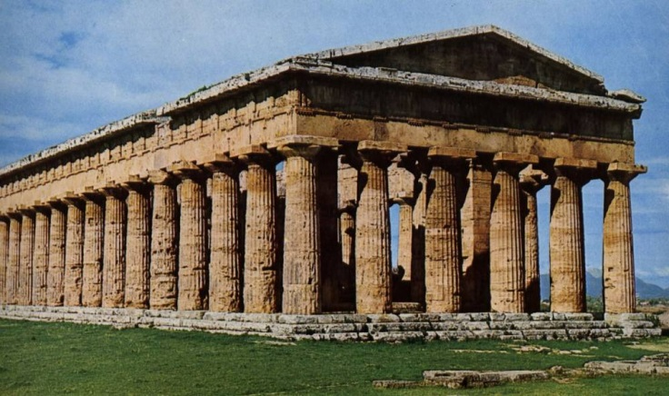
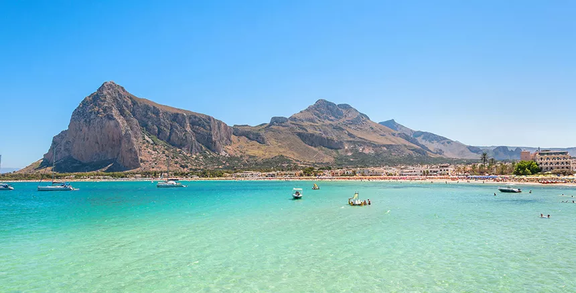
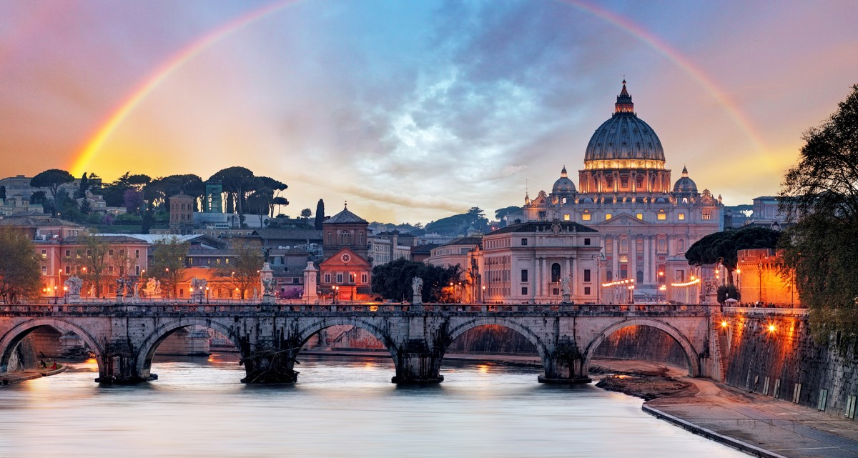
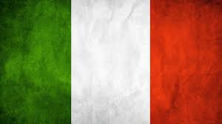
ITALY

Slide 3
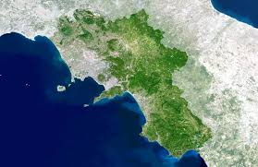
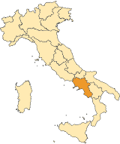
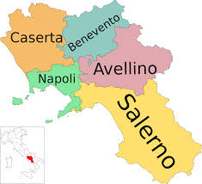
Campania
It is a region of Southern Italy. .
In addition to the capital of the Naples region, the provincial capital cities are Avellino, Benevento, Caserta and Salerno.

Slide 4
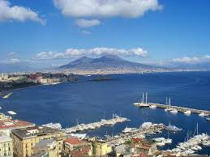
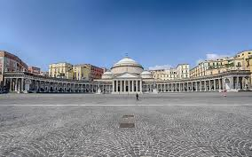
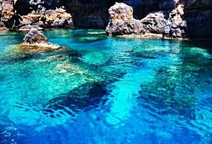
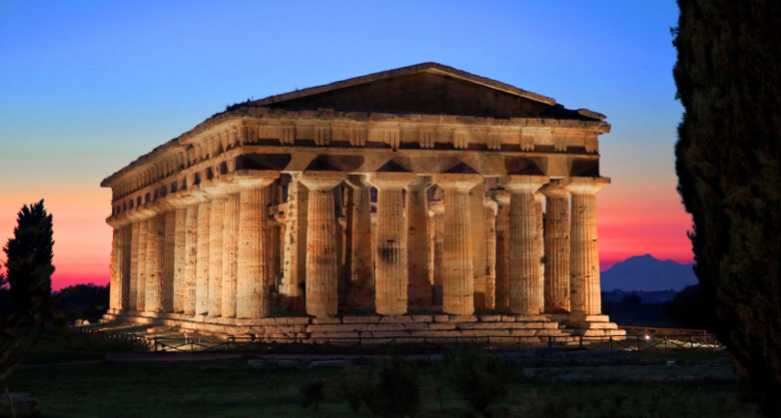
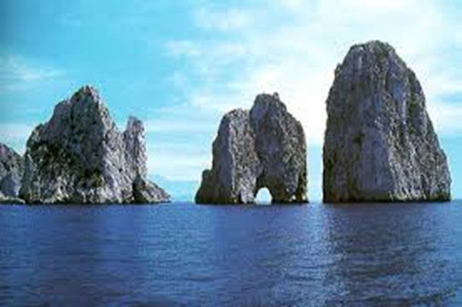
In our region there are many places that a lot of tourists visit every day, for example: Pompei, Ercolano, Capri’s island,Naples and another places!

Slide 5
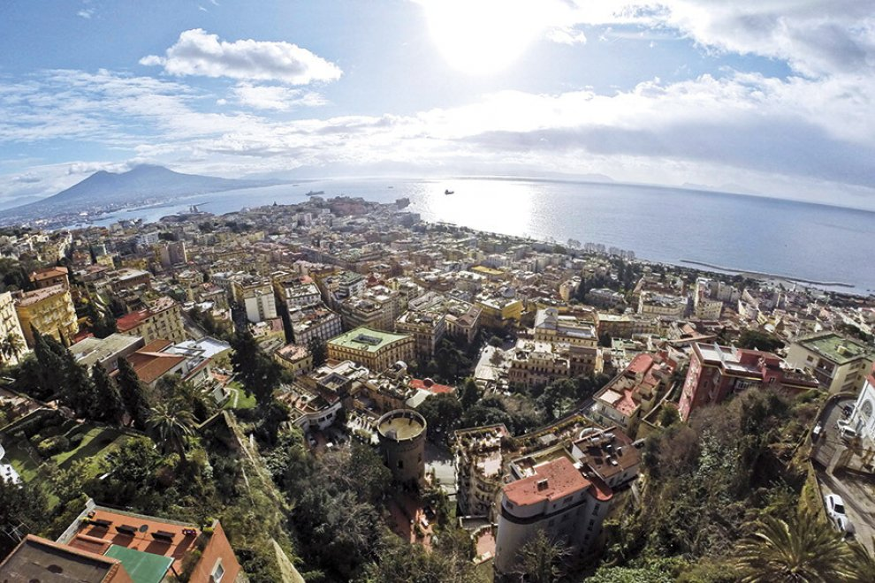
Naples
Naples is the capital of Campania. Here we can find: the famous St. Gennaro’s church, Naples sotterranea, the Vesuvio so in this city there is the sea. It has 983.755 abitants.

Slide 6
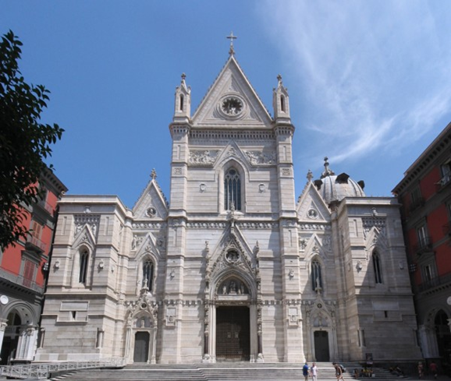
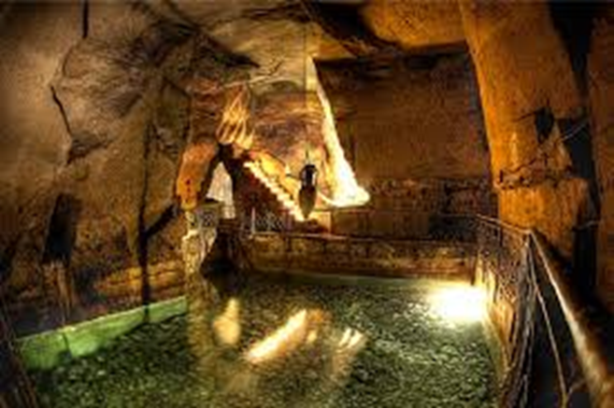
St. Gennaro’s church where there is the Saint’s blood that every 19 th september become liquid.
Underground Naples are characterized by many Roman buildings such as the aqueduct.

Slide 7
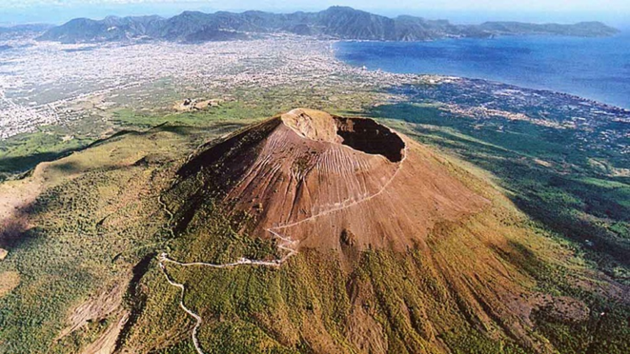
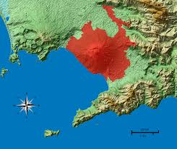
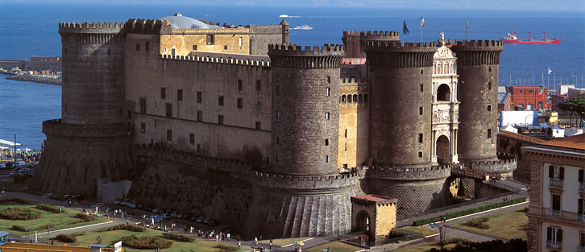
This is the Vesuvio:
This is the «Maschio Angioino»:

Slide 8
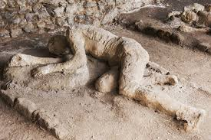
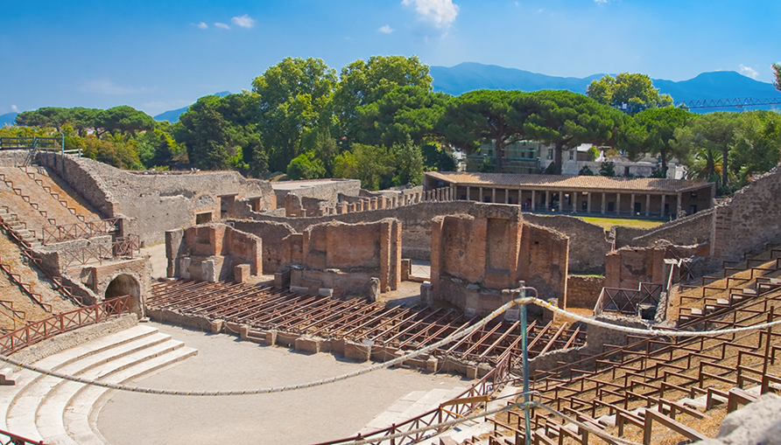
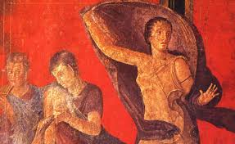
Pompei
This is one of the most importants archaeological sites in Campania where we can observe a reality dating back to 79 AD when the Vesuvio eruptioned.

Slide 9
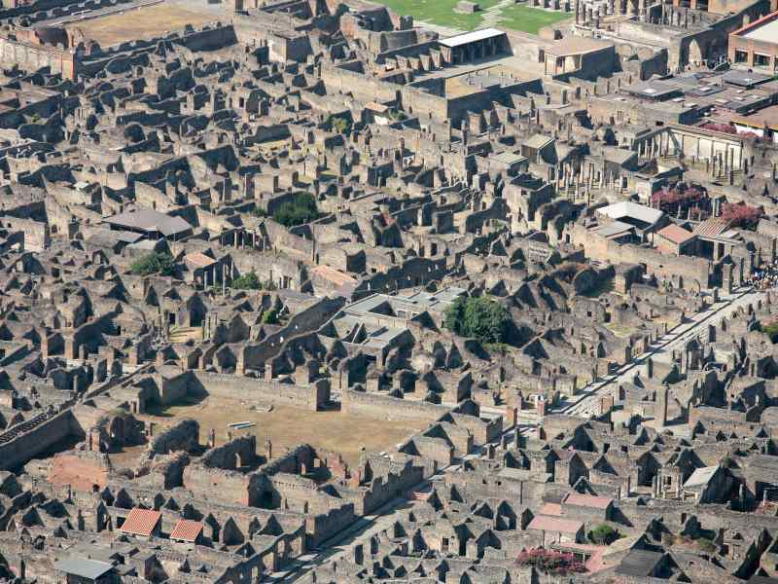
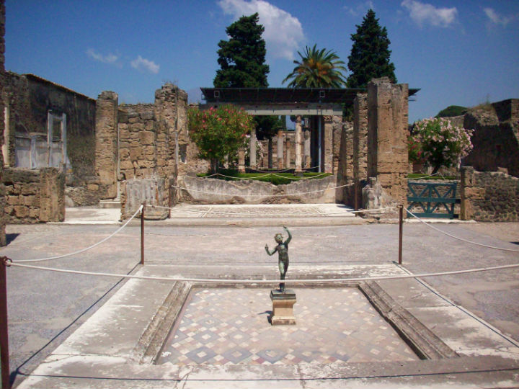
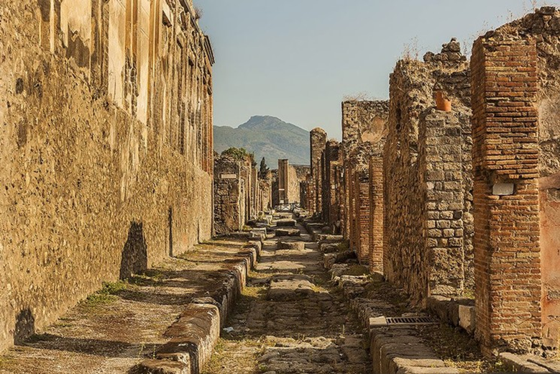

Slide 10
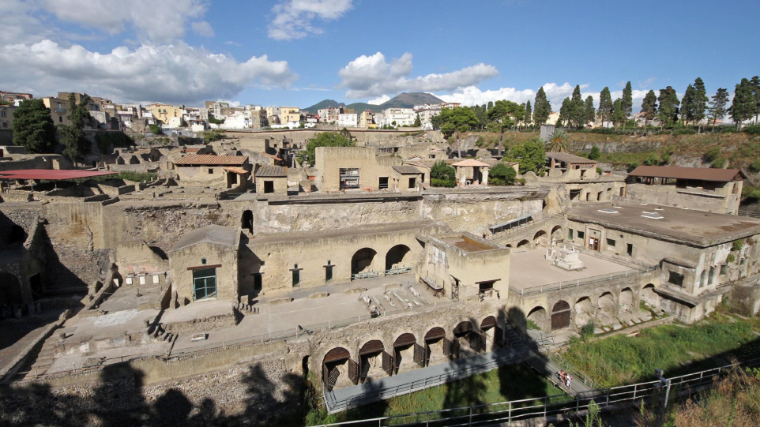
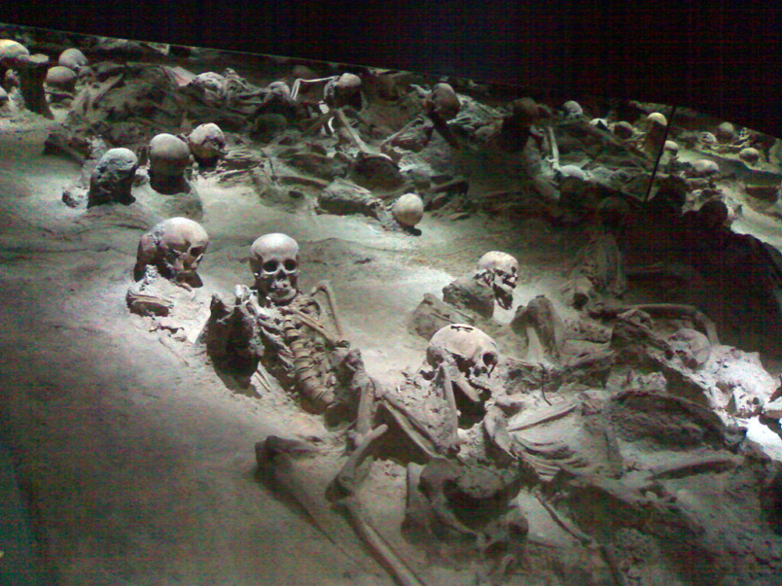
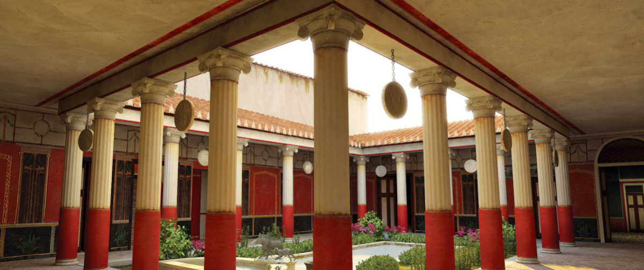
Ercolano
Ercolano is the another of the most importants Campania’s sities aercheological .

Slide 11
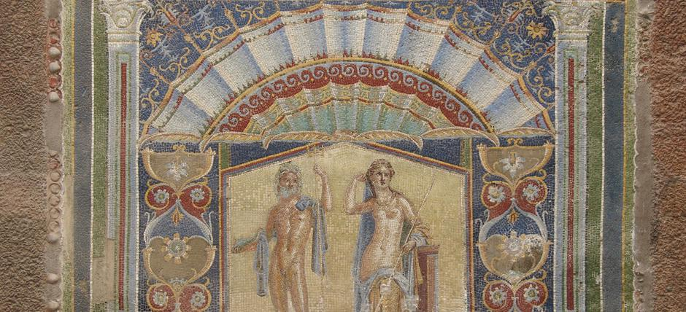
…And this is one the most importants painting in Ercolano’s archeological area.

Slide 12
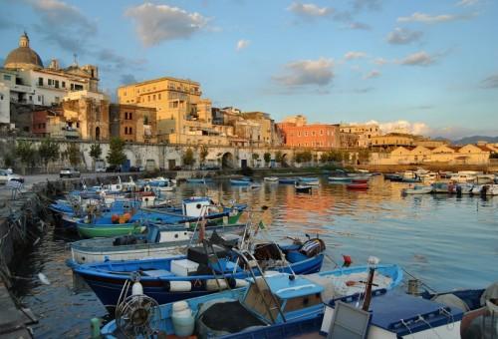
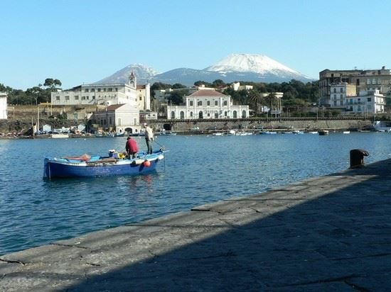
This is the Ercolano’s port :

Slide 13
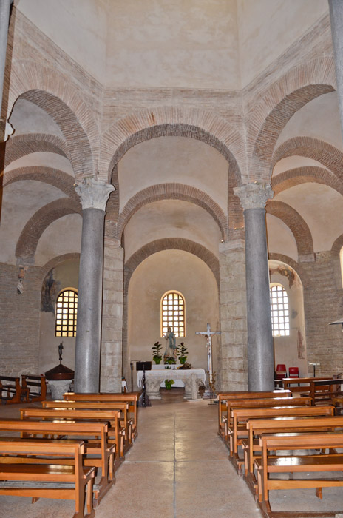
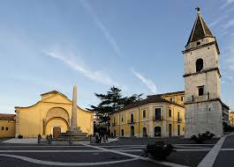
Benevento
The Saint Sofia’s church has been built by the longobards around the 600 AD.

Slide 14
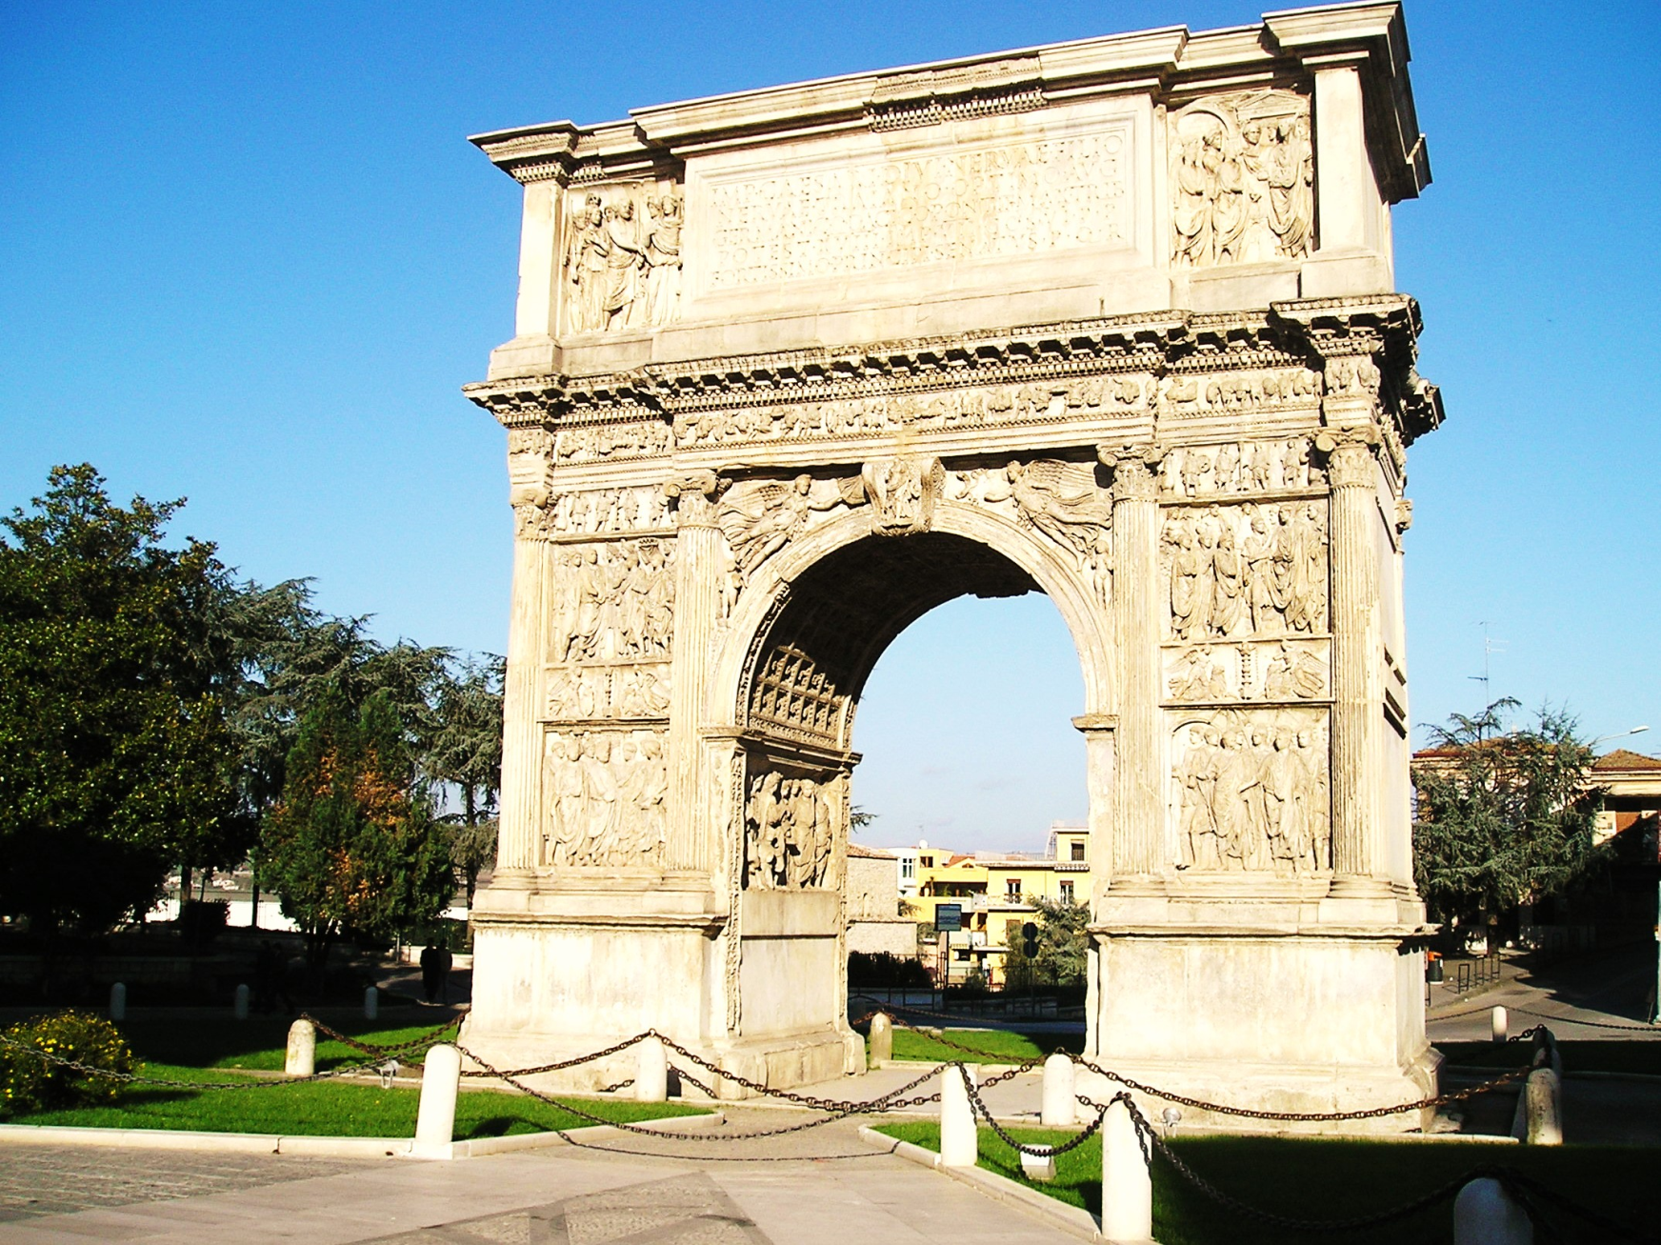
The Traian's bow of Benevento is a celebratory bow dedicated to the Emperor Traian on the occasion of the opening of the Via Traiana, a variant of the Appia Street which shortened the path between Benevento and Brindisi.

Slide 15
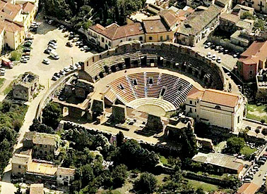
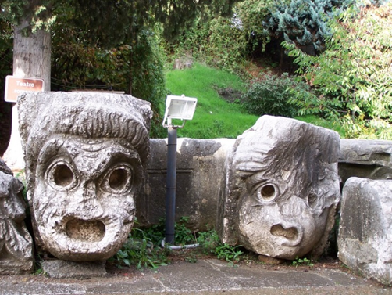
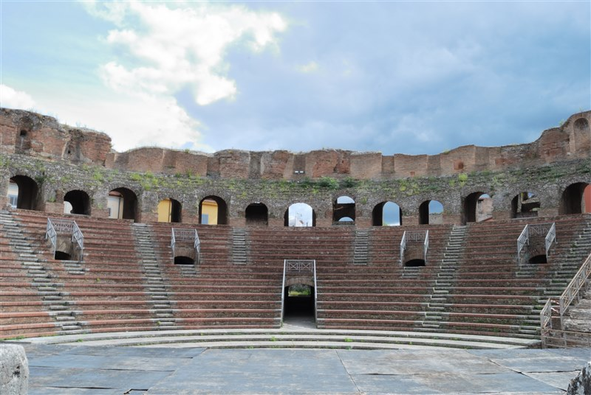
The Roman amphitheater of Benevento dates back to the first century AD, at the time of Emperor Nerone.

Slide 16
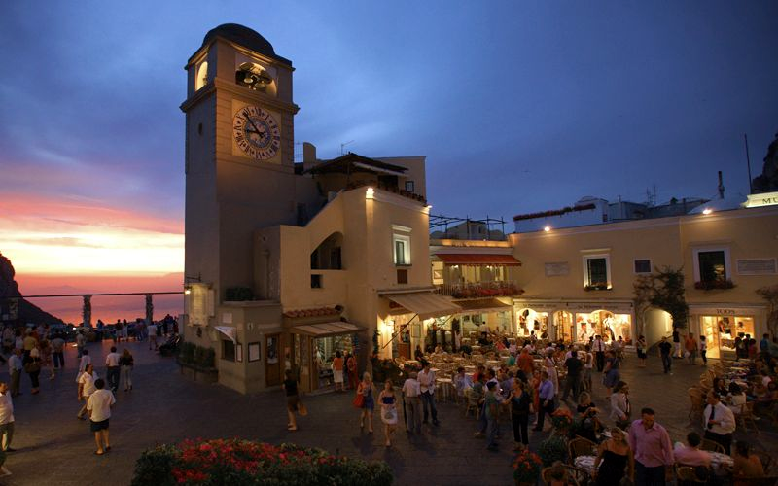
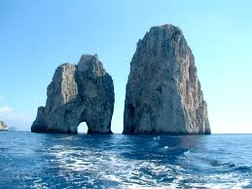
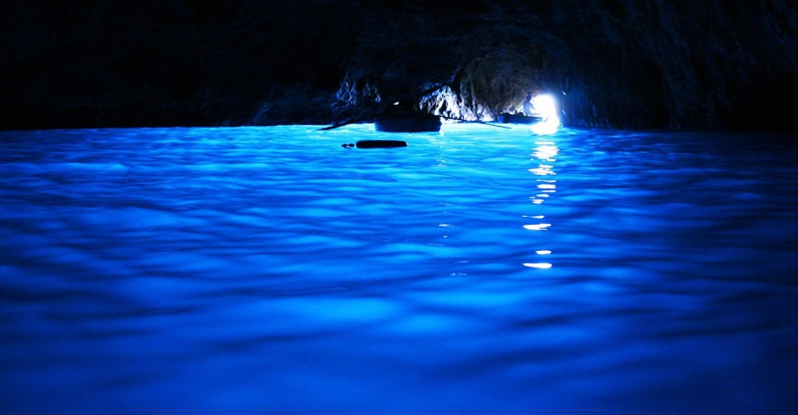
Capri’s island
Capri is one of the most beautiful places in our region, here we can see the faraglions, various caves such as the "blue cave" and finally among the typical alleys of the area the famous «Capri’s square».

Slide 17
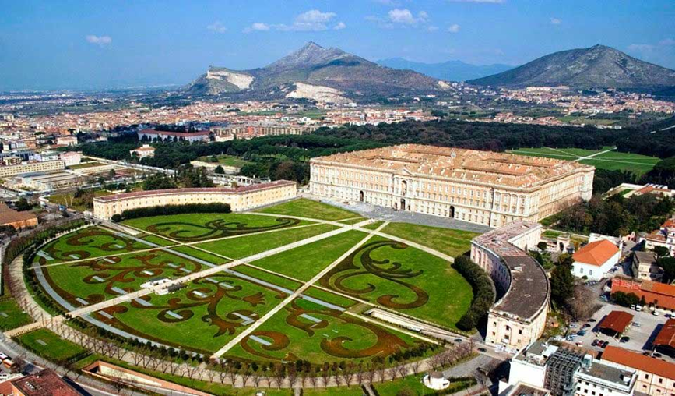
The Caserta’s Palace
It is the largest royal residence in the world per volume and the historic owners were the Bourbon of Naples..

Slide 18
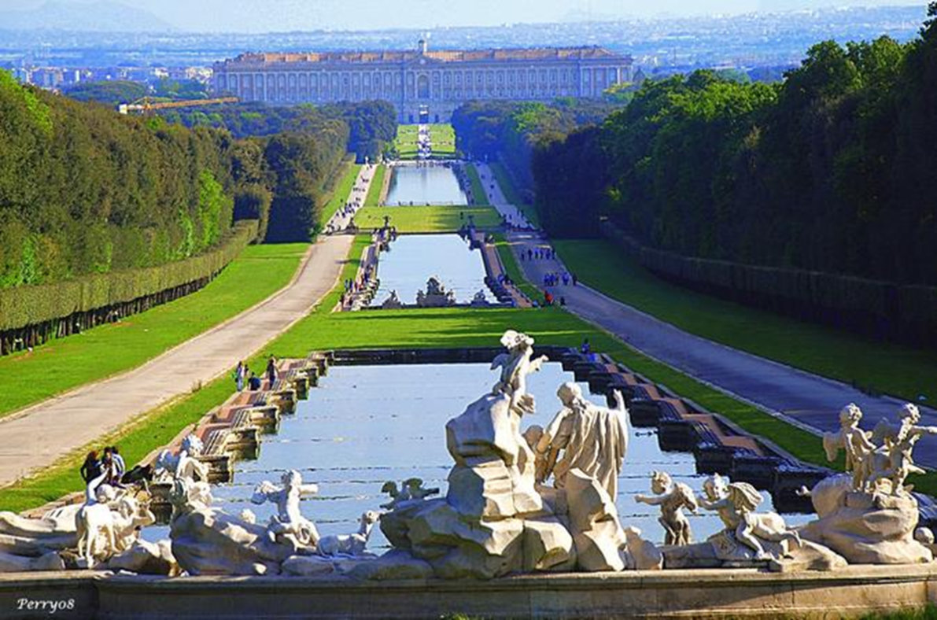
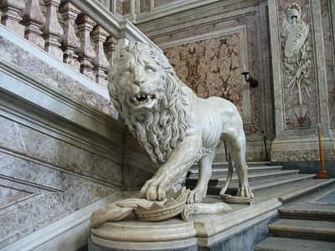
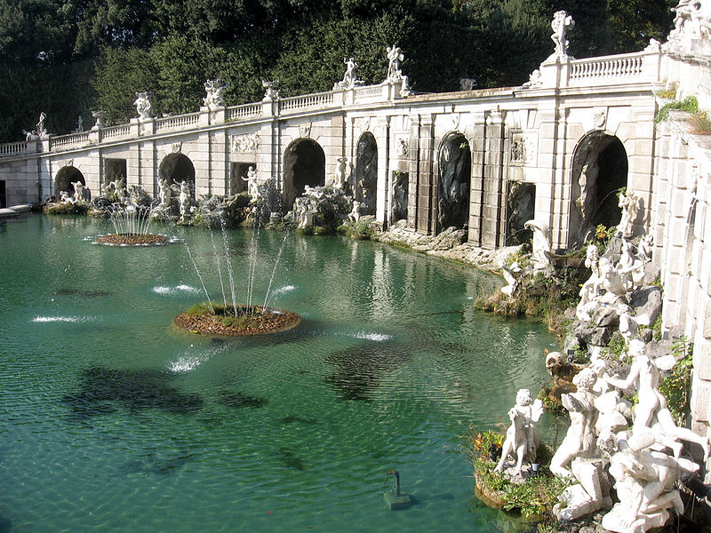
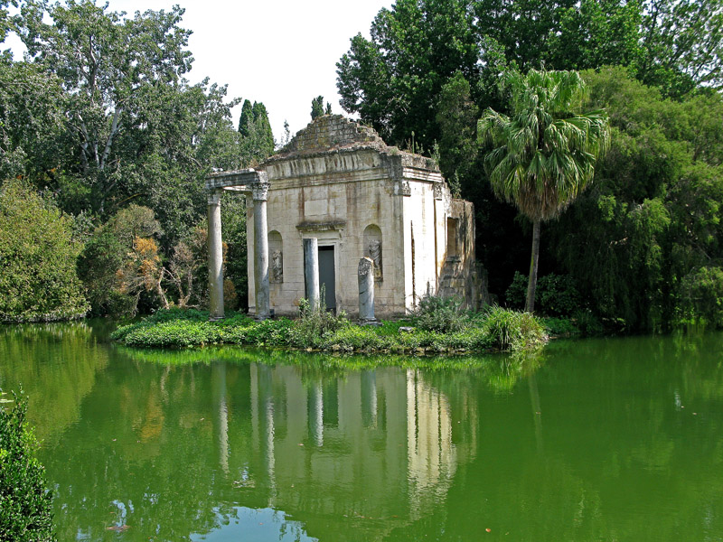

Slide 19
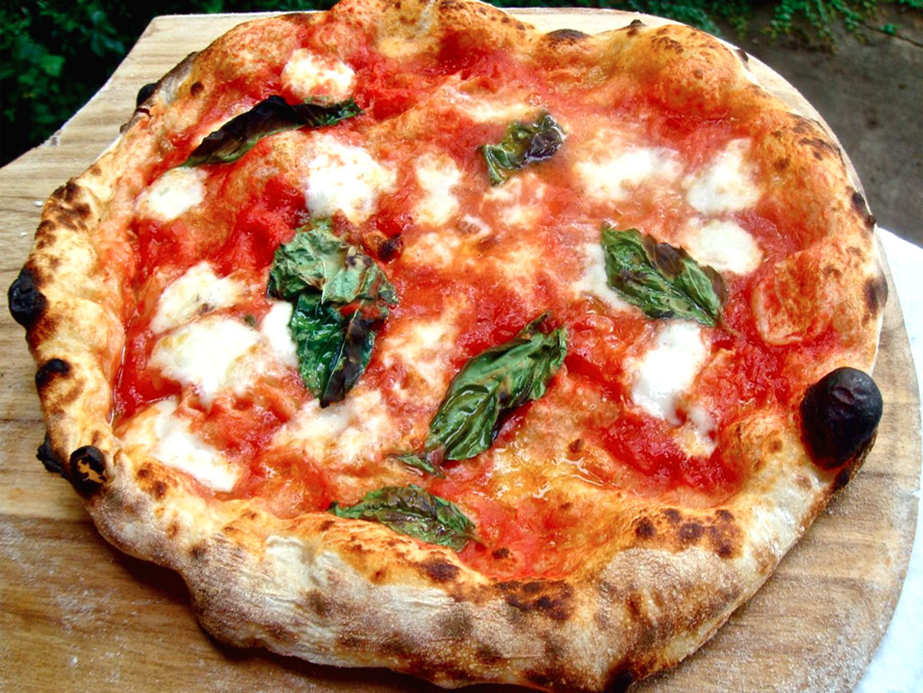
The typical products of the area are : oil, mozzarella, wine,a lot of sweets and finally there is ,in particular, the food that is known in all over the world today: the PIZZA !

Slide 20
Made by:
Vittoria Clemente
Veronica De Simone
Vincenzo De Mizio
Assunta Damiano
Gaia Valeria Gallo
High school «Enrico Fermi»
a.s. 2016-2018

