Slide 1
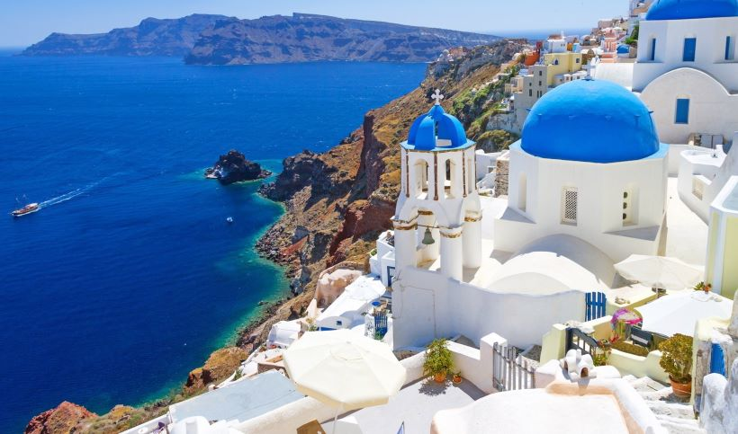
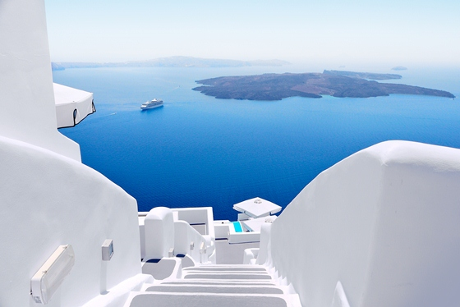
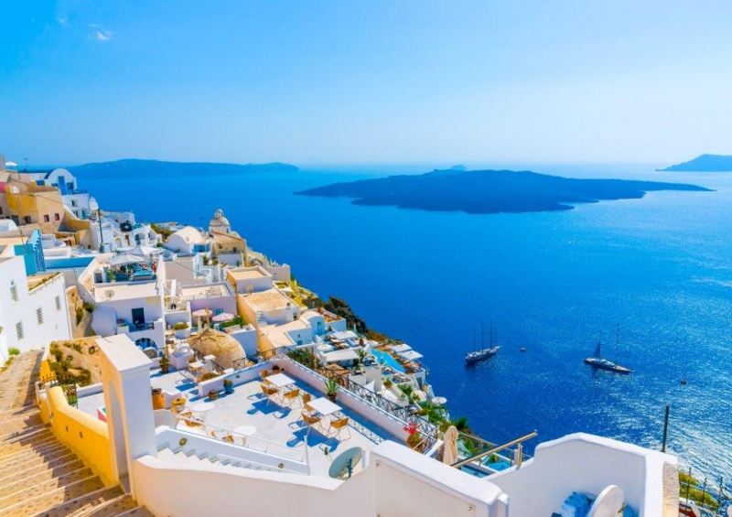
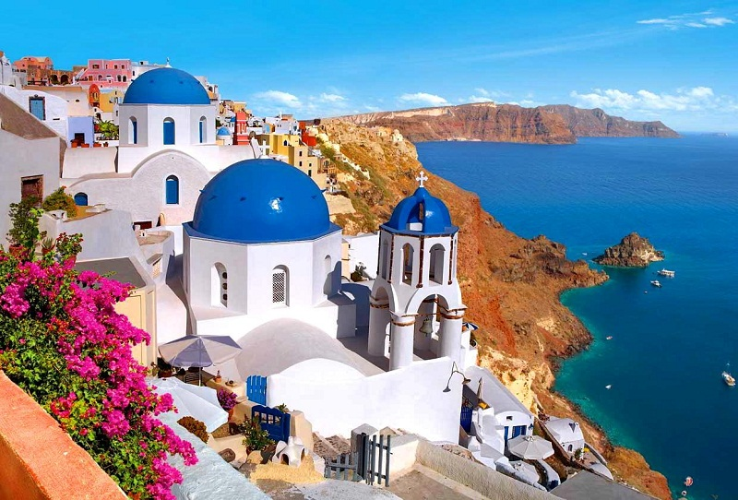
SANTORINI

Slide 2
Santorini, Thira or Stroggili (former name) is an island located in the southern Aegean Sea, the island complex of the Cyclades.

Slide 3
She is known for her volcano. The last volcanic activity was the year 1950.

Slide 5
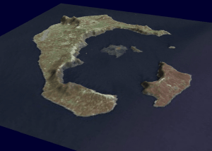
Santorini belongs to the volcanic arc of the Aegean and is characterized as an active volcano along with Methana, Milos and Nisyros. Santorini as well as the islands of Thirassia and Aspronissi are remnants of the volcanic island of Strongylis.

Slide 7
Strongyli was a volcanic cone. The central part of it was blasting along with the crater of the volcano from the Minoan eruption in 1613 BC. and resulted in the creation of what we now call the caldera of Santorini and the destruction of the prehistoric civilization of the island.

Slide 8
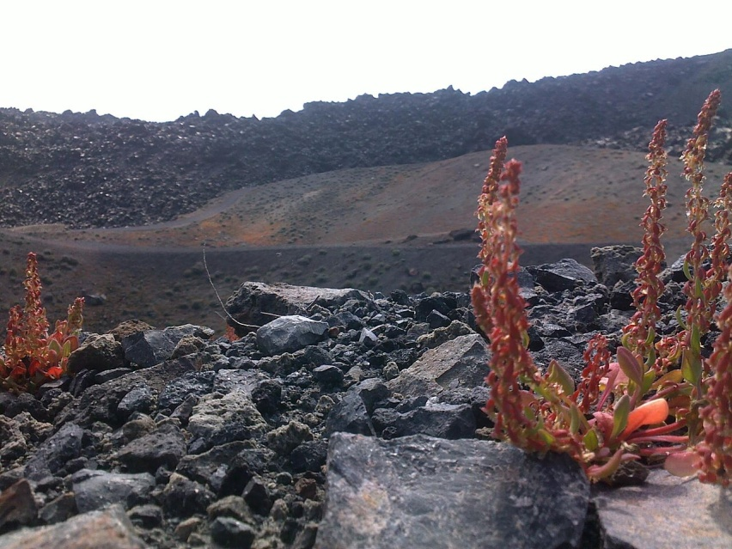
Before the volcanic activity began in Santorini, two and a half million years ago, Santorini was a small island consisting of metamorphosed rocks, mainly metamorphosed limestones and schists.

Slide 9
These rocks are now strongly altered.

Slide 10
Then, around 500,000 years ago, the volcano of Peristeria, which produced Andesian lavas, was created on the north of the island.

Slide 11
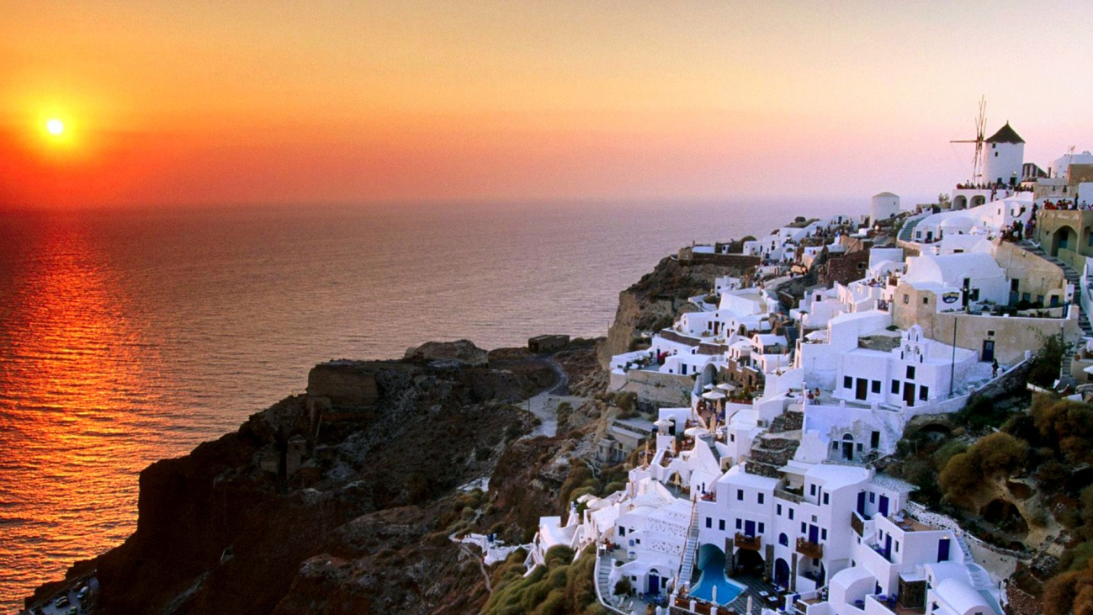
Today remains of this volcano are located in Mikro Prophet Elias and the Great Mountain.

Slide 12
During the last eruption and earthquake of 1956 in this caldera a tsunami was lifted that destroyed all the floats that existed in the area as well as almost all the coastal buildings of the wider region. Then Santorini mourned 53 victims.

Slide 13
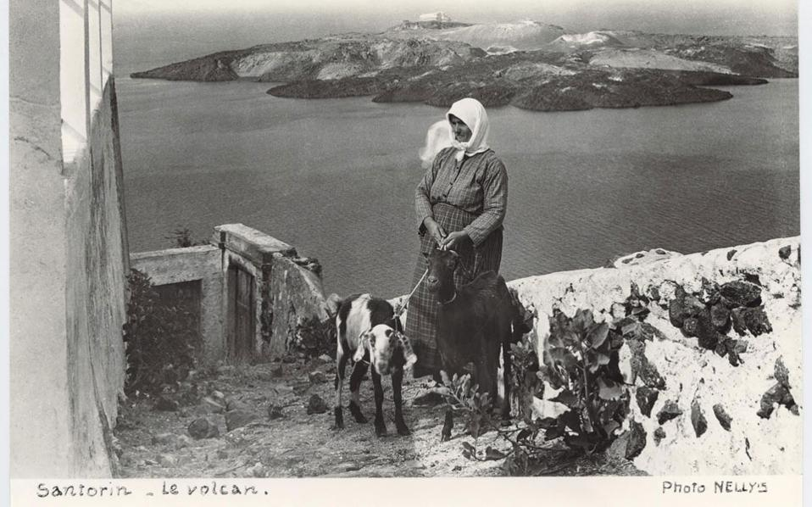
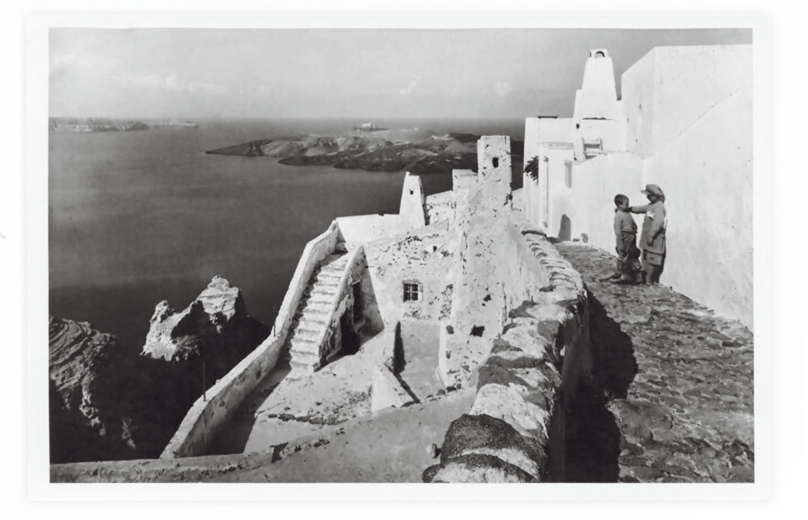

Slide 14
Today the site is accessible by boat that approaches an existing small bay of Nea Kameni. The diameter of Caldera Santorini reaches 16 km.

Slide 16
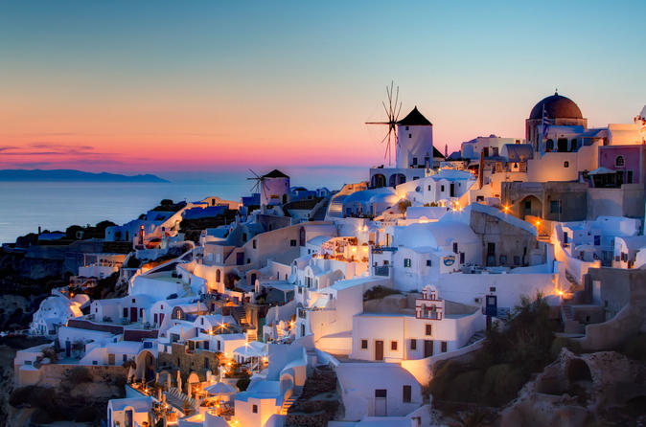
The island's capital is Fira.

Slide 17
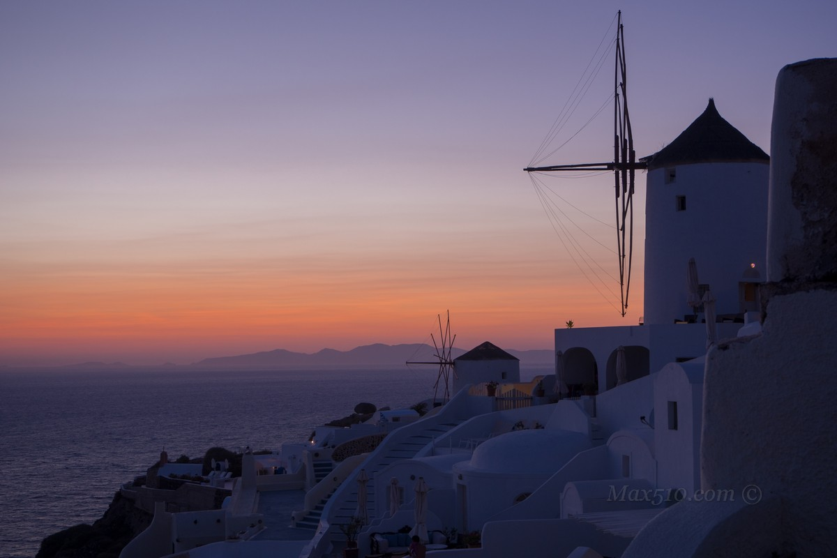
The second inhabited center on the north of the island is Oia, an old center renowned for its windmills and from which you can admire the sunsets on the Aegean Sea.

Slide 18
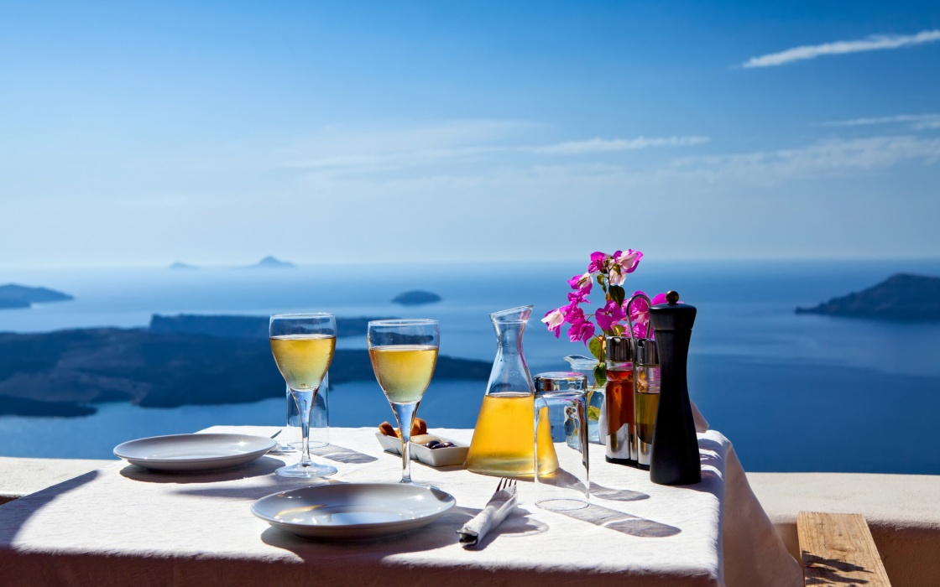
The main economic resource is the export of high quality wines and fine wines. The island produces a very sweet and full-bodied wine, the Vin Saint, not to be confused with the same Tuscan wine.

Slide 19
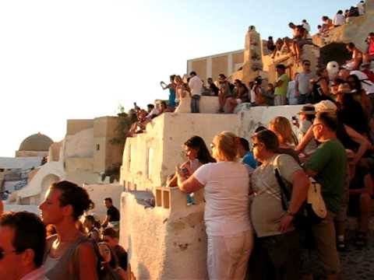
Santorini is also a renowned tourist resort.

Slide 20
ATHINA DROULIA ASSUNTA DAMIANO

