Slide 1
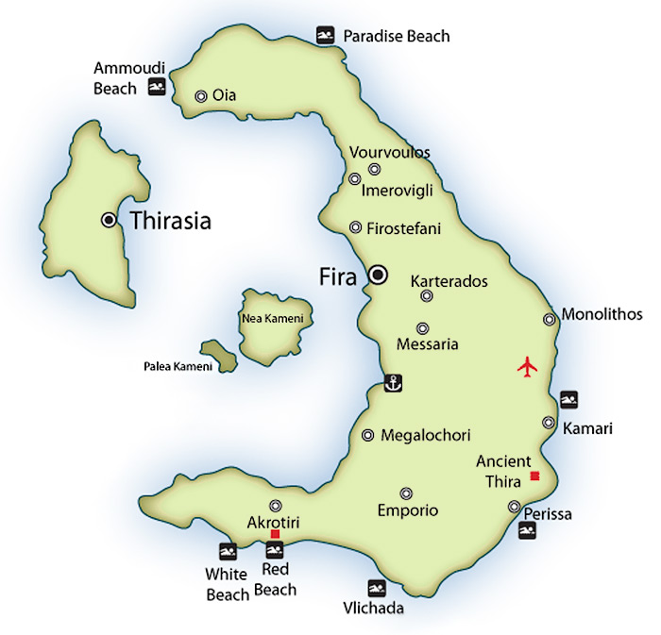
Greek Volcanoes and Earthquakes
By: Flowy-Ann FONCLAUD
Debora MANICORD

Slide 2
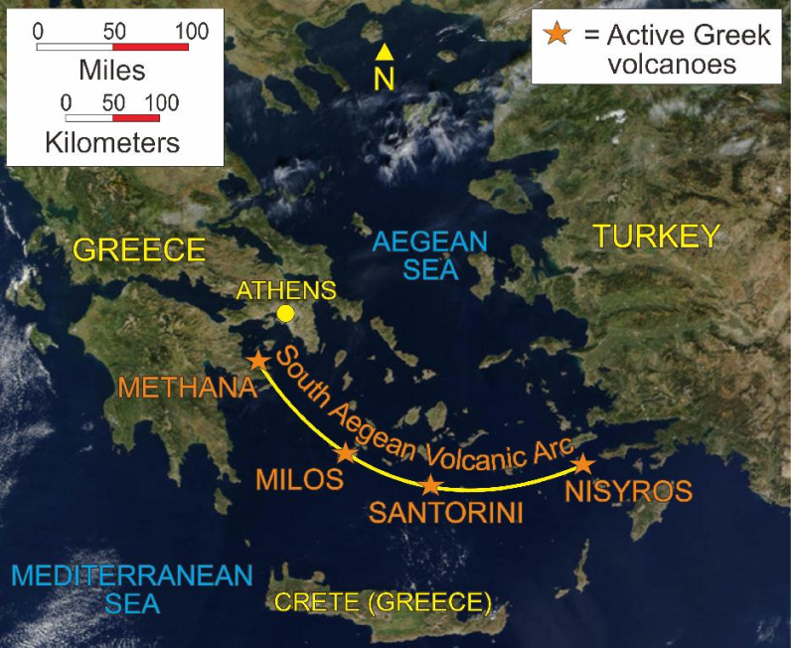
Greek Volcanoes
Methana
Kos
Nisyros
Poros
Sanntorini(Nea Kameni)
Yali
Aegina

Slide 3
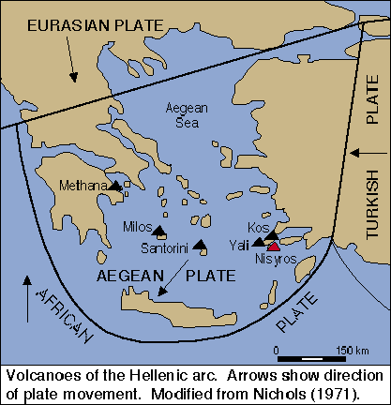
Geological Genesis
Add vidéo

Slide 4
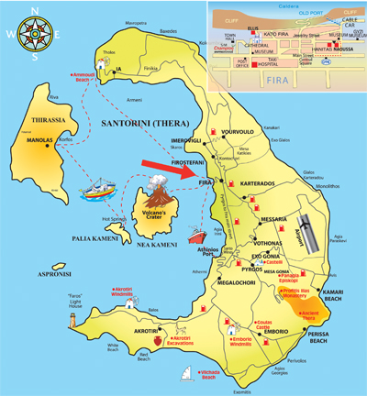
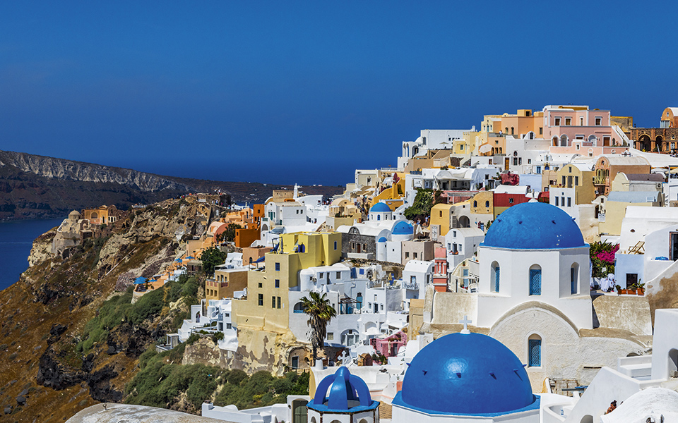
Volcanic Caldera
The largest known eruption happened about 3500 years ago and shaped the caldera we know today, which is considered one of the most beautiful in the world and which attracts hundreds of thousands of visitors every year, who come to admire the splendor of the sunset from Oia.
Santorini’s half-moon-shaped bay is the center of the caldera (a cauldron-like volcanic depression), which collapsed after a volcanic eruption during the Minoan civilization, eventually leading to their decline, just like Pompeii

Slide 5
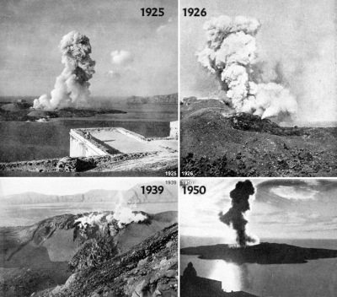
Minoan Eruption

Slide 6
« The Mycenaean Pompei »
“nuées ardentes” were released through a “split” in the cone wall, of limited area, generating a high velocity jet of tephra fluidized in a red hot gas stream. Such a jet is immensely destructive and lethal, causing death by pulmonary oedema. The shape (like a blowtorch) and course of the ash fallout, as measured by deep sea cores, shows that these nuées ardentes passed over the eastern part of Crete, causing severe destruction and depopulation.

Slide 7
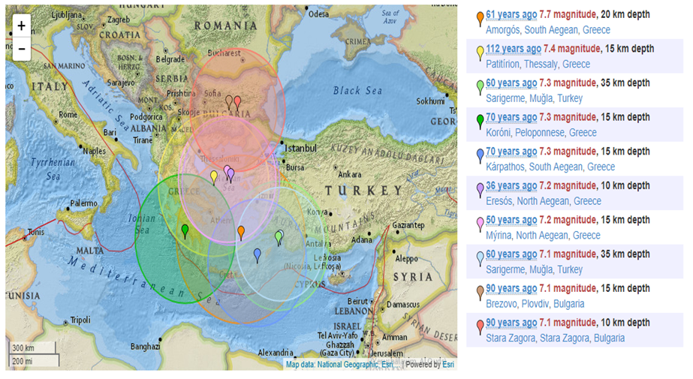
Greek Earthquakes

Slide 8
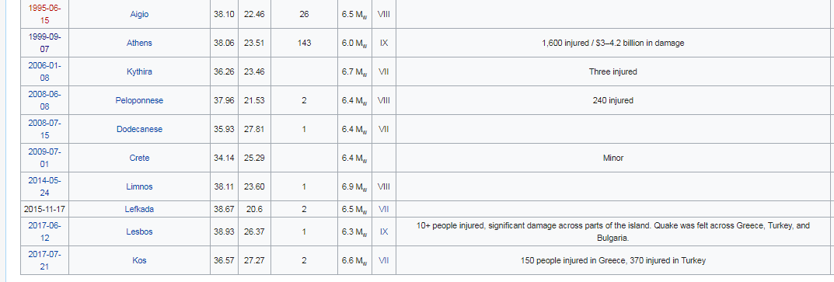
Greek Earthquakes
In 1956, an earthquake struck the island, which led to the collapse of the volcano’s magma chamber. The disaster also destroyed over 2,000 houses.

Slide 9
Geological Genesis of earthquakes
The high seismic activity of the country is due to the fact that it is located at the boundary of the Africa-Eurasia convergence. Within this framework, the Anatolian plate rotates counterclockwise(fig. 1). From the west, the Adria microplate rotates counterclockwise. As a consequence, the Aegean microplate moves fast towards SW. The external Aegean area is subject to a general compressional stress field and the inner Aegean area experiences a general extensional stress field.
Many of the quakes that strike Greece have their epicenters under the sea.While these can shake up surrounding islands, they rarely cause severe damage. The ancient Greeks attributed earthquakes to the God of the Sea, Poseidon, perhaps because so many of them were centered under the waters.

