Slide 1
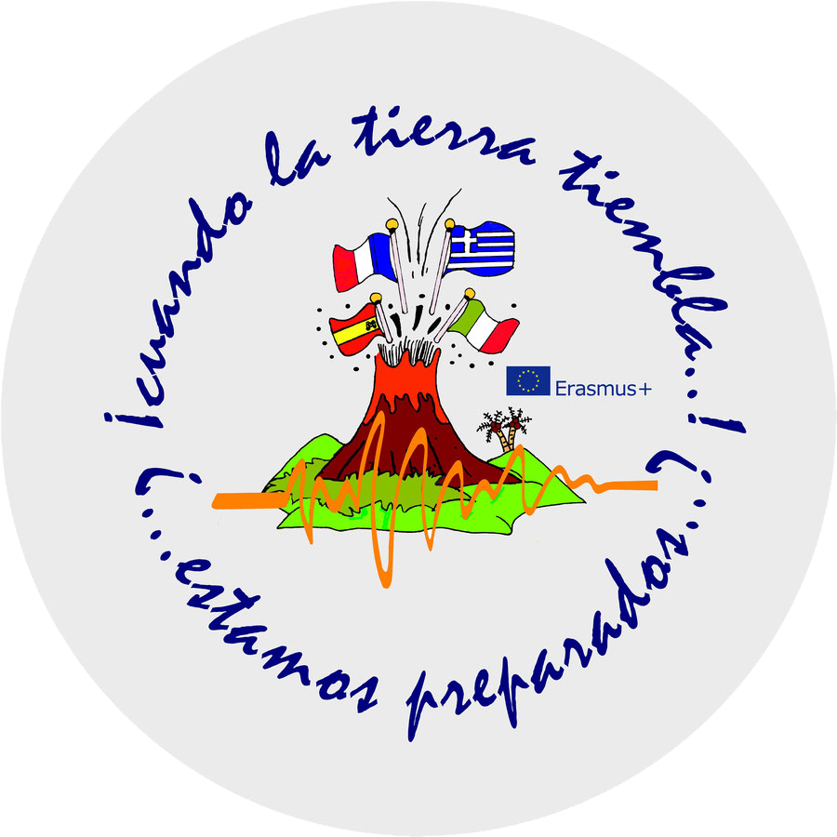
When the earth shakes! are we prepared?
ERASMUS 2017-2018
SPAIN
FRANCE
ITALY
GREECE

Slide 2
INDEX:
INTRODUCTION: The Mercalli Scale
1. Geological genesis of the volcanoes of the Volcanic Arc of the Antilles.
2. Study of the volcano La Soufrière de Guadalupe and analysis of its latest eruptions and its consequences in the surrounding areas.
3. Study of the flora and fauna of the Soufrière.
4. Analysis of the last eruption of the Soufrière Hills volcano on the island of Montserrat near Guadeloupe.
5. Geological genesis of the dolinas "Mare au Punch" and "Gueule Grand Gouffre".
6. Genesis of the Guadeloupe earthquakes, analysis of the "Barre de l'ile" and Malendure seismic fault.
7. Analysis of the geothermal power generation plant in Bouillante.
8. Study of the Marina Costeau Nature Reserve and the mangroves of Vieux-Fort in Marie Galante.

Slide 3
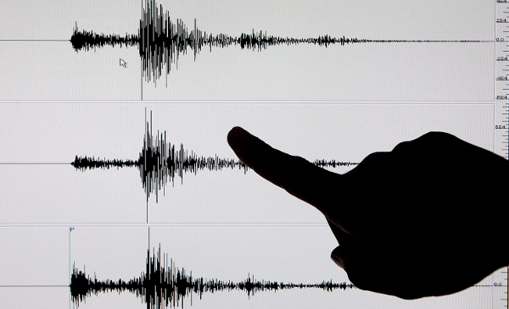
LA ESCALA MERCALLI THE MERCALLI SCALE
INTRODUCTION
Estefanía Vázquez y Noémie Gorjux

Slide 4
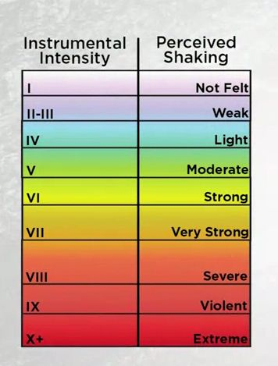
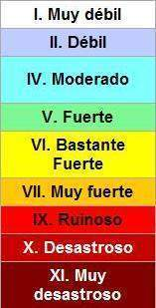
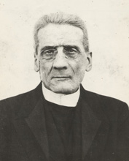
¿Qué es la escala Mercalli? What is the Mercalli scale?
The name of Mercalli Scale refers to the Italian seismologist Giusseppe Mercalli, who created the ,measurement in 1902- is a 12-point scale written in Roman numbers.
This is based on the effect or damage produced in the structures and the sensation perceived by the people. Therefore, the Mercalli Scale evaluates the intensity of the earthquake according to these indicators. In addition, to establish the intensity are considered historical records, interviews, newspaper news, among other aspects.

Slide 5
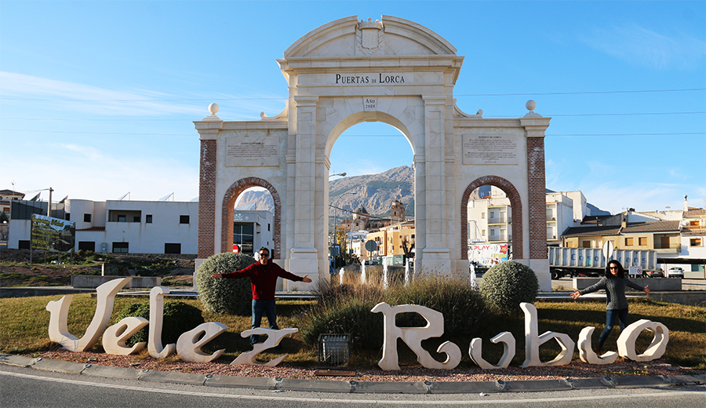
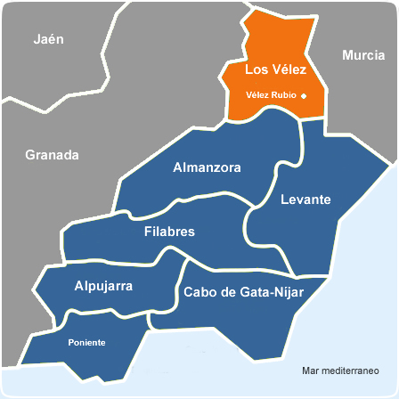
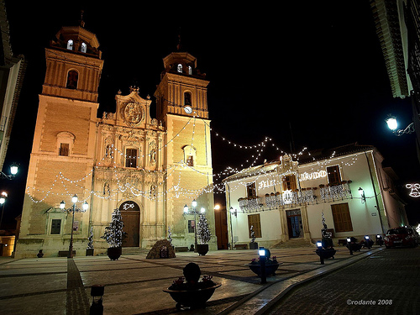
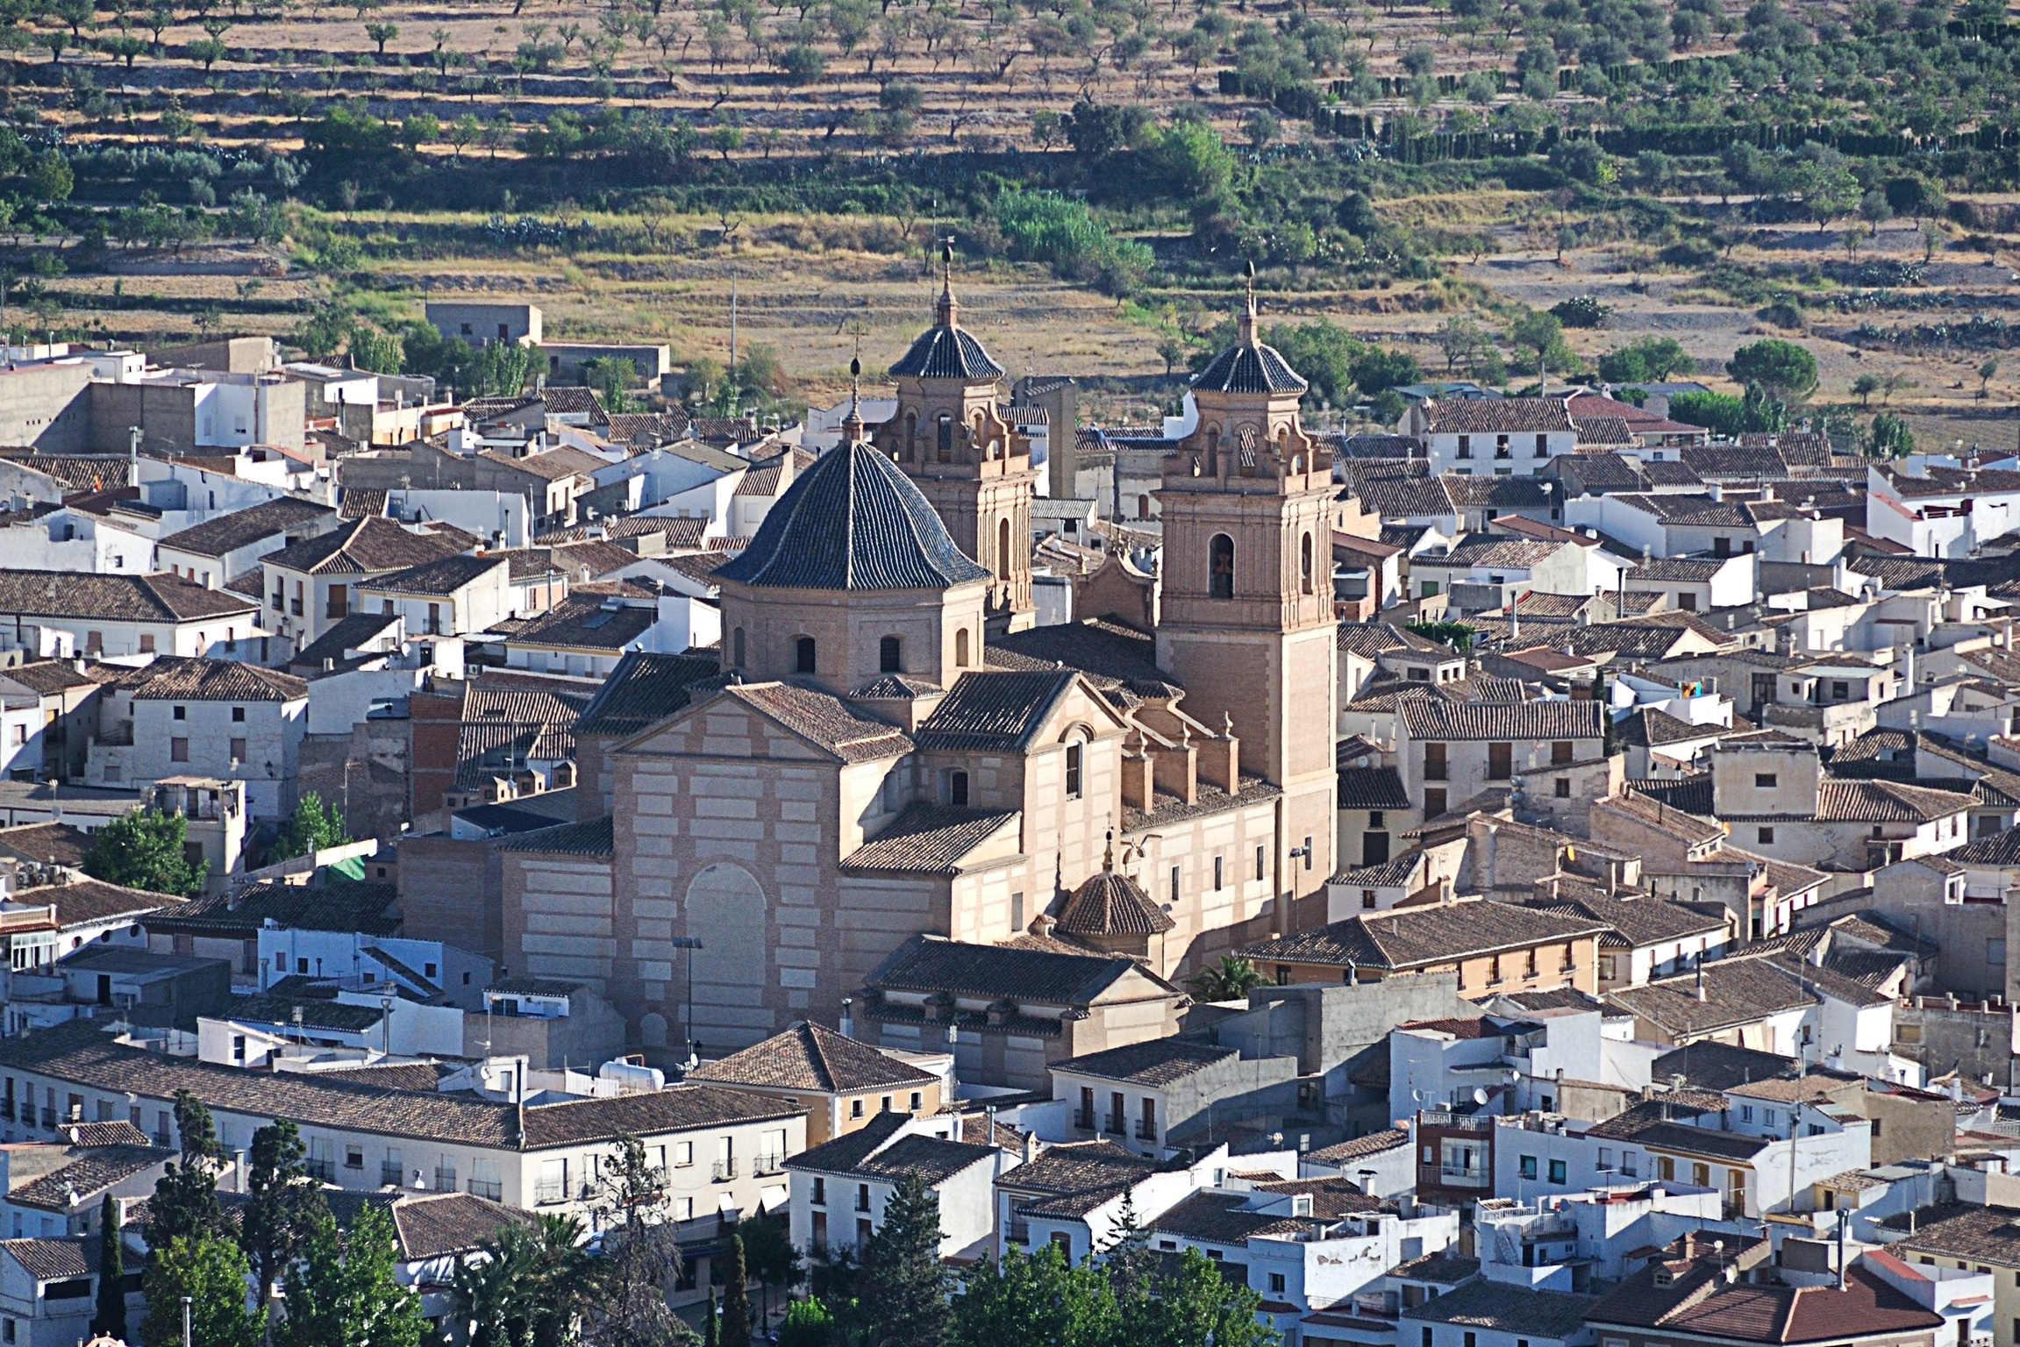
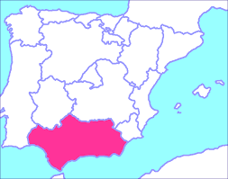
TERREMOTO DE VÉLEZ RUBIO, 1751 EARTHQUAKE OF VÉLEZ RUBIO
Grade VIII because many of the buildins were in such a ruinous state that they had to be demolished and rebuilt again, like the San Pedro’s Church, now La Encarnación’s Church and there were also severe damages in structures poorly constructed like the humble houses of the neighbours.

Slide 6
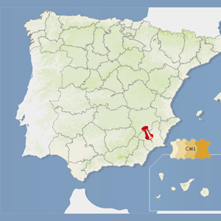
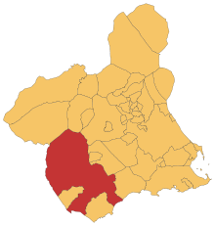
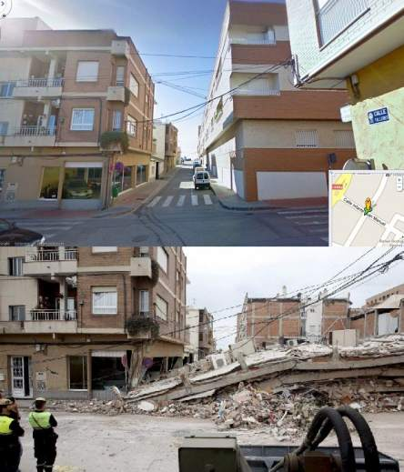
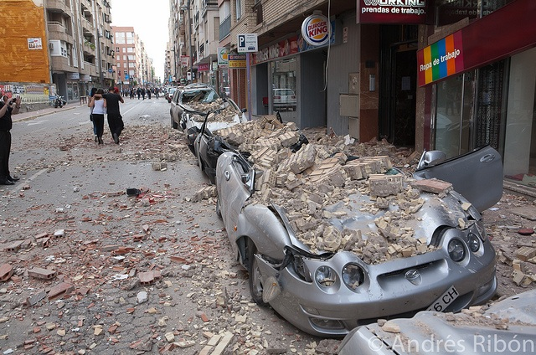
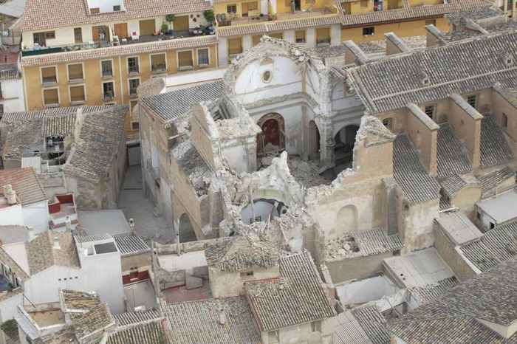
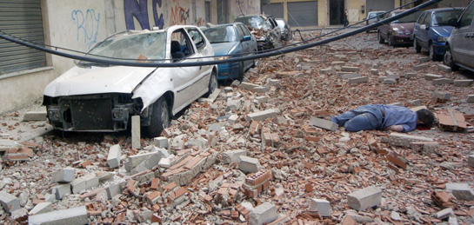
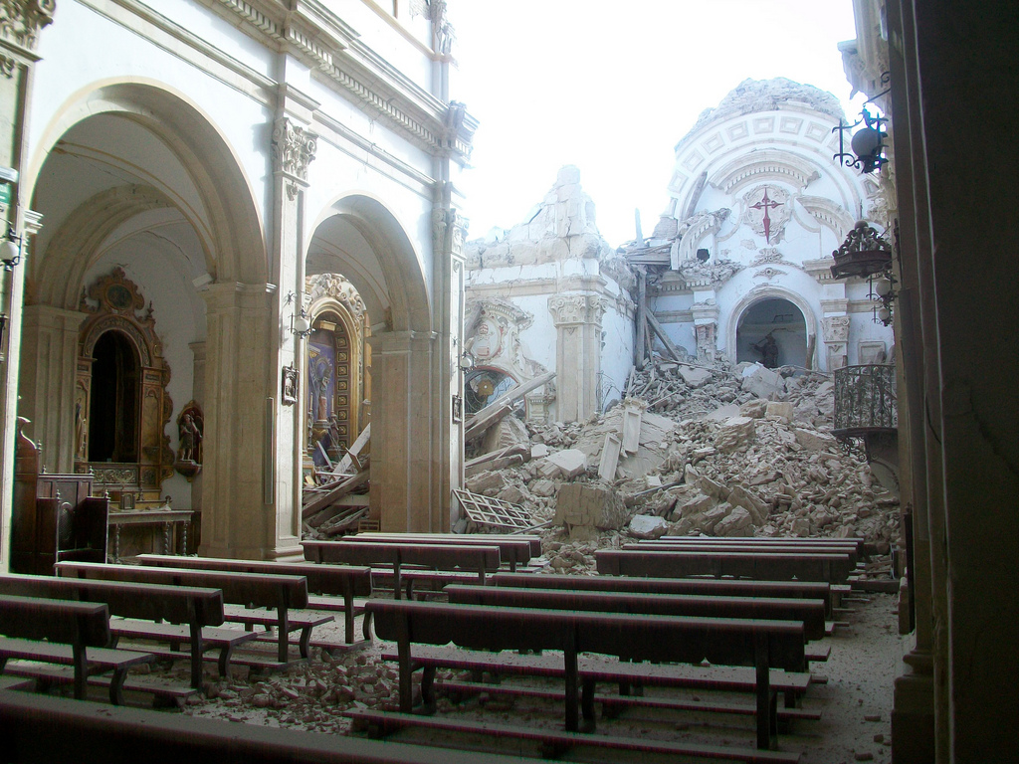
TERREMOTO DE LORCA, 2011 EARTHQUAKE OF LORCA
Grade VIII because as Toñi Castañeda tell us in her description, the earthquake was perceptible all over the world, including people in vehicles, with serious damages in buildings (cracks, broken glasses, broken pipings…) and damaged and completely removed furniture of place.

Slide 7
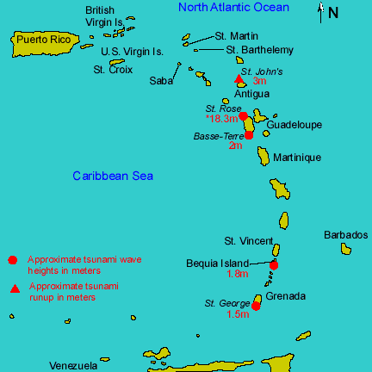
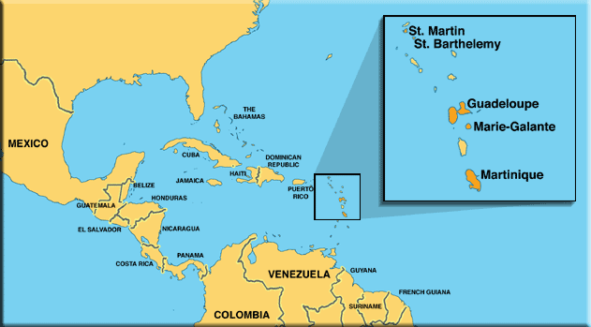
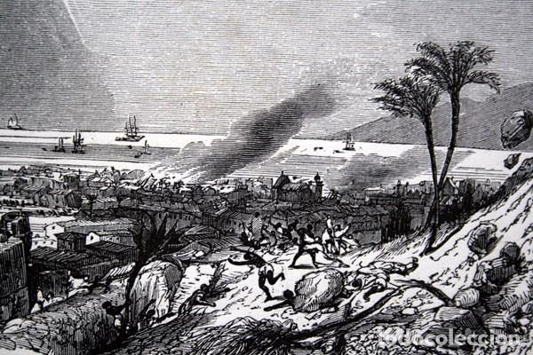
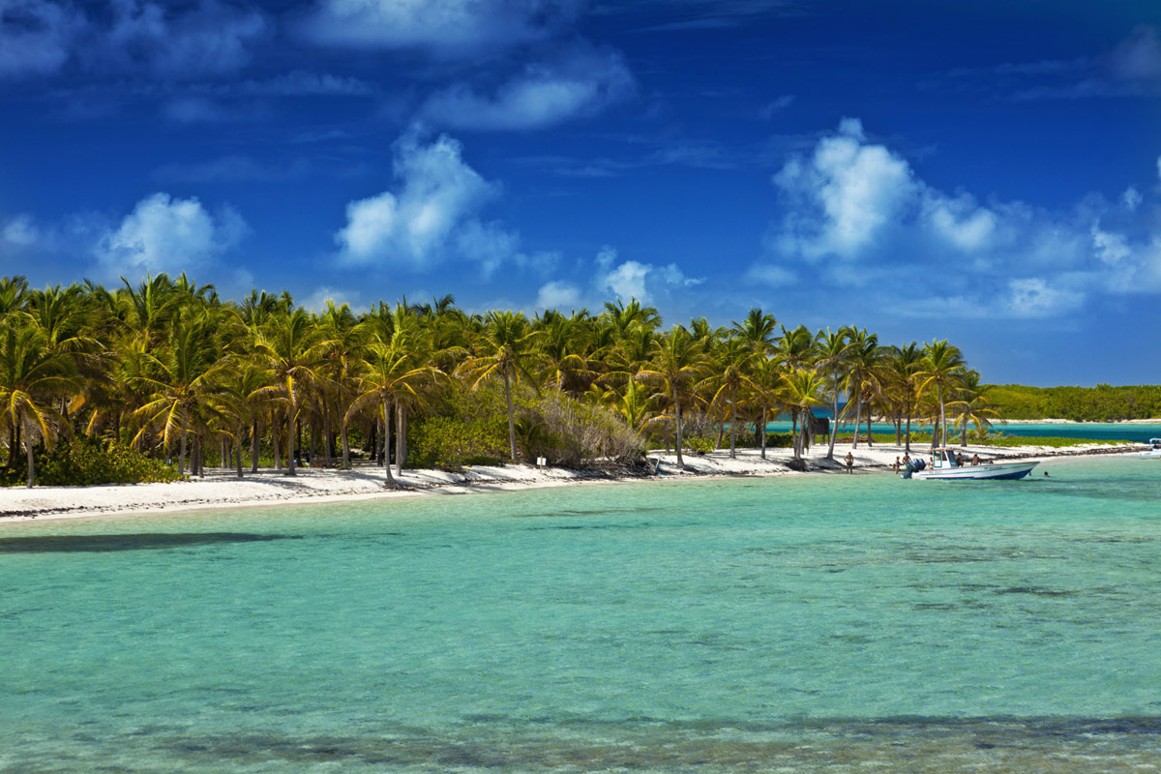
TERREMOTO DE GUADELOUPE 8 de febrero de 1843 EARTHQUAKE OF GUADELOUPE OF FEBRUARY 8 1843
Grade X or XI because of the considerable damages in buildings and wooden constructions, buildings were separated from the foundations, many peole lost their homes, there was general panic and people fell to the ground during the earthquake…

Slide 8
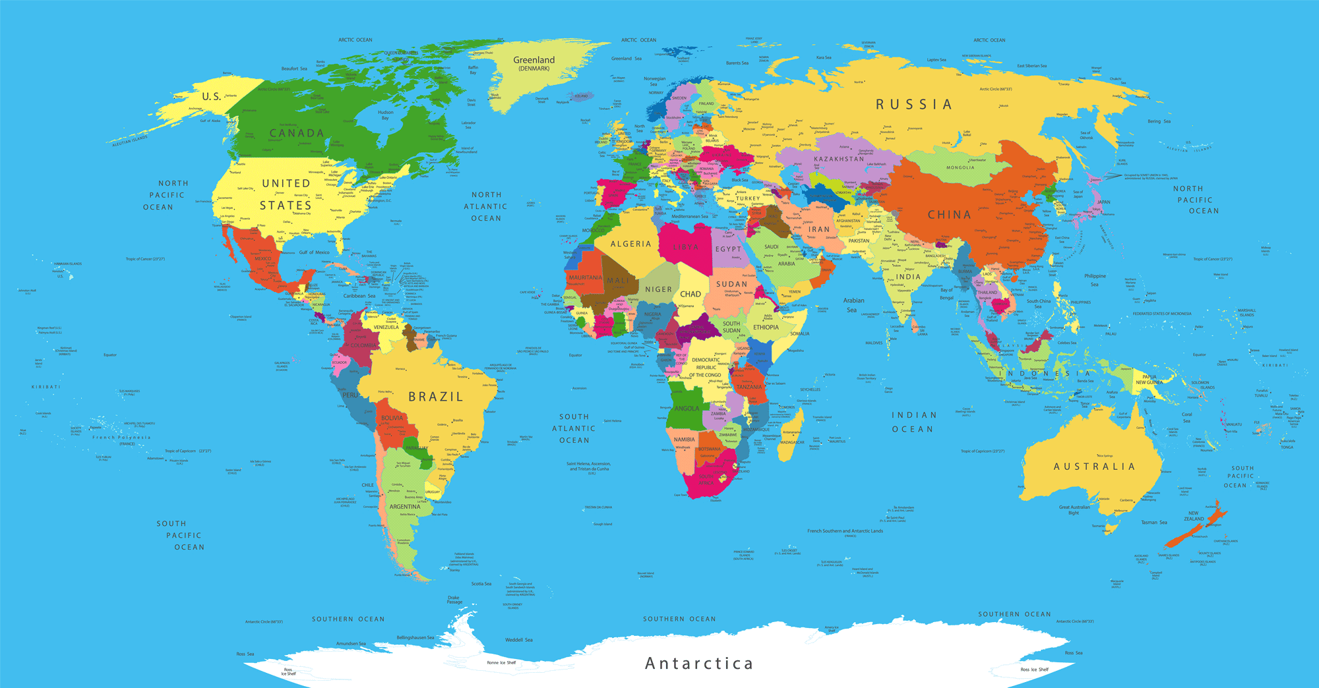
SPAIN-GUADELOUPE

Slide 9
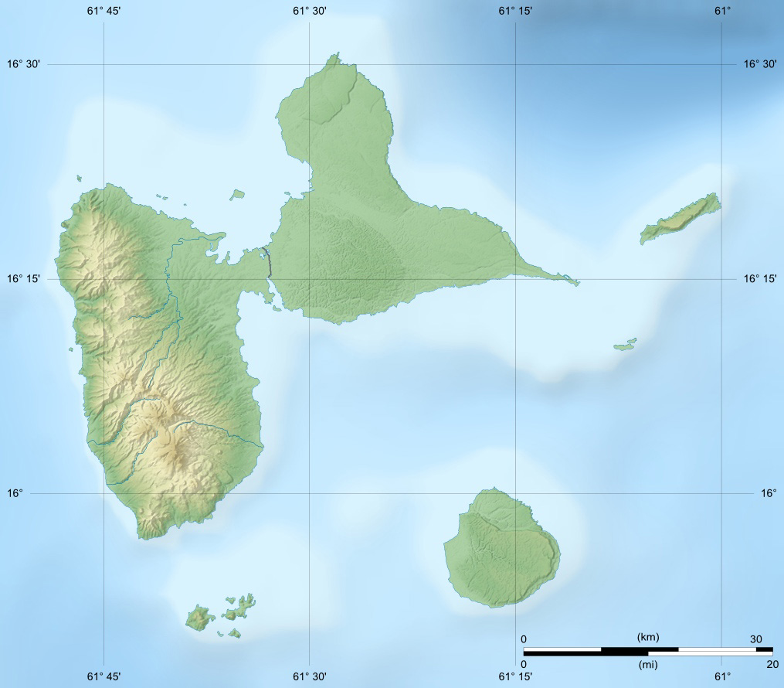
POINTE-NOIRE

Slide 10
1. Geological genesis of the volcanoes of the Volcanic Arc of the Antilles.

Slide 11
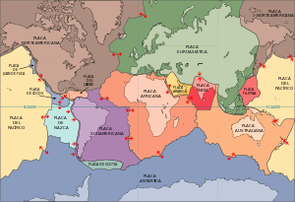
1.1 Situation of the islands
The smaller Antillas coincide with the edge of the outdoor plate of the Caribbean plate

Slide 12
1.2 how are they formed?
The volcanism in Basse Terre started 3 millions years ago withe the shape of the Complejo Basal and the Cadena Norte, in the north end of the island

Slide 13
How are they formed?
Most of the islands were formed for subduction, when one or more Atlantic plates slipped under Caribbean plate

Slide 14
1.3 the formation process
In the subdutcion area, the edge of the plate slips under the othet plate, oppressing her. When a continent is near to a subduction area, emerge along its coastline volcanos that they act like natural valves to break free presion produced for the push of the plate in subduction against the oppressed plate.

Slide 15
The formation process
Temperatures and pressure (which increase with depth) generate volatilization of part of the subduction plate components causing the melting of its mantle and generate a low density magma that rises from the lithosphere through the Earth's crust to the surface

Slide 16
The formation process
But if there is no land near a subduction zone, the resulting chain of volcanoes will emerge from the seabed constituting volcanic islands and will have the shape of an arc parallel to the boundary of the pressed plate

Slide 17
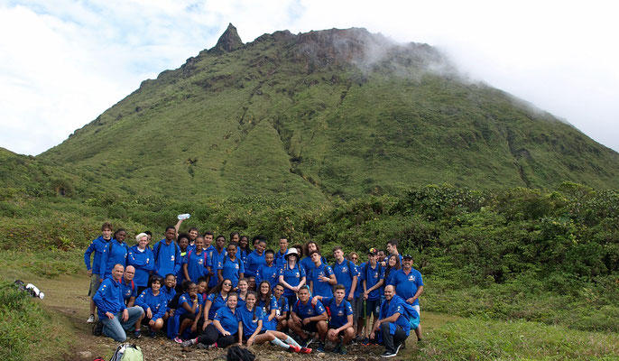
2. Study of the volcano LA Soufrière de GuadElOupe and analysis of its latest eruptions and its consequences in the surrounding areas.
2.1 LA SOUFRIÈRE.
It is the highest point of the Lesser Antilles, the dome of the Soufiére belongs to the volcanic complex of the Grande-Découverte, which was built around 200 000 years ago in southern Basse-Terre. In the shape of a truncated cone, the dome is relatively recent as it was built in the 15th century.

Slide 18
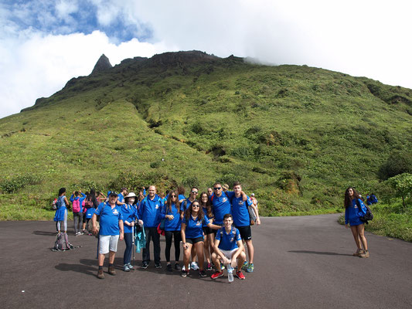
2.2 ANALYSIS OF ERUPTIONS.
Since its formation, the dome of the Soufriere, composed of relatively viscous lava and basaltic andesite, has experienced many eruptions in the terrain. These eruptions occur when the magma, without having to return to the surface, causes warming, deep aquifers of vaporization. This vaporization pressure then leads to fracture of the building and a sudden release of ash, boulders and residues of old lava and water vapor.

Slide 19
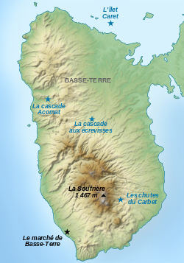
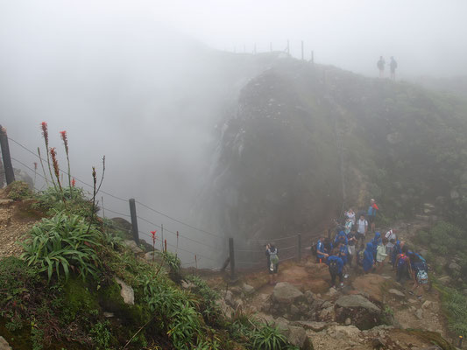
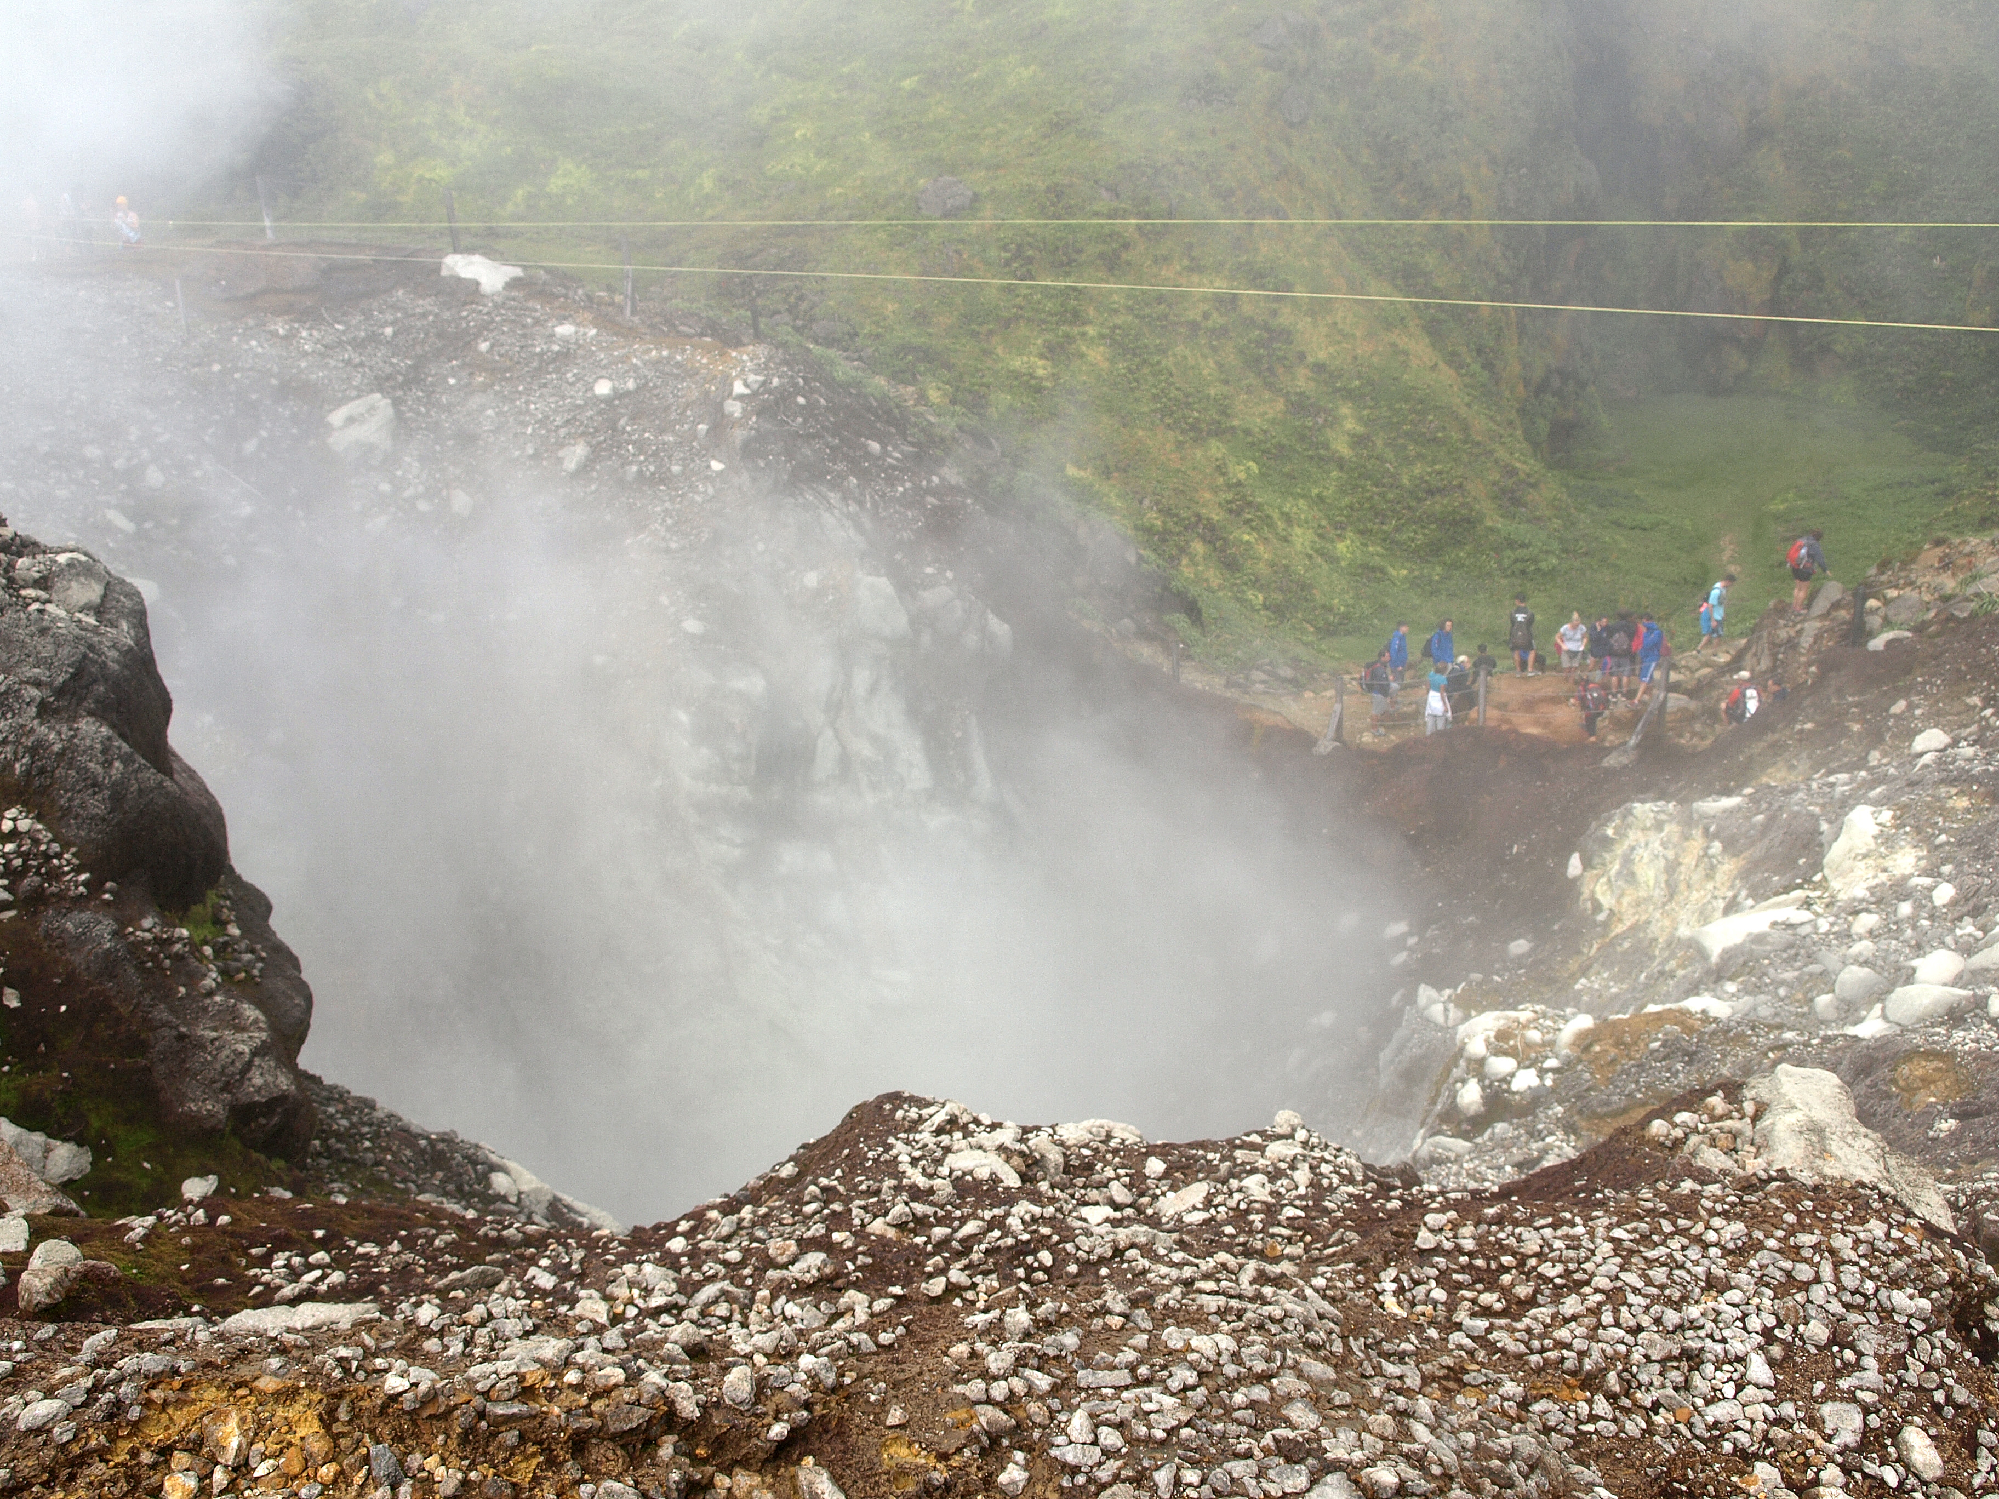
2.3 CONSEQUENCES
The last eruptions of the Soufrière are in 1976, when fears of a violent explosion of the dome had led the authorities to temporarily evacuate the population. Very fractured, the dome is now the site of hydrothermal activity.

Slide 20
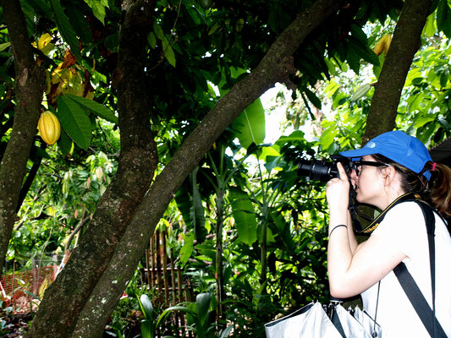
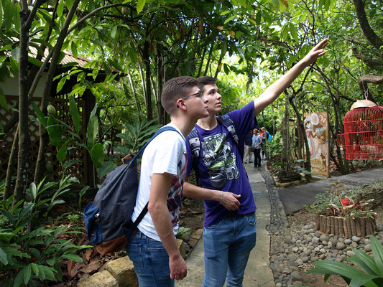
3. . Study of the flora and fauna of the Soufrière. .

Slide 21
3.1 Flora in Guadeloupe and Martinica
The flora is grouped into three large varieties of tropical trees and flowers:
Coconut trees, palm trees, bamboos, frangipani, hibiscus, bougainvillea and roses.
Beautiful coral reefs
Underwater life rich in species of various shapes and colors

Slide 22
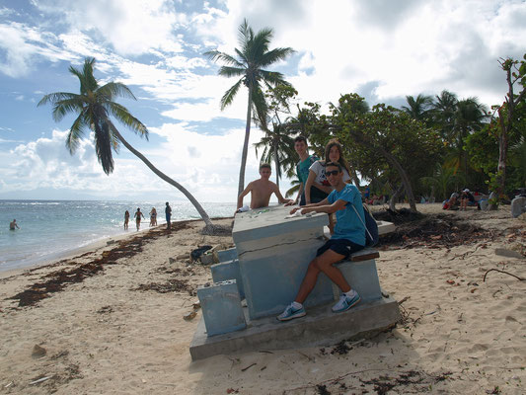
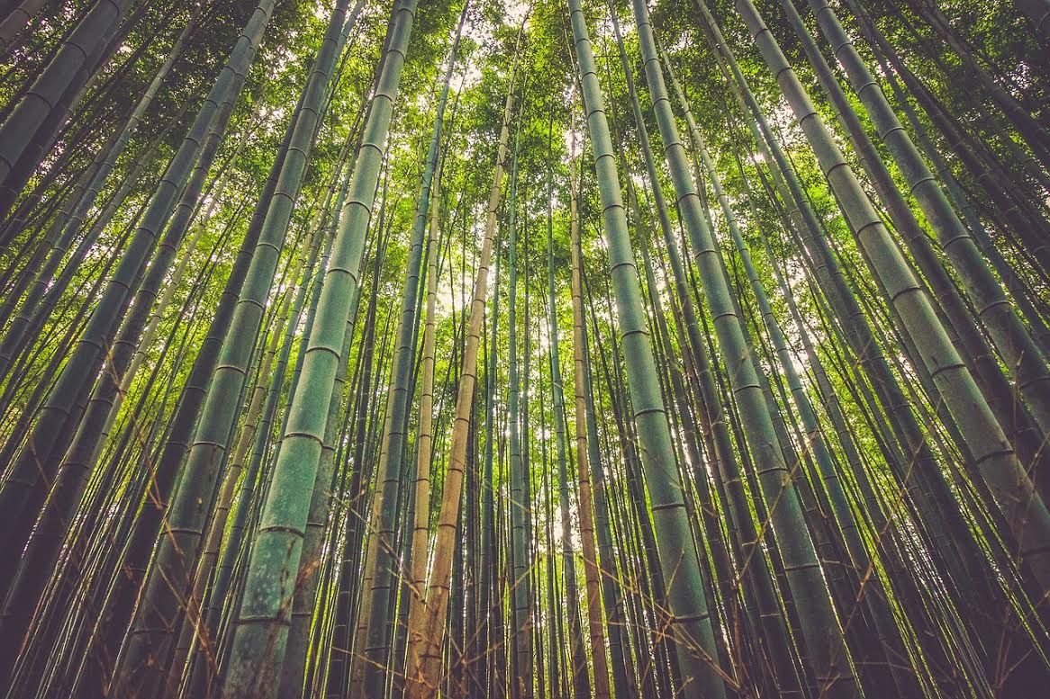
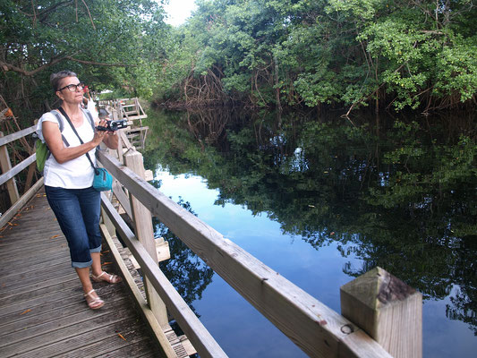
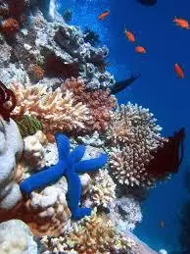
3.2 photos of Flora
Coconut
trees
bamboos
manglar
Coral reefs

Slide 23
3.3 Fauna in Guadalupe and Martinica
Wild animals
No dangerous species live
Raccoon is the symbol of the National Park
Different types of birds like the woodpecker, Blackbird or thrush
Most outstanding birds: pelican,
ciberon and malfini

Slide 24
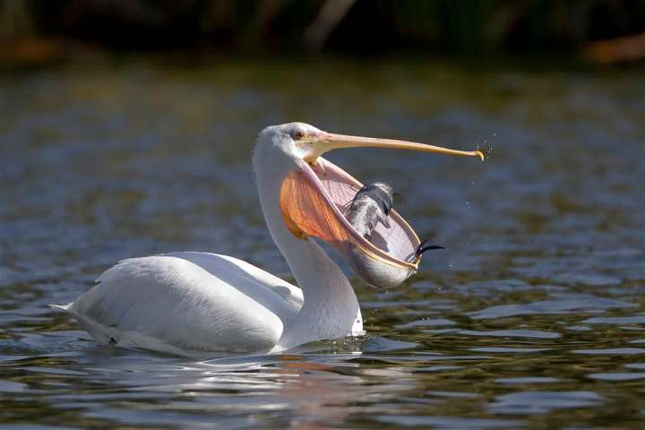
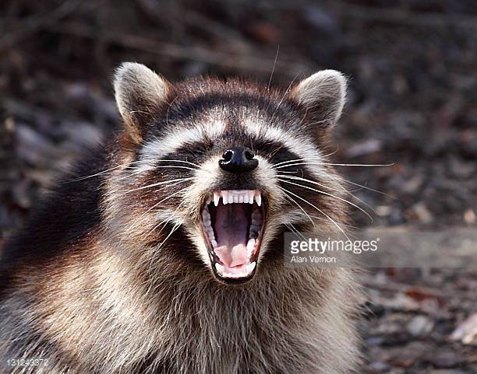
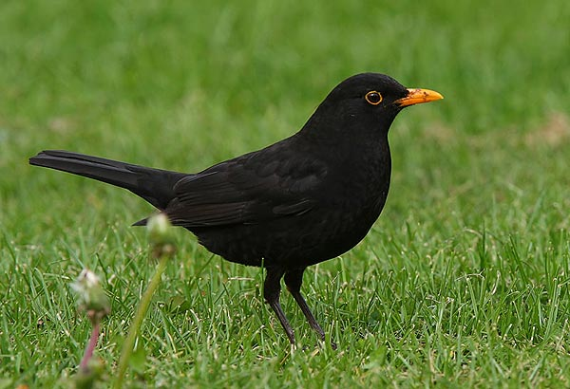
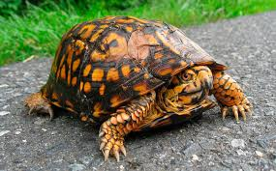
3.4 photos of Fauna
Pelican
Raccoon
Turtle
Blackbird

Slide 25
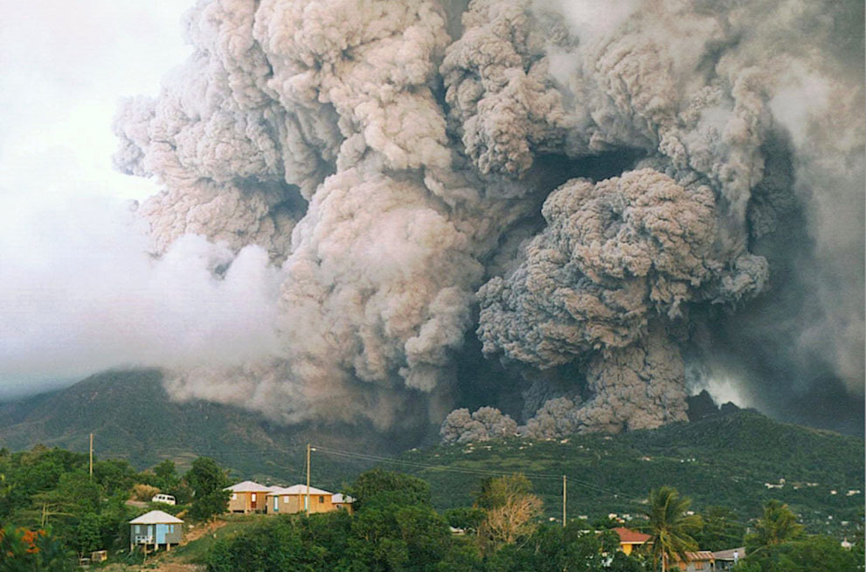
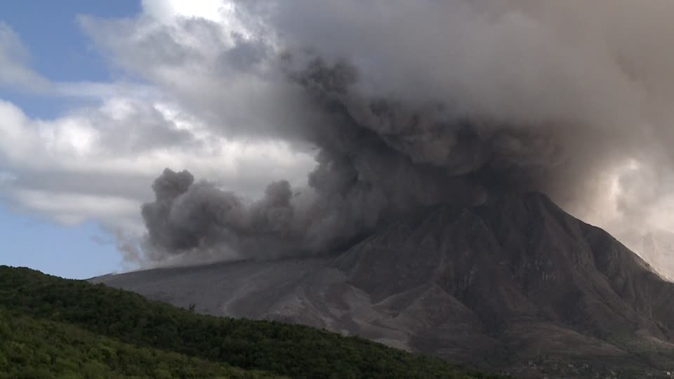
4. Analysis of the last eruption of the Soufrière Hills volcano on the island of Montserrat near Guadeloupe.
SOUFRIERE HILLS: The volcano is the most active in the Caribbean and it caused the abandonment of the capital of the island years ago, due to the danger that this mountain meant for its habitants.
The island of Montserrat is dependent on the United Kingdom. It is located in the Caribbean Sea, northwest of Guadalupe.

Slide 26
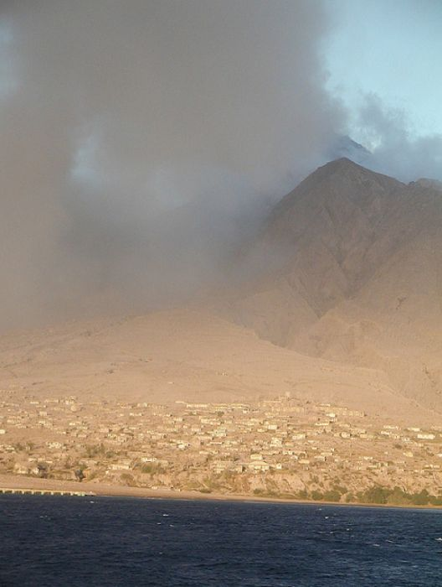
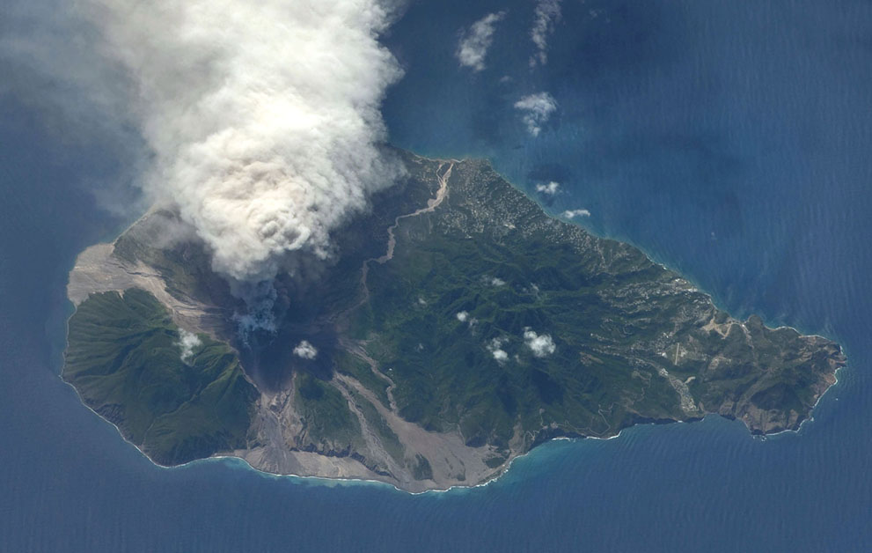
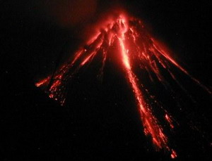
Until 1995 the capital of the island was Plymouth, in July of that year the Soufrière Hills volcano, which had not erupted since the 17th century, expelled pyroclastic material that partially destroyed the city.

Slide 27
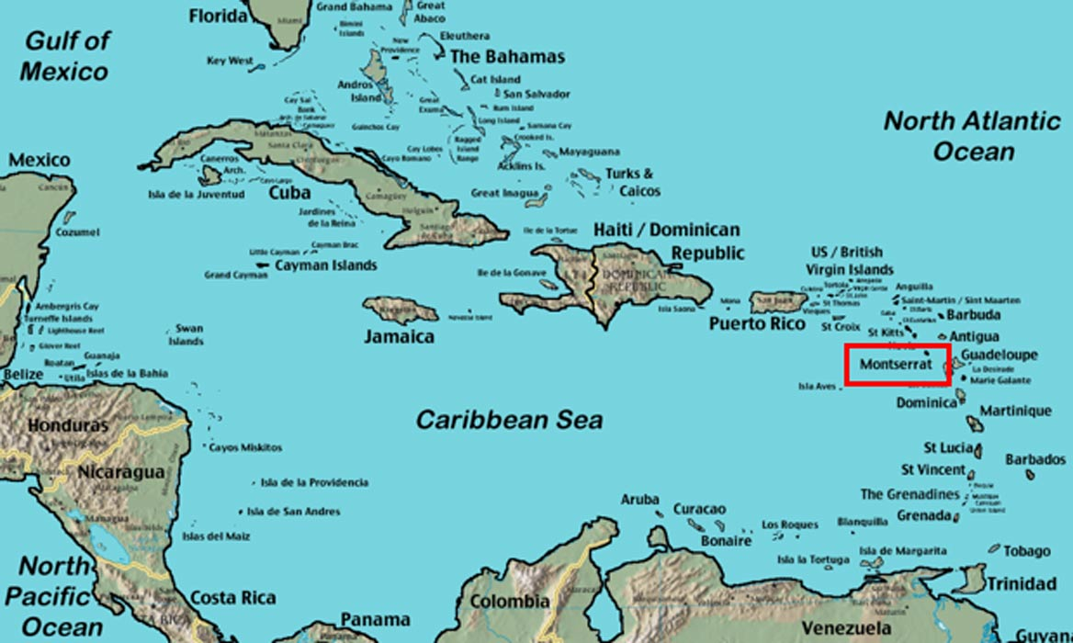
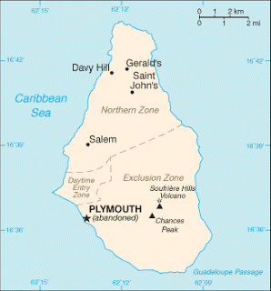
In the following two years it was tried to reconstruct but in 1997 an eruption left the city in the state that you can see in the photos and the city was abandoned. Also because it was not evacuated in time, 19 people died. After this event an 'exclusion zone' was created in the south of the island where it cannot be entered without the corresponding permissions.

Slide 28
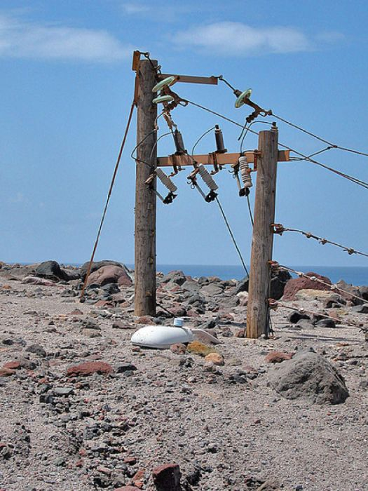
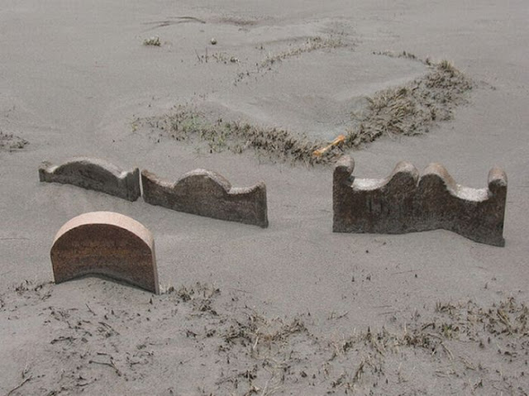
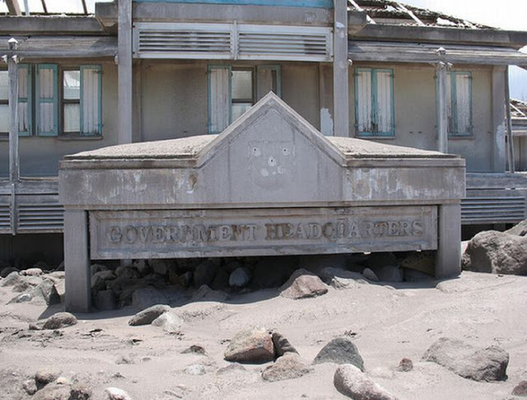
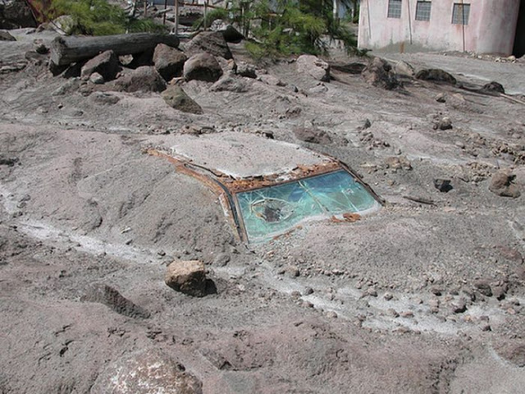
From the end of 2006 until 2010, eruptions of the volcano have continued, one of the most monitored in the world.

Slide 29
MARIE-GALANTE

Slide 30
5. Geological genesis of the dolinas "Mare au Punch" and "Gueule Grand Gouffre".

Slide 31
5.1 What is a sinkhole?
A sinkhole is a geological depression in areas with Karst relief, those that have been caused by the disintegration and decay of certain rocks whose components are soluble in water. They usually have more or less taper and flat bottom consisting of insoluble rocks.

Slide 32
5.2 The sinkholes of Guadeloupe
La Mare Au Punch. (Island Marie-Galante)
La Mare Au Punch. (Isla Marie-Galante)

Slide 33
Gueule Grand Gouffre. (Island Marie-Galante)
It corresponds to a former littoral sinkhole which calcareous subsoil has been dropped by the erosive action of the bottom of the sea at the foot of the cliff. The Gouffre formed thus then today has direct access to the sea, which constitutes one of the major tourist sites of Marie-Galante.

Slide 34
6. GenESis OF GUADELOUPE’S EARTHQUAKES, anAlisis OF THE “Barre de l’ile” AND THE SISMIC FAULT OF Malendure.

Slide 35
6.1 GENESIS OF GUADELOUPE’S EARTHQUAKES
The Guadeloupe earthquakes are due to an arc-insular subduction, namely the subduction of the North American Plate under the Caribbean Plate. The oceanic dorsal is constantly creating oceanic lithosphere, which when it moves away from the dorsal axis is cooled by increasing its density, which initiates a sinking in the mantle and when sinking, the oceanic lithosphere rubs with the continental lithosphere and with the mantle, so a big fault is produced where strong earthquakes and volcanoes are generated.

Slide 36
6.2 Marie-Galante: the fault of Morne-Piton
Known regionally as the 'Barre de l'île', the Morne-Piton fault forms a spectacular geomorphological break in the landscape of Marie-Galante, with an unevenness that can reach 130 meters. This fracture is thus marked by a cliff separating the northern sector of the island ("les Bas"), the highest part of the south ("les Haults").

Slide 37
6.2 Marie-Galante: the fault of Morne-Piton
One of the most important faults in the archipelago If the Morne-Piton fault is clearly visible in the landscape of Marie-Galante, geophysical studies throughout the industry show that the fault extends in the sea a total length of more than 80 kilometers, especially to the west. It is therefore one of the largest faults in the archipelago and is a "normal" fault that probably remains active today, as shown by the existence of valleys on the slope of Marie-Galante.

Slide 38
6.3 Basse-Terre: the fault of Malendure
Unlike the Morne-Piton fault, well marked in the landscape of Marie-Galante for several kilometers, the Malendure fault shows a much more modest expansion, which provides a representation of the movements that affect Earth's crust and Are the origin of earthquakes more or less intense.

Slide 39
6.3 Basse-Terre: the fault of Malendure
FAILLE NORMALE
MALENDURE
A normal fault! Appearing on a cut road, the Malendure fault affects the volcanic deposits generated by the activity of the chain Bouillante and whose age is between 1 million years and 200,000 years. In detail, these volcanic deposits consist of flows of debris, lapilli and ash fall. They provide information on volcanic products and the tectonic cause of the fracture. Depending on the direction and magnitude of the relative motion that occurs between the two blocks present in the plane of the fault we can deduce that this fault is << normal >>, because the movement causes a horizontal extension of the earth. On the contrary, a fault is called << inverse >> when the movement induces a shortening in the earth that affects.
FAILLE INVERSE

Slide 40
7. Analysis of the geothermal power generation plant in Bouillante.

Slide 41
7.1 ¿What is geothermal energy?
Geothermal energy is a renewable energy that is obtained through the use of the natural warmth of the interior of the Earth that is transmitted through the bodies of hot rock or reservoirs by conduction and convection, where arise processes of interaction of fluids and rocks, giving rise to geothermal systems.

Slide 42
This plant currently generates approximately 10 MW, and possesses two exploration licenses with a total additional potential capacity of up to 30 MW, all located on the island of Guadeloupe, a French territory in the Caribbean.

Slide 43
7.2 How to get energy?
A geothermal reservoir is an area beneath the surface, usually between 500 and 4,000 m of depth (so it is usable with existing technology), where there are rocks at high temperature, with high permeability (fractures + pores) saturated in fluid.
These fluid-borne rocks that are more than 230 ° C and are a mixture with steam and dissolved minerals. Sometimes, part of these fluids, make their way to the surface through faults (hot water is less dense than cold) and generate manifestations such as hot springs, fumaroles and geysers.
To take advantage of the geothermal resource located in depth, is necessary to drill wells to extract the fluid which is that carries power from the rock hot. Once on the surface, the fluid is separated into a vapor phase, which is sent to a power plant, where finally turns the heat energy into electrical energy. The liquid phase, along with salts disuel...

Slide 44
The Bouillante geothermal plant sells its electricity under a new agreement of purchase of energy, with Electricite de France SA (EDF) the French electric company. As a renewable plant of vital importance for the island of Guadeloupe, the station has access to certain benefits that the French Government established in the region in order to promote the development of renewable energy, mainly through a system of incentives and tax benefits.

Slide 45
8. Study of the Marina Cousteau Nature Reserve and the mangroves of Vieux-Fort in Marie Galante
8.1 study of the natural reserve marine cousteau
This is the principal dive site with no less than 6 spots to discover. The two small islets that mark depths between 40m to the east and 60m to the west are surrounded by a majestic slope that rises smoothly to the surface.

Slide 46
The coral garden:
A mass of coral only 3 meters under the boat.

Slide 47
The pool:
Created in one of the islets, the white coral sand illuminates a bathtub as if it were a pool.

Slide 48
The aquarium:
A strip of sand-style ski slope sinks in a beautiful fall up to 50 meters with huge barrel sponges.

Slide 49
8.2 Vieux-Fort in Marie Galante
The Vieux-Fort trail, which leads to the beach of Canot Cove, runs along the most beautiful beaches on the St. Louis coast and the mangrove swamps at the mouth of the Vieux Fort.

Slide 50
In addition it crosses historical places and the interior of the country with its areas of cultivation of sugar cane and livestock.

Slide 51
THE END

